Slide 1
Professionalism in Chemical Pathologists
Major General (Retd) FAROOQ AHMAD KHAN, HI(M) MBBS, MCPS, Dip Endocrinology (Lond), FCPS, FCPP, FRCP (Ire), FRCPath(UK), PhD(Lond) Professor of Pathology Consultant Chemical Pathologist & Endocrinologist President College of Pathologists Pakistan

Slide 2
Defining Professionalism
I do not strive for a clear and unambiguous definition of ‘‘professionalism’’ because I do not believe one is possible
(Erde 2008)

Slide 3
Defining Professionalism
To some professionalism means defending the medical profession against external threats, particularly corporatized health care in the US.
To others, it is the art that complements the science in an effective, well rounded physician.
It is a ‘‘value-oriented ideologically based construct’’. Baldwin (2006)
It is ‘‘independence of judgement and freedom of action’’. Freidson (2001)

Slide 4
Medical professionalism
Comprises the following set of behaviors:
Physicians subordinate their own interests to the interests of others.
Physicians adhere to high ethical and moral standards.
Physicians respond to societal needs, and their behaviors reflect a social contract with served.
Physicians evince core humanistic values, including honesty and integrity, caring and altruism and empathy, respect for others, and trustworthiness.
Physicians exercise accountability for themselves and for their colleagues.
Physicians demonstrate a continuing commitment to excellence.
Physicians exhibit a commitment to scholarship and to advancing.
Physicians deal with high levels of complexity and uncertainty.
Physicians reflect upon their actions and decisions.
(Swick 2000)

Slide 5
Medical professionalism
Medical professionalism signifies set of values, behaviours, and relationships that underpins the trust the public has in doctors
Royal College of Physicians (2005)

Slide 6
Different perspectives of medical professionalism
US: More emphasis on knowledge, technical competence and altruism
UK and Australia: More emphasis on ‘service’

Slide 7
Professionalism as core competency in doctors (Canada)

Slide 8
Professionalism as core competency in doctors- ACGME (USA)

Slide 9
Professionalism as core competency in doctors- Tomorrow`s Doctor (UK)

Slide 10
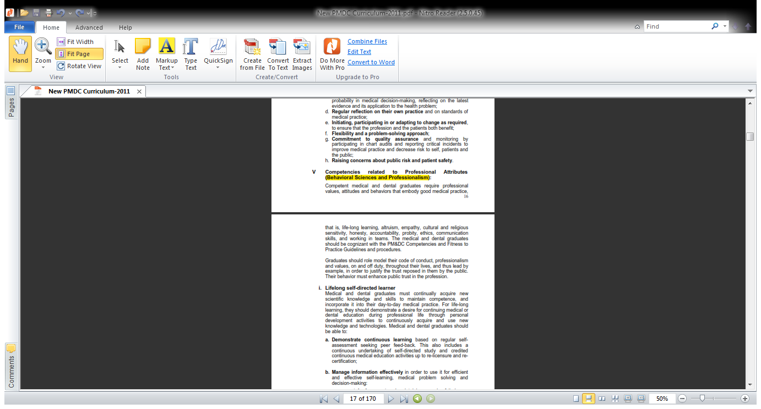
Professionalism as core competency in doctors- PMDC –Curriculum 2011

Slide 11
Professionalism Royal College of Pathologists` Perspective
The Royal College of Pathologists (UK) endorses the Royal College of Physicians‘ definition of medical professionalism:
“Medical professionalism signifies a set of values, behaviours and relationships that underpins the trust the public has in doctors”

Slide 12
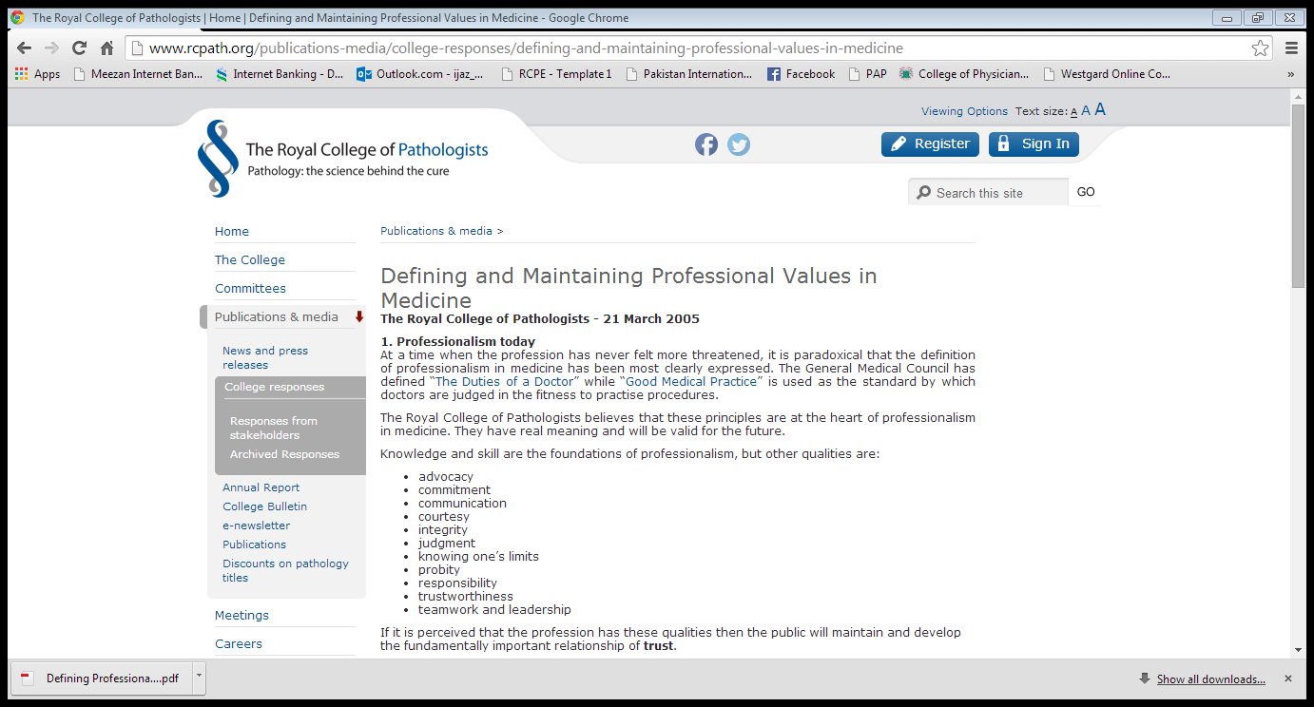
Professionalism Royal College of Pathologists` Perspective

Slide 13
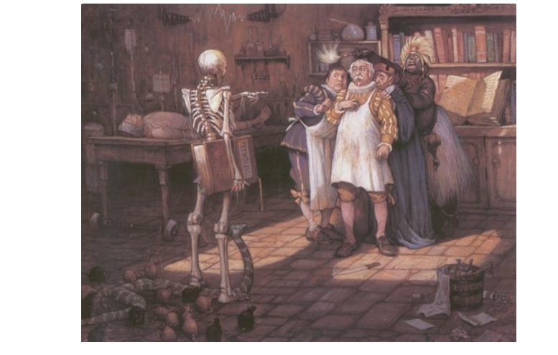
What is the role of Pathologist in a health setting?
“Pathology is never boring; you get to see a fascinating range of horrible medical conditions, without having to tell patients the bad news. (Smith, R., 2008)”

Slide 14
Another pathology trainee claims
“You are like the doctor for the doctors, the central nervous system for the hospital and the doctor for the most number of patients”.

Slide 15
What is the role of a Chemical Pathologists in a health setting ?
Almost same as for any other Pathologist i.e. CNS of the hospital!!

Slide 16
Do we need professionalism in Chemical Pathologists ?
Yes definitely !!

Slide 17
What should be attributes of professionalism in a Chemical Pathologist ?

Slide 18
Good Communicator ?
“Now pathologists are judged not by the accuracy of their diagnoses (everyone expects their diagnoses to be correct) but by their ability to communicate. The best diagnosis is of no value if it is not communicated properly.”

Slide 19
Who are the people you have to communicate as Chemical Pathologist?
Patients
Clinical colleagues
Vendors
Lab staff
Hospital Administrators
Students
Others

Slide 20
Good Communication – hallmark of professionalism in Chem Path
“To be a good pathologist, I have to communicate well, both in writing and orally, to my surgeons, to my technologist, and to my pathology trainees and those of other specialties…..If you don‘t do it well, it doesn‘t matter whether you are able to diagnose correctly or not….. you‘re unprofessional! They won‘t trust you and won‘t respect you”
Canadian Pathologist Nadia Mikhail

Slide 21
Chemical Pathologist as Manager
Management specific to pathology include:
quality
safety
risk assessment
information
resource
financial
business
staff management
knowledge of government regulations
accreditation.

Slide 22
Chemical Pathologist as Manager
In the words of a trainee:
‘To know how a laboratory functions, the safe storage of dangerous goods, quality assurance, and that sort of thing. I really see there’s benefit in implementing this. ’
(Trainee Hans)

Slide 23
Chemical Pathologist as Business Manager
Pathology is a business, and, particularly in the private sector, it is one of the more profit-driven of the medical specialties.
The development of business models of pathology has been described as posing major financial challenges for the pathologist (Murphy, 2003).
Many pathologists are employed by commercial organisations and may find themselves divided between loyalty to the company and responsibilities to the patient.
There may be fundamental clash between business and medicine
Pathologists must pay particular attention to exercising leadership in the business of pathology while safeguarding interest of the patient

Slide 24
Possible ethical issues in the practice of Chemical Pathology
Honesty
Conflict of interest
Collegial and interpersonal interactions
Reporting/recognising medical errors
Confidentiality
Privacy

Slide 25
Scenario No 1
You are working as a Consultant Chemical Pathologist in a private hospital.
You suggest some new tests which will lead to substantial increase in hospital revenue as well as improved patient care
Is it ‘Professionalism”?

Slide 26
Scenario No 2
You are working as a Consultant Chemical Pathologist in a public sector hospital.
In your hospital some obsolete tests are done .
Some test panels are used which comprise unnecessary tests
You want to delete all these tests from the test-menu which will lead to saving of significant amount of public fund
Is it ‘Professionalism”?

Slide 27
Scenario No 3
You are working as a Consultant Chemical Pathologist in a large private hospital.
In your hospital some obsolete tests are done .
Some test panels are used which comprise unnecessary tests
You want to delete all these tests from the test-menu but it will lead to significant loss of revenue to the hospital
Is it ‘Professionalism”? (difficult question?)

Slide 28
Scenario No 4
You are a trainee in Chemical Pathology in a public sector hospital working on a meager honorarium.
There are several private labs in the vicinity of your hospital.
One of these private labs has offered you to work in their lab after working hours at a handsome salary but they have one condition!!
You will direct patients from ‘sarkari’ hospital to this lab.
Will you accept the offer?
Is it ‘Professionalism”?
Which part of ethics it covers?
Conflict of interest?

Slide 29
Scenario No 5
You are a PhD scholar in Chemical Pathology in a reputed institute with large collection of data.
Your husband is an MPhil student in another institute but he badly needs some experimental data to complete his research.
Your husband requests you to give some data to him otherwise his training will be terminated and career ruined.
Will you give the data generated at your institute to him.
Is it ‘Professionalism”?
Which part of ethics it covers?
Honesty / confidentiality?

Slide 30
Ethical values in Chemical Pathology
“The basic competencies of professionalism are integral to every pathology report, in feedback to our colleagues and the institutions within which many pathologists work”
Gorstein (2002), editor of Human Pathology journal,

Slide 31
Scenario No 6
You are a Professor of Chemical Pathology in a tertiary care hospital
Your daughter is getting married today and you are very busy in the marriage hall as her baraat is about to arrive
Suddenly you receive a call from ICU of the hospital requesting you to visit a critically ill patient and give your expert advice to help treating physician.
Will you go to the hospital leaving the ceremony?
Is it ‘Professionalism”?
What it is called?
Altruism !!!

Slide 32
Altruism
What is altruism?
Altruism is the most talked about part of professionalism
Closest meaning in Urdu / Arabic: Isar
Putting patient`s interest in front of own

Slide 33
Scenario No 7
You are a Consultant and Supervisor of Chemical Pathology in a tertiary care hospital
You received an email from a trainee from another institute with the request to review her dissertation and give some expert advice on her study.
She is not known to you and there is no commitment for co-authorship in the publication.
Will you help her in spite of your very busy schedule?
Is it ‘Professionalism”?
What it is called?
Another example of altruism?

Slide 34
Last but not the least
As a Muslim it should not be difficult for us to understand professionalism
Just keep in mind all our life is to be accounted for one day – the day of Judgement.
Try to become ‘good Muslim’ and professionalism will be understood and automatically come inside us

Slide 35
Thank you

