Slide 1

Pakistan Society Of Chemical Pathologists
Distance Learning Programme In Chemical Pathology
(DLP-2)
Lesson No 1
Optical Techniques
By
Brig Aamir Ijaz
MCPS, FCPS, FRCP (Edin)
Professor Of Pathology /
Consultant Chemical Pathologist
AFIP Rawalpindi

Slide 2
Supplementary Question
Out of the white (sun) light human eyes can see : a. One hundred colours b. Seven colours c. Seven colours and infra-red d. Seven colours and ultraviolet e. Throughout the spectrum
  Best Answer:
  a. One hundred colours

Slide 3
“Chemical Pathology is nothing but colours and electricity”

Slide 4
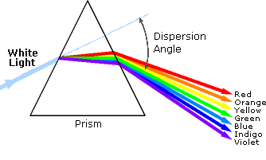
Dispersion of Light

Slide 5
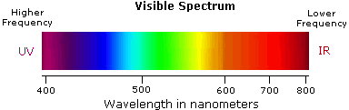
The Spectrum

Slide 6

Wavelength and Frequency
Wavelength: nanometers (nm); Frequency: Hertz (Hz)

Slide 7
The VIBGYOR
Violet: 400 - 420 nm
Indigo: 420 - 440 nm
Blue: 440 - 490 nm
Green: 490 - 570 nm
Yellow: 570 - 585 nm
Orange: 585 - 620 nm
Red: 620 - 780 nm

Slide 8
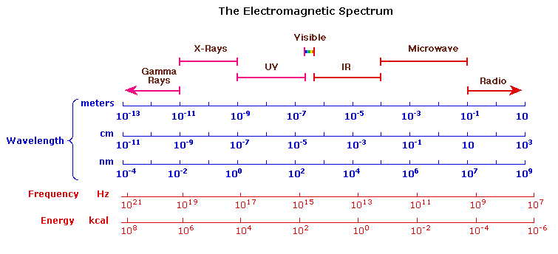

Slide 9
Q 1. Absorbance of light is: a. Difference between incident and transmitted light b. Light absorbed in a solution after striking it c. Negative Log of incident and transmitted light d. Molar absorption of light by the solution e. Ratio of incident and transmitted light
      c. Negative Log of incident and transmitted light

Slide 10
Difference between Absorption and Absorbance
Absorption: The phenomena of absorbing light by a solution when an incident light strikes on it.
Absorbance: It is mathematic expression of absorption. Analogous to pH.

Slide 11
Absorbance
Negative log of ratio between light transmitted through a material and the light falling upon a material i.e.:
A (λ) = -log(I_{t}/ I₀)
Where
A is the absorbance at a certain wavelength of light (λ),
I_{t} is the intensity of the light that has passed through the solution (transmitted light),
I₀ is the intensity of the light before it passes through the solution (incident radiation).

Slide 12
What is the unit of Absorbance?
None
Some scientists use arbitrary unit known as Absorbance Unit (AU)

Slide 13
What is Transmittance?
A simple ratio between the light falling upon a material and the light transmitted through a material i.e.:
T (λ) = I_{t}/ I₀
Where
T is the Transmittance at a certain wavelength of light (λ),
I_{t} is the intensity of the light that has passed through the solution (transmitted light),
I₀ is the intensity of the light before it passes through the solution (incident radiation).

Slide 14
Absorbance and Transmittance
Absorbance (–Log I_{t}/ I₀) | Transmittance (I_{t}/ I₀)
0 | 1
0.1 | 0.79
0.25 | 0.56
0.5 | 0.32
0.75 | 0.18
0.9 | 0.13
1 | 0.1
2 | 0.01
3 | 0.001

Slide 15
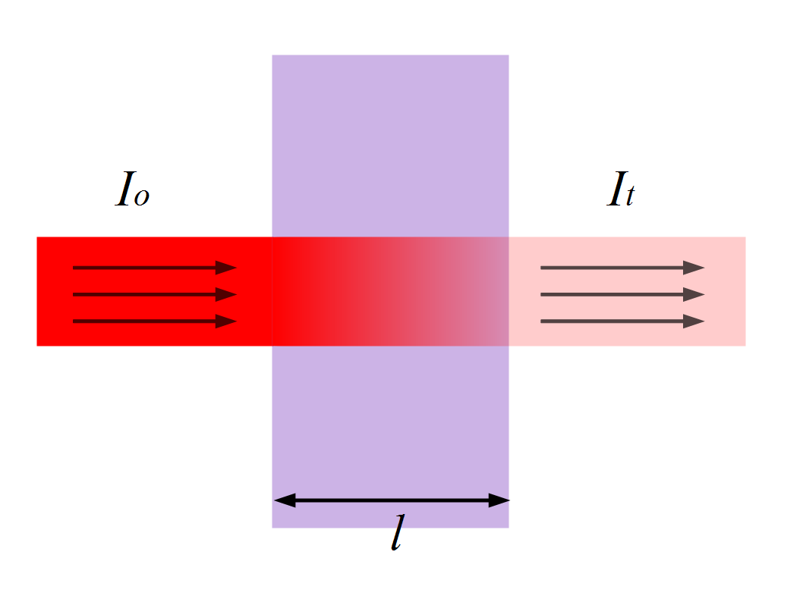
Transmittance

Slide 16
Percentage Transmittance (%T)
Commonly used in Labs e.g. Estimation of Haemoglobin
How to derive:
  Transmittance x 100

Slide 17
Transmittance and %T
Transmittance (I_{t}/ I₀) | Percentage Transmittance (%T) (Tx100)
1 | 100
0.79 | 79
0.56 | 56
0.32 | 50
0.18 | 18
0.13 | 13
0.1 | 10
0.01 | 1
0.001 | 0.1

Slide 18
Absorbance and %T
More commonly used on spectrophotometers
Absorbance can be derived from %T as following:
A = 100 – %T
A = Log 100 – Log %T
A = 2 - Log%T
So if you know %T you can calculate absorbance using this formula

Slide 19
Q 2. According to Beer-Lambard`s Law absorbance of a solution increases with: a. Intensity of the light source b. Length of the light path c. Number of light scattering particles d. Percentage transmittance of the light e. Reflectance of light
      b. Length of the light path

Slide 20
Beer-Lambard`s Law
Absorption of light is directly proportional to concentration of the absorbing molecule or
A = elc
e is Absorptivity (extinction coefficient),
l is the path length,
c is the concentration of the absorbing molecule.

Slide 21
Q 3. A lab technologist is testing glucose in the plasma by Glucose Oxidase method on a photometer. Which colour of light he should use for this colorimetric estimation of glucose: a. Black b. Green c. Red d. White e. Yellow
      b. Green

Slide 22
Which wavelength is used for measurement of red-coloured glucose solution after GOD-PAP reaction?
500-520 nm !!

Slide 23
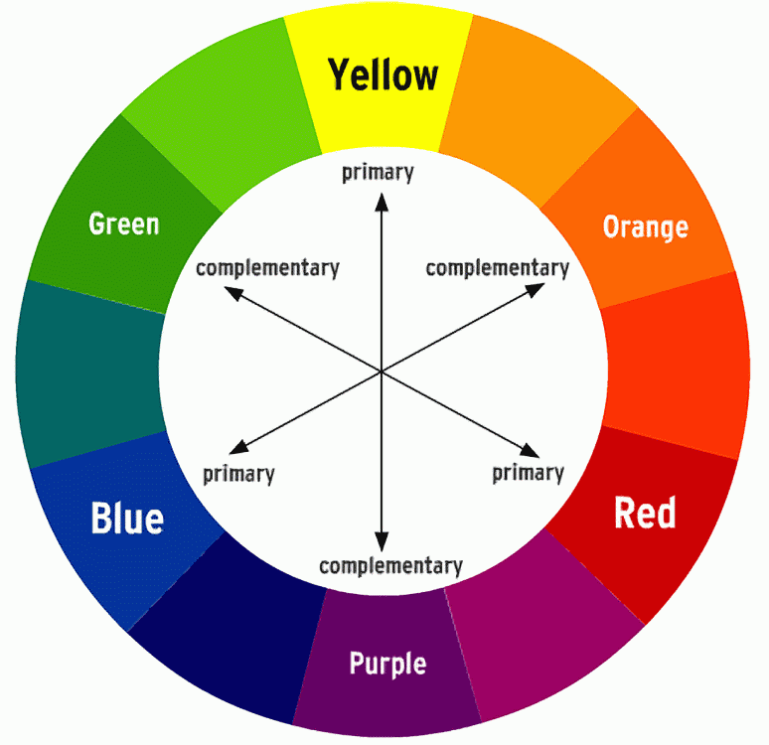
The Colour Wheel

Slide 24
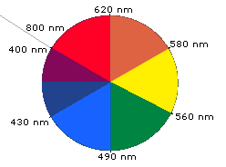
The Colour Wheel

Slide 25
Q 4 : Part of the spectrophotometer which selects wavelength of light for striking on a sample solution is: a. Diffraction grating b. Lens c. Photomultiplier tube d. Prism e. Slit
      e. Slit

Slide 26
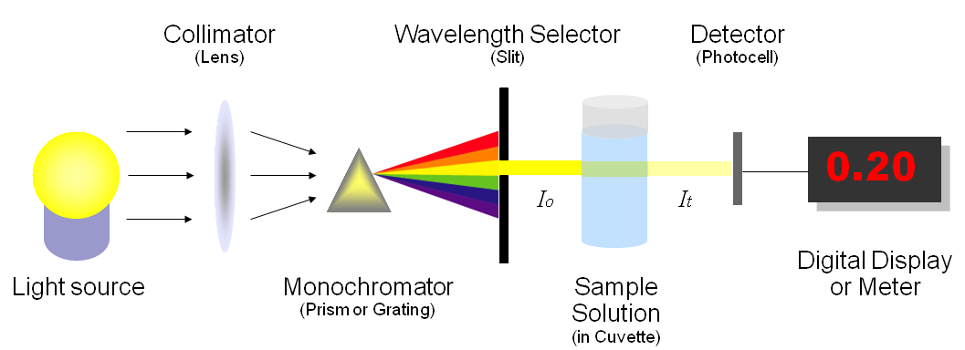
Parts of Spectrophotometer

Slide 27
Q 5 : Use of photodiodes is a technological advancement for photodection in spectrophotometry. Its major advantage over photomultiplier tube is: a. Continuous current draw b. Glass enclosed tube c. Higher sensitivity to magnetic field d. Low generation of photoelectrons e. Measurement at wide wavelength range
      e. Measurement at wide wavelength range

Slide 28
Types of Photodectors
Photomultiplier tube (PMT)
Photodiodes

Slide 29
Photodiodes
This is a class of solid-state detectors that work on the principle that they collect the charge generated by ionizing radiation in a solid.
These detectors are made of semiconducting material and are operated much like a solid-state diode

Slide 30
Advantages of Photodiodes over PMT
There are several advantages to replacing vacuum tube technology with a solid-state alternative.
Compared to the glass enclosed photomultiplier tube, the solid-state photodiode is much smaller and orders of magnitude more rugged.
They also offers a much greater dynamic range, with a linear response over 10⁶ . In contrast the dynamic range of PMT is limited to 10^{4 .}

Slide 31
Q 6 : The spectral technique with lowest detection limits used in Chemical Pathology Laboratories is: a. Atomic Absorption Spectrophotometry b. Chemiluminescence c. Fluorometry d. Nephelometry e. UV Spectrophotometry
      b. Chemiluminescence

Slide 32
Q 7 : The phenomena of Raleigh Light Scattering is said to be the reason of blue colour of the sky. Which one of the following attributes is true for Raleigh Light Scattering: a. Deals only with polarized light b. Particles equal in size to the wavelength of incident light c. Reduction in incident light due to scattering d. Scattering in angular region in forward direction e. Symmetrical light scattering
      e. Symmetrical light scattering

Slide 33
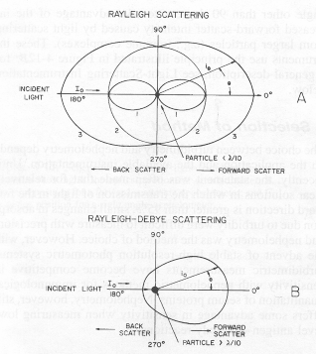
Raleigh Light Scattering
It is a phenomena in which light scattering is symmetrical.
While Releigh-Debye is a non-symmetrical light scattering

Slide 34
Q 8 : In Atomic Absorption Spectrometry Advantage of using graphite furnace analysis over flame analysis include all EXCEPT: a. Entire sample is atomised b. Low sample consumption c. Lower limit of detection d. Minimum matrix interferences e. Short turnaround time
      e. Short turnaround time

Slide 35
Atomic Absorption Photometry
Very High Sensitivity : About 95% atoms remain in ground state and are not excited. In AA the light is absorbed by these 95% atoms. So the ability of this technique to measure very small quantity of substances is very high i.e. high analytical sensitivity.
  Very High Specificity: Use of a hollow cathode lamp made of the material to be analysed is the reason of very high specificity of this technique.

Slide 36
Q 9 : In Atomic Absorption Spectrometry, least type of interference is: a. Chemical interference b. Dissociation interference c. Ionization interference d. Non-specific interference e. Spectral interference
      e. Spectral interference

Slide 37
Q 10 : Luminescence has a great advantage over absorbance. The reason of this advantage is that luminescence is: a. Abundant in natural substances. b. Carried out on less complicated equipment c. Measurement of absolute light d. Not dependent on condition of the solution e. Related to energy produced by cathode rays
      c. Measurement of absolute light

Slide 38
Q:11: Optical techniques used in Chemical Pathology and other biological sciences use following characteristics of light:
      Emission
      Absorbance
      Scattering
      Transmittance
      Reflectance

Slide 39
      a. Definition of Basic Characteristics of Light
Emission: The dissipation of energy when electron return from higher energy state to lower energy state. Some elements possess this property.
Absorbance: Mathematical expression of absorbed energy (light). It is the capacity of a substance to absorb radiation, expressed as logarithm(log) of the reciprocal of transmittance(T) of the substance.
Scattering: This is scattering of light in all direction as a result of collision of light with some molecules
Transmittance: The ratio of the intensity of light entering the sample to that exiting the sample at a particular wavelength is defined as the transmittance.
Reflectance: The ratio of the total amount of light reflected from a surface to the amount of light incident on the surface.

Slide 40
      b. Techniques based on characteristic of Light
Emission: a. Fluorometery b.Chemiluminescence c. Electrochemiluminescence d. Flourescence Polarization
Absorbance: a. Spectrophotometry b. Atomic absorption
c. Detection Systems in HPLC
Scattering: a. Nephalometry b. Turbidimetry c. Flow Cytometry
Reflectance: a. POCT testing b. FTIR

Slide 41
Great advantage of Emission (Luminescence) over Absorption
Luminescence is generally more sensitive than absorption because it is easier to accurately measure a small amount of absolute light than to accurately detect a small decrease in relative energy.

Slide 42
Flourescence and Phosphorescence
Flourescence and Phosphorescence are two examples of Emission (luminescence).
In these techniques the emitted light is best detected at a right angle to the incident light.
Fluorescene and phosphorescence differ in their quantum mechanical mechanism for the dissipation of the stored energy.
Generally, fluorescence emits UV light and phosphorescence emits visible light.
However, most importantly, in both cases the emitted light is generally linearly proportional to the analyte concentration.

Slide 43
      c. ONE technique in which more than one of the characteristics of light are utilized:
  Flow Cytometery

Slide 44
      Q 12. A protein in a solution has concentration of 4 g/L. The length of cuvette is 2 cm and only 50% of certain light beam is transmitted a. Using Beer-Lambert Law, calculate absorbance of the solution (Please give equation(s) as well as value of absorbance).
A = 2 – log 50
A = 2 - 1.698
A = 0.302

Slide 45
      b. How will you calculate absorbance of light when concentration of this protein solution is 8 g/L? (Please give formula and value of absorbance).
Molar Absorptivity (ε ) = A / l x c (from previous question)
ε = 0.302 /2x 4 = 0.0376 L/mol/cm
Now applying equation
A = ε x l x c
A = 0.0376 x 2 x 8 = 0.6016

Slide 46
      c. To calibrate the measuring instrument of this solution (e.g. spectrophotometer) what is the highest per cent transmittance (%T) and highest absorbance (A) you can use?
Highest transmittance: 100% T
(0-log 100T i.e. 100% transmittance and zero absorbance)
Highest Absorbance: 2
(2 - 0 i.e. 100% absorbance and zero transmittance)

Slide 47
      Q 13. A scientist is developing a reaction mixture for a clinically important analyte. Please answer following queries regarding ‘molar absorptivity’ a. The concept of molar absorptivity.
Molar absorptivity is a measure of how strongly a chemical species absorbs light at a particular wavelength.
It is a constant for a given compound at a given wavelength under specified conditions of solvent, pH and temperature etc.

Slide 48
  b. He has short-listed two reaction mixtures:
  Mixture A with molar absorptivity = 100, 000
  Mixture B with molar absorptivity = 50,000.
  Which mixture he should select?
Mixture A with molar absorptivity = 100, 000

Slide 49
  c. He wants to select wavelength for a solvent which have two peaks of
  maximum absorbance. The wavelengths of maximum absorbance
  with molar absorptivity of this solvent are:
Which wavelength he should select?
 | wavelength of maximum absorption (nm) | molar absorptivity
Wavelength A | 410 | 15
Wavelength B | 380 | 1000
Wavelength B 380

Slide 50
  d. Comment on the trueness of the statement “Molar absorptivity increases with concentration of the solute”.
False
Molar absorptivity is constant and does not increase with the concentration of the solute

Slide 51
Thank You and Best Of Luck

