Slide 1

Pakistan Society Of Chemical Pathologists
Distance Learning Programme In Chemical Pathology
(DLP-2)
Lesson No 6
Electrophoresis
By
Brig Aamir Ijaz
MCPS, FCPS, FRCP (Edin)
Professor Of Pathology /
Consultant Chemical Pathologist
AFIP Rawalpindi

Slide 2
Part I
MCQs (One Best Type)

Slide 3
A Useful Resource to Learn Electrophoresis
http://quizlet.com/4388803/cp_serum-proteins-flash-cards/original

Slide 4
Q. 1: Electrophoretic mobility of a protein is -3.1 mobility units on agarose gel. Negative notation in this value is due to: a. Length of the agarose gel b. pH of the buffer c. Size of the albumin molecule d. Speed of albumin migration e. Temperature of the medium
      b. pH of the buffer

Slide 5
Electrophoretic Mobility
Electrophoretic mobility depends on several factors e.g.
  Length of field
  Distance travelled
  Support media
  Size of the particle
By convention movement from anode to cathode is taken as ‘Positive’
Albumin at alkaline pH is an anion and moves from cathode to anode, so this movement is denoted with a ‘Negative’ notation
So the notation depends on pH which determines the charge on the proteins.

Slide 6
Q 2. Agarose gel electrophoresis is one of the most commonly used traditional protein separation systems. Its advantage over previous formats is: a. Abundant ionisable groups b. Clarity on drying c. Greater endosmosis d. High affinity for proteins e. Small pore size
      b. Clarity on drying

Slide 7
Agarose Gel
Agaorse gel is a very commonly used support media. It has several characteristics:
  Minimal ionizable groups
  Clarity on drying which facilitates densitometry
  Minimum endosmosis
  Low affinity for proteins, so proteins migrate freely
  Large pore size

Slide 8
Q 3: Automated systems of electrophoresis have been successfully used in clinical laboratories. They include automation of all of the following steps EXCEPT: a. Alteration in molecular sieve b. Densitometry c. Multiple staining d. Sample application e. Temperature control
      a. Alteration in molecular sieve

Slide 9
Q 4: In capillary electrophoresis primary driving force for migration is: a. Endosmosis b. Site potential c. Stern potential d. Wick flow e. Zeta potential
      a. Endosmosis

Slide 10
Two Forces on a Molecule in Electrophoresis
Electromotive force
Endosmosis

Slide 11
Electromotive force
This force is created when charge is applied to a protein (or other compound) in support medium with a fluid buffer

Slide 12
Endosmosis
This is a compensatory flow of the fluid buffer towards the negative pole (cathode).
The solid support has a slight negative charge and is drawn towards the positive pole (anode), but, being a solid support, it cannot move.

Slide 13
Q 5 : Protein electrophoresis of a serum sample showed a wide band n Albumin region. What could be the most probable cause: a. Bent applicator b. Bis-albuminaemia c. Fibrinogen d. Haemolytic Sample e. Medication by the patient
      e. Medication by the patient

Slide 14
Artefacts and non-significant Findings
Faulty application techniques may cause artefacts in manual electrophoresis
If plasma is used as sample, fibrinogen band may appear near point of application
Presence of two types of albumin in one patient may show as duplicate bands in albumin region i.e. bis-albuminanaemia
Albumin bound drugs may appear as wide band
Haemolytic sample may show a band in alpha-2

Slide 15
Part II
Match the answers
(Extended Matching Questions)

Slide 16
Q 6 : Proteins and other molecules move to cathode or anode depending on charge on their surface but at a very specific pH, proteins and other molecules become absolutely neutral and stop migration. Ordinary diffusion is also counteracted.
These characteristics are indicative of which electrophoresis technique / support media?
      e. Isoelectric focusing

Slide 17
Isoelectric Focusing (IEF)
Slides courtesy of Dr Sobia Irum (AFIP Rwp)

Slide 18
Principle of IEF
IEF is a technique for separating different biomolecules on the basis of their isoelcetric points in a stabilized pH gradient.
Isoelectric point (pI): It is the pH of a solution at which the net charge of protein is zero. In electrophoresis there is no motion of the particles in an electric field at the pI.
The pH gradient forces a protein to remain in its pI. Thus this concentrating effect is called focusing.

Slide 19
Procedure of IEF
IEF requires stable pH gradient which is created with carrier ampholytes, a group of amphoteric polyaminocarboxylic acid. Mixtures of 50 to 100 ampholytes are added to the medium and when electric field is applied a natural pH gradient establishes, that is negatively charged ampholytes moves towards anode and positively charged towards cathode and align themselves according to their pI values during electrophoresis .
When a protein has reached its isoelectric point, it will stop migrating through the gel at a certain point.
Some of its uses are new born screening, oligoclonal band and ALP isoenzyme

Slide 20
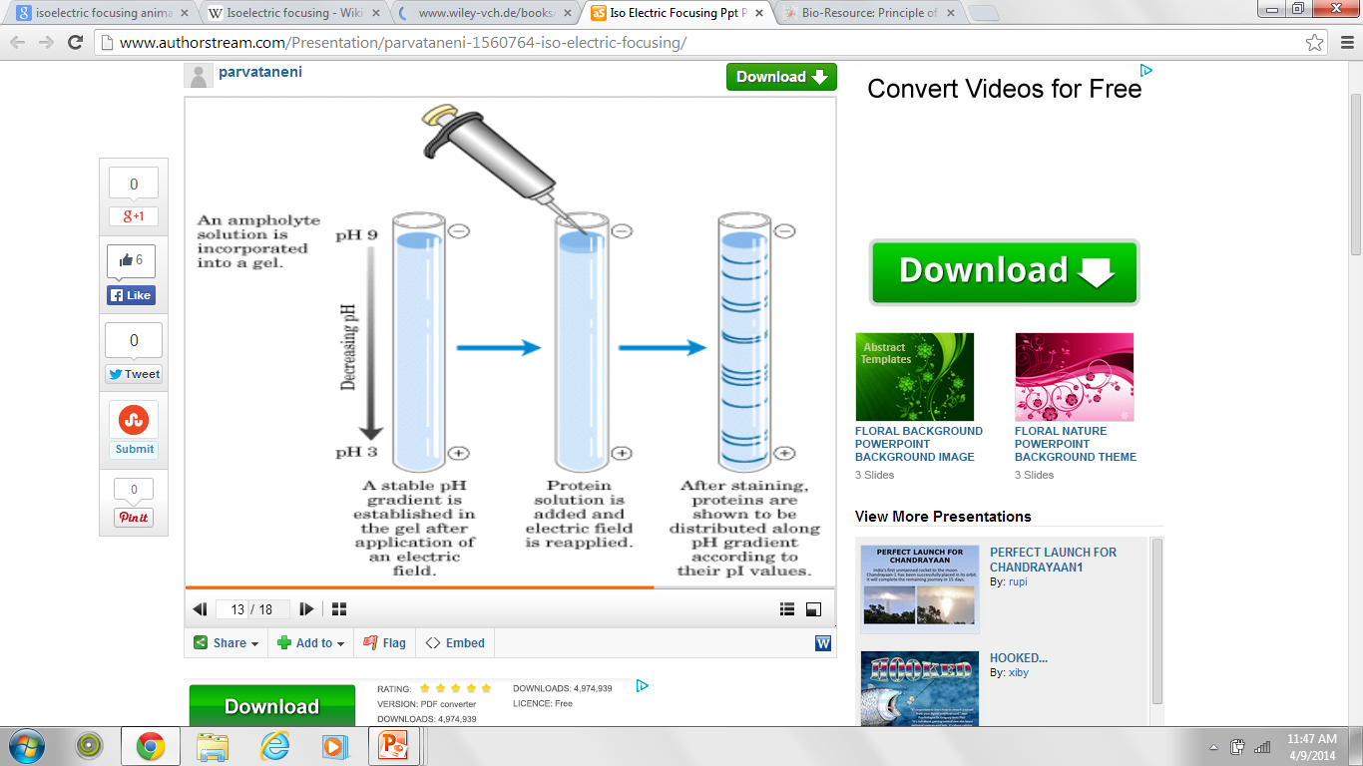

Slide 21
Q 7 : Electrophoretic separation based on mass-to-charge ratio and molecular size of the compounds resulting in improvement in resolution e.g. separation of proteins.
These characteristics are indicative of which electrophoresis technique / support media?
      j. Polyacrylamide gel

Slide 22
Polyacrylamide gel
Slides courtesy of Dr Majid Latif (AFIP Rwp)

Slide 23
Polyacrylamide gel electrophoresis (PAGE)
This technique uses thermostable, transparent, strong and relatively chemically inert polyacrylamide gel which can be made in a wide range of pore sizes
Separation is based on both charge-to-mass ratio and molecular size (molecular sieving)
No endosmosis
Pre cast mini-gels are available in a variety of concentrations for most protein or nucleic acid separations

Slide 24
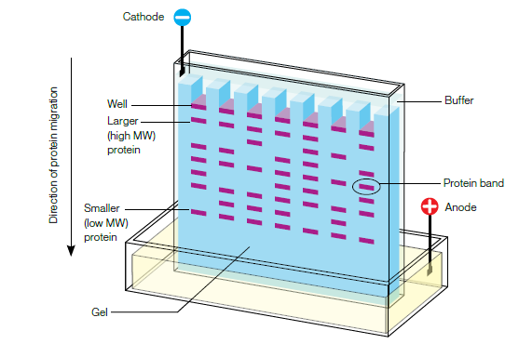
Scheme of electrophoretic protein separation in a PAGE

Slide 25
Q 8 : Proteins are stacked before separation and there is no need to carry out step of pre-concentration of specimens with low protein.
Resolution is much improved.
These characteristics are indicative of which electrophoresis technique / support media?
      d. Disc electrophoresis

Slide 26
Disc Electrophoresis
Discontinuous (Disc) electrophoresis uses two gels that are buffered at different pHs.
When proteins migrate from one gel to the other they become concentrated into sharp bands, which produce higher resolution than in conventional electrophoresis.
Used in samples with small quantities of protein e.g. CSF

Slide 27
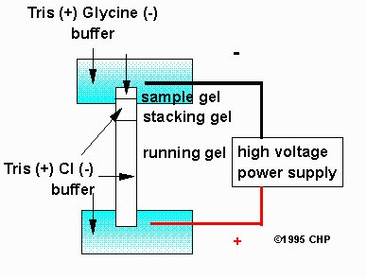
Disc Electrophoresis

Slide 28
Q 9 : High resolution separation of charged substances without a sieving matrix and with application of high voltage, small sample volume and short running time. Ease of automation and extensive applications.
These characteristics are indicative of which electrophoresis technique / support media?
      b. Capillary zone electrophoresis

Slide 29
Capillary electrophoresis
Slides courtesy of Dr Qurat Ul Ain (AFIP Rwp)

Slide 30
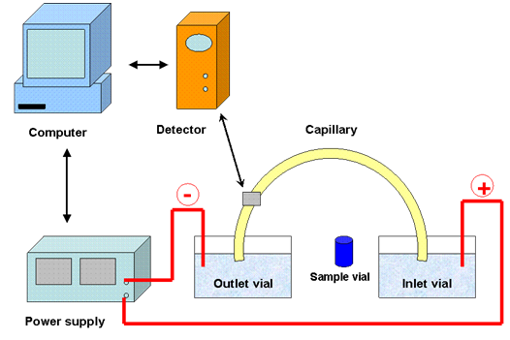
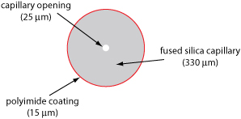
Capillary electrophoresis(CE)
Electrophoresis is carried out in a small bore, fused silica capillary tube typically coated with a thin polymeric covering at exterior. Inner surface carries negative charge that creates an ionic cloud with predominantly positive charge.
As this electroosmotic flow is main driving force, all sample components migrate towards the negative electrode.

Slide 31
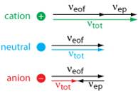
Electrophoretic mobility in CE
When an electric field is applied across the capillary tube, the ion’s total mobility, ν_{tot}, is a sum of its electrophoretic mobility(V_{ep})and its electroosmotic mobility or endosmosis (V_{eof}).
Cat ions elute first because they have a positive electrophoretic velocity, ν_{ep}, and high V_{eof} followed by neutral species and anions as shown.
Time taken by ion to travel a particular distance helps in identification while peak area or height relates to amount

Slide 32
Advantages of CE
Simple with selective separation mechanism
Efficient heat dissipation as compared with traditional electrophoresis
Permits application of voltages in range of 25 to 30kV
Enhances separation efficiency
Reduces separation time to less than 1 min
Very small sample injection (in nanoliter)
Minimal reagent consumption
High degree of system automation
Online interfacing with other instruments

Slide 33
Procedure of CE
Cathode -
Anode +
EOF
Protein migration
DETECTION OF
PROTEINS
INJECTION OF
SERUM
Electro migration
The Electro-Osmotic Flow (EOF) is a stronger force than the Electrical Field. As a result, all proteins are carried towards the cathodic end of the capillary.
The point of application is Anodal end. Fastest moving proteins is positively charged gamma globulin followed by beta-2 , beta-1, alpha-2, alpha-1 globulins and albumin.

Slide 34
Applications of CE
Analysis of proteins found in serum, urine, CSF and body fluids
Study of hemoglobin variants, lipoproteins, carbohydrate-deficient transferrin (CDT)
Forensic and therapeutic drug screening
Molecular diagnostics
Counter-ion analysis in drug discovery
Carbohydrate analysis for the determination of post translational modifications

Slide 35
Q 10 : Very high speed, integration of multiple functions, very low sample volume, laser induced fluorescence detection system. All channels fabricated on the same surface, great potential for automation.
This principle is the basis of which electrophoresis technique / support media?
      g. Microchip electrophoresis

Slide 36
Microchip electrophoresis
Slides courtesy of Dr Amina Tariq (AFIP Rwp)

Slide 37
Microchip electrophoresis
Microchip is glass wafer that has been chemically etched through a photolithographic pattern to define its channels.
The etched wafer is then bonded to a second wafer containing drilled holes to provide fluidic access to the channels.

Slide 38
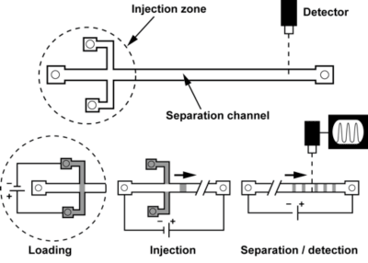
Fundamental elements
Sample injection zone
Electrophoretic separation channel
System for detection of the migrating analytes

Slide 39
Steps of operation
  Electrokinetic sample loading
  Voltage application to inject a narrow band into separation channel
  Separation of analytes due to different mobilities
  Detection of distinct zones primarily by laser induced fluorescence (LIF)

Slide 40
Advantages
Low sample and reagent volume requirement
Faster operation ( usually 50 – 200 s)
Hardware economy
Reduces operator intervention
New separation matrices provide single base resolution
Microchip CE integrated with PCR is used in genotyping for disease diagnostics as well as forensic DNA profiling.

Slide 41
Part III
Interpretation of Electrophoresis Reports

Slide 42
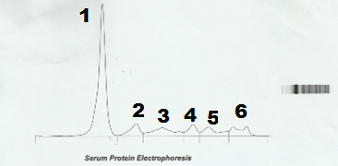
Movements of Proteins in
Traditional Electrophoretic Field
Suppose this electrophoretogram is generated from a traditional agarose gel electrophoresis please answer following questions:
Which is cathode end (Point 1 or Point 6)
Which is the point of application of sample (Point 1 or Point 6)
Name the fastest moving protein band (1 or 6)

Slide 43
Movements of Proteins in
Traditional Electrophoretic Field
In agarose gel electrophoresis point of application is cathode (point 6 in the example)
Fastest moving band is of albumin towards anode
Slowest is of gamma globulin
Gamma globulin in fact may move towards cathode due to some endosmosis

Slide 44
Movements of Proteins in
Capillary Electrophoresis
Suppose this electrophoretogram is generated from a capillary zone electrophoresis (CZE) please answer following questions:
Which is cathode end (Point 1 or Point 6)
Which is the point of application of sample Point 1 or Point 6
Name the fastest moving protein band 1 or 6

Slide 45
Movements of Proteins in
Capillary Electrophoresis
In capillary zone electrophoresis point of application is usually anode (point 1 in the example)
Fastest moving band is of gamma globulin towards cathode.
The reason of this migration pattern in CZE is that the main driving force in CZE is endosmosis
Slowest moving protein here is albumin

Slide 46
Q.11: Patient No 1
This is densitometry of a traditional electrophoresis. Just identify the bands and write their names:
1
Answer:
1: Albumin 2: Alpha 1 3: Alpha 2
4: Beta 1 5: Beta 2 6: Gamma

Slide 47
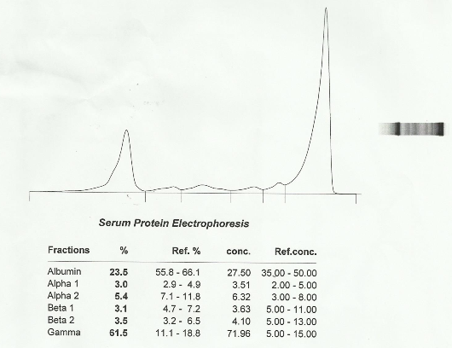
Q.12: Patient No 2
The following protein electrophoresis report is of a 50 years female.
Total Proteins (TP): 117 g/L (11.7 g/dl). Please comment (Concentration in g/L):
Suggested Answer:
Increased TP and gamma globulin, decreased albumin, alpha 1 and alpha 2, beta 1 and beta 2. A discrete paraprotein band in gamma region probably due to IgG myeloma proteins. Advised: Immunofixation

Slide 48
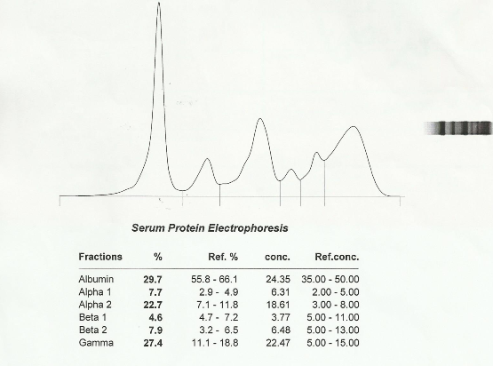
Q.13: Patient No 3
Pinkish coloured serum sample received for protein electrophoresis from a 75 years female. Her ESR is >140 mm and renal function tests are deranged. Total Proteins (TP): 82 g/L (8.2 g/dl)
Please comment (Concentration in g/L):
Suggested Answer:
Increased TP and gamma globulin and alpha 2. Decreased beta 1and albumin. Polyclonal rise in gamma region. Findings suggestive of hemoglobin-haptoglobin complex in alpha 2 region probably due to hemolysis and inflammatory process causing polyclonal rise of gamma globulins.

Slide 49
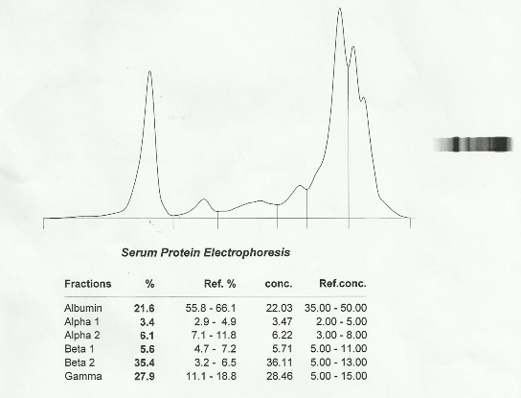
Q.14: Patient No 4
Protein electrophoresis from a 50 years male.
Total Proteins: 102 g/L (11.7 g/dl). Please comment (Concentration in g/L):
Suggested Answer:
Increased TP, beta 2 and gamma globulin. Decreased albumin. Paraprotein bands in gamma region probably due to IgA myeloma proteins. Merging of beta-gamma region may be due to liver disease. Advised: Immunofixation

Slide 50
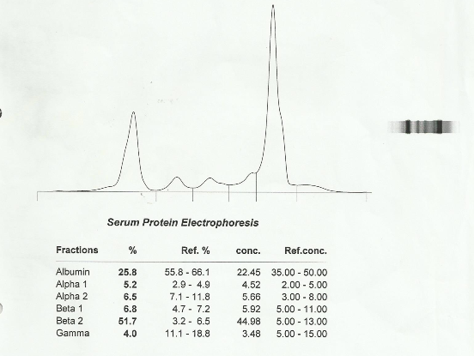
Q.15: Patient No 5
Protein electrophoresis from a 60 years male with markedly reduced renal functions. Total Proteins: 87 g/L (8.7 g/dl).
Please comment (Concentration in g/L):
Suggested Answer:
Increased TP, beta 2 and gamma globulin. Decreased albumin. Increased beta 2 globulin probably due to renal impairment.

Slide 51
Part IV
Short Answer Questions:

Slide 52
Q. 16: Which electrophoresis systems will be most suitable for following analytes:
Lipoproteins
Oligoclonal bands of IgG
DNA fragments
RNA
Isoenzymes of Alkaline Phosphatase

Slide 53
Lipoproteins
Gradient Gel Electrophoresis
Support media: Polyacrylamide gel
Denaturing : Sodium dodecyl sulphate, a denaturing agent, is added to create a gradient of denaturant to improve separation.
Detection system: Lipoproteins are then stained with Sudan Black B.
Quantification system: with Direct Densitometry at 600nm

Slide 54
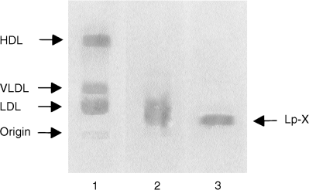
Lipoprotein
Technique: Gradient gel electrophoresis
Traditional methods , using a rectangular gel regardless of thickness, are collectively termed as gel electrophoresis
Gel may be cast with additive such as
  Ampholyte which create a pH gradient
  Sodium dodecyl sulphate that denatures protein

Slide 55
Lipoprotein
Support media: Polyacrylamide gel.
Other medium that can be used include
  Agarose medium
  Cellulose acetate
Detection system : After separation Lipoproteins are stained with Sudan Black B.
Quantification system: Direct Densitometry at 600nm

Slide 56
Oligoclonal bands of IgG
Isoelectric Focusing
Support media: Agarose gel
Detection system: pH gradient is created by carrier ampholytes i.e. amphoteric polyaminocarboxylic acids during electrophoresis. Slow moving proteins migrate through these narrow buffer zones and stop at their individual pIs.
Quantification system: Immunoblotting on nitrocellulose strip, staining with immunoperoxidase and reflectance scanning. Paraprotein containing serum is used as internal standard.

Slide 57
DNA fragments
Gradient gel electrophoresis
Support media: Agarose gel with CYBR Gold fluorescent stain. DNA ladder markers are added for accurate size and mass estimation.
Detection system: Comparison of sample fragment with DNA ladder marker also helps in identification of sample DNA.
Quantification system:
1.Multiplex ligand dependant Probe amplification by PCR
2. Comparison of sample fragment with DNA ladder marker also helps in quantification of sample DNA.

Slide 58
Agarose gel electrophoresis for DNA fragments-movie clip
(To see the clip click the link in slide show
Make sure you are connected to the internet)
http://www.jove.com/video/3923/agarose-gel-electrophoresis-for-the-separation-of-dna-fragments

Slide 59
RNA
Gradient gel electrophoresis
Support media: Agarose gel for large RNAs (≥600 nucleotide) and Polyacrylamide gel for small RNA 20-600 nucleotides
Detection system: Denaturing gradient is created by adding formaldehyde or formamide to support media. Ethedium bromide is added for RNA visualization. Then RNA is transferred to a membrane for detection by Northern blotting after hybridization with probe.
Quantification system:
By spectrophotometry as RNA ladder (mixture of known fragment size markers) with known spectrophotometrically determined RNA concentration is added in gel and increase in signal is due to concentration of corresponding RNA fragment in sample.

Slide 60
Isoenzymes of ALP
Isoelectric focusing
Support media: Polyacrylamide gel
Detection system: Low molecular weight amphoteric molecules with varying isoelectric points form pH gradient. Serum is briefly treated with neuraminidase that remove sialic acid residue more readily from bone ALP than Liver ALP thus improving their separation. Buffered substrate with chromogen is added to already separate zones of ALP on agar and presence of ALP is detected by change in colour.
Quantification system: By Spectrophotometry

Slide 61
Thank You and Best Of Luck

