Slide 1

Pakistan Society Of Chemical Pathologists
Distance Learning Programme In Chemical Pathology
(DLP-2)
Lesson No 11
Laboratory Automation
By
Brig Aamir Ijaz
MCPS, FCPS, FRCP (Edin)
Professor of Pathology /
Consultant Chemical Pathologist
AFIP Rawalpindi

Slide 2
Part I
MCQs (One Best Type)

Slide 3
Q.1: Various analytical systems used in a Chemical Pathology lab have been automated. Which of the following analytes still waits proper automation? a. Ethanol in serum b. Lipoprotein (a) c. Protein electrophoresis d. Serum Bicarbonate e. Stone analysis
      e. Stone analysis

Slide 4
Q 2. The autoanalysers in which all specimen pass through the same stream at the same rate are called: a. Closed systems b. Continuous-flow systems c. Discrete systems d. Random access systems e. Single channel systems
      b. Continuous-flow systems

Slide 5
Q 3. A centrifugal analyser has one of the following characteristic components: a. Centrifuge as part of the autoanalyser b. Polarized light thrown on rotating samples c. Rotor used for mixing of samples with reagents d. Separating samples on the basis of density e. Using rotating bar code reader
.
      c. Rotor used for mixing of samples with reagents

Slide 6
Types of Autoanalysers
Slides courtesy of Dr Sobia Irum (AFIP Rwp) and Dr Nudrat Khan (QAMC Bwp)

Slide 7
Why Automation?
Great increase in the number of tests advised
Minimize the variations in results from one person to another
Minimize errors found in manual analyses – equipment variations – pipettes
Use less sample and reagent for each test

Slide 8
Types of Analyzers
Continuous Flow
  Tubing flow of reagents and patients samples
Centrifugal Analyzers
  Centrifuge force to mix sample and reagents
Discrete
  Separate testing cuvettes for each test and sample
  Random and/or irregular access

Slide 9
Continuous Flow
This first “AutoAnalyzer” (AA) was a continuous-flow, single-channel, sequential batch analyzer capable of providing a single test result on approximately 40 samples per hour.
Analyzers with multiple channels (for different tests), working synchronously to produce 6 or 12 test results simultaneously at the rate of 360 or 720 tests per hour.

Slide 10
Continuous flow
In continuous flow analyzers,
  samples were aspirated into tubing to introduce samples into a sample holder,
  bring in reagent,
  create a chemical reaction,
  and then pump the chromagen solution into a flow-through cuvette for spectrophotometric analysis.

Slide 11
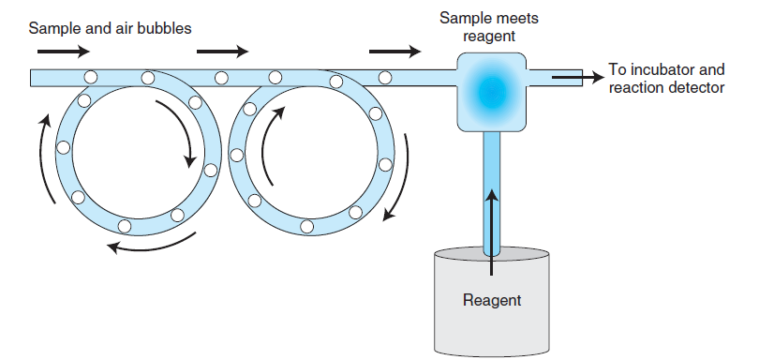
Continuous Flow

Slide 12
Drawbacks of
Continuous Flow
Significant carry-over problems
Wasteful use of continuously flowing reagents
Leading to ultimate demise of these autoanalysers

Slide 13
Centrifugal Analyzers
Discrete aliquots of specimens and reagents are piptted into discrete chambers in a rotor
The specimens are subsequently analyzed in parallel by spinning the rotor and using the resultant centrifugal force to simultaneously transfer and mix aliquots of specimens and reagents into radially located cuvets.
The rotary motion is then used to move the cuvets through the optical path of an optical system

Slide 14
Discrete analyzers
Discrete analysis is the separation of each sample and accompanying reagents in a separate container.
They have the capability of running multiple tests on one sample at a time or multiple samples one test at a time.
They are the most popular and versatile analyzers and have almost completely replaced continuous-flow and centrifugal analyzers.

Slide 15
Advantages of Discrete Analyzers
Sample reactions are kept discrete through the use of separate reaction cuvettes, cells, slides, or wells that are disposed of following chemical analysis.
This keeps sample and reaction carryover to a minimum but increases the cost per test due to disposable products.

Slide 16
Q 4: Bar code is the most common electronic identification system used in Pathology Laboratories. Which of the following bar code system is best for reduction of labeling and accessioning errors: a. Assigning bar codes by the autoanalyser (on which test is to be done) b. Assigning bar code at laboratory reception c. Assigning bar code at the bedside of the patient d. Using primary and secondary bar codes e. Using separate bar codes for different specimen tubes of the same patient e.g. plain tube & EDTA tubes.
      c. Assigning bar code at the bedside of the patient

Slide 17
Q 5 : A Lab Technologist working on a Chem Path autoanalyser complains to the Consultant Chemical Pathologist about a sample tube that there are spots on the upper part of the bar code and he cannot run this tube. Consultant instructs him to carry out the test and don`t worry about the ‘spoiled’ bar code. The test was carried out without any problem or complaint. Which of the following qualities of bar coding system has prevented spoiling of the code in spite of the spots: a. Bar/Space Patterns b. Quiet Zones c. ‘Start and Stop’ symbologies d. Two dimensional coding e. Vertical redundancy
      e . Vertical redundancy

Slide 18
BAR CODE
Slide courtesy of Dr Nudrat Khan, QAMC Bwp

Slide 19
What is Barcode
A barcode is an optical machine-readable representation of data, which shows certain data on certain products
Very commonly used on commercial products to ensure secured price labelling
In laboratory its purpose is to ensure sample identification and accession.

Slide 20
Types of Barcodes
One dimensional
Two dimensional
QR
Dot codes

Slide 21
Vertical Redundancy
In single dimensional codes the vertical lines and their spacing constitute the code but whole length of the vertical lines are not essential for the code. It is said that code is repeated in vertical direction
So a symbol with printing defects, such as spots or voids, can still be read.

Slide 22
Two Dimensional Barcode(2D)
  A two-dimensional code stores information along the height as well as the length of the symbol
  Since both dimensions contain information, at least some of the vertical redundancy is gone.

Slide 23
Elements Of Bar Code
(Single Dimension)
Start and Stop Symbologies
Quiet Zones
Bar and Space pattern

Slide 24
Start and Stop Symbologies
At the beginning and end of some bar code symbols, there are "start" and "stop" characters.
These characters identify the symbology and also enable the scanner to read the symbol bidirectionally, decoding the data in the correct order

Slide 25
Quiet Zones
An area of 1/4" width next to the start and stop characters that contains no markings.
It is essential for the scanner to recognize the bar code.
If the space is too short, the bar code symbol will not be read by the scanning device.

Slide 26
Bar/Space Patterns
These are the wide and narrow black bars and whites spaces contained in the bar code
This is the actual coding area

Slide 27
Q 6 : Pneumatic tube (shoot) is a mechanical system used to transport samples to the laboratory. Which one of the following is its major disadvantage as compared to other mechanical delivery systems: a. Delays in specimen delivery b. Hameolysis c. Larger initial cost d. Larger stations e. Need of batching specimens
      b. Hameolysis

Slide 28
Mechanical Delivery Systems
Slides courtesy of Dr Majid Latif (AFIP Rwp)

Slide 29
Pneumatic Tube Systems
Pneumatic tube systems provide rapid specimen transportation and are reliable when installed as point to point services
Problems
  Hemolysis
  It is due to sudden accelerations/decelerations and sharp turns
  Avoidance of sudden accelerations and decelerations and the use of proper packing material inside the carriers will minimize hemolysis.
  Misrouting of carriers
  When switching mechanisms are introduced to allow carriers (bullet shaped containers used to hold specimens) to be sent to various locations

Slide 30
Electric Track Vehicles
Larger carrying capacity than pneumatic tube systems
Do not have problems with damaging specimens by acceleration and/or deceleration forces
Some systems maintain the carrier in an upright position by use of a gimbal (a device that permits a body to incline freely in any direction or suspends it so that it will remain level when its support is tipped), enabling the carrier to move both vertically and horizontally on an installed electric track
The containers hold dry ice or refrigerated gel packs with the specimens if desired
Specially useful in quickly transporting specimens between floors or between laboratory locations that are some distance from each other

Slide 31
Disadvantages of
Electric Track Vehicles
A primary disadvantage is the cost of moving the track and loading/unloading stations if the laboratory is expanding or moving
The stations may be larger than the pneumatic tube stations.
If the station is not located directly in the central laboratory (centralized testing; core laboratory), additional staff may be necessary to unload the carts and transport the specimens to their final destination, and the electric track system may not achieve its desired goal of rapid specimen transport.

Slide 32
Mobile Robots
Advantages
Mobile robots have been used successfully to transport laboratory specimens both within the laboratory and outside the central laboratory
They are easily adapted to carry various sizes and shapes of specimen containers
Reprogrammable with changes in laboratory geometry
Disadvantages
Need to batch specimens (batch analysis) for greater efficiency
Require laboratory personnel to place specimens onto or remove specimens from the mobile robot at each stopping place.

Slide 33
Q 7 : In a busy lab of Tertiary Care Hospital your main concern is reducing pre-analytical errors without increasing ‘turn- around-time’. Which of the following options will be most suitable for placing patient samples in a chemical path autoanalyser: a. Primary gel tubes after centrifuging b. Primary gel tubes without centrifuging c. Plain tubes without gel without centrifuging d. Sample cups with serum e. Sample tubes with serum
      a. Primary gel tubes after centrifuging

Slide 34
Q 8 : You lab manager has reported a strange problem in the autoanalyser. It gives message “reagent bottle empty” while there is sufficient reagent in the bottle. Which of the following functions of the autoanalyser most probably requires a trouble shoot: a. Internal conveyer belt b. Level sensing system c. Reagent bar code reader d. System software e. Tube racks
      b. Level sensing system

Slide 35
Q 9 : Various immunoassay techniques have been successfully automated. Which of the following immunoassay techniques, though initially automated, is no longer used in any autoanalyser: a. Dry multilayer films b. Flow cytometery c. Fluorescence d. TINA-QUANT® e. Radioimmunoassay
      e. Radioimmunoassay

Slide 36
10. ELISA is a time-honoured immunoassay technique used for many hormones / proteins etc. Automation is also available in ELISA but it is different from other autoanalysers. Which of the following phrases best describes automated ELISA: a. Closed b. Coated particles c. Homogenous d. Robotic e. Solid-phase
      d. Robotic

Slide 37
Automation in Immunoassays
Slides Courtesy of Dr Qurat-ul-Ain, AFIP Rwp

Slide 38
Automation in immunaassay (IA)
Defined as minimum human activity in performing an assay that measures antigen and antibody reaction
In contrast with other powerful analytic techniques, such as mass spectroscopy and nuclear magnetic resonance, modern IA is technically simple as it depends on complexity in reagents rather than in instrumentation.

Slide 39
Design options for an immunoassay
Competitive vs immunometric assay
Small molecule (hapten) vs protein analyte
Equilibrium vs kinetic assay
Type of binding reagent
Type of bound free label seperation
Type of solid phase
Type of label

Slide 40
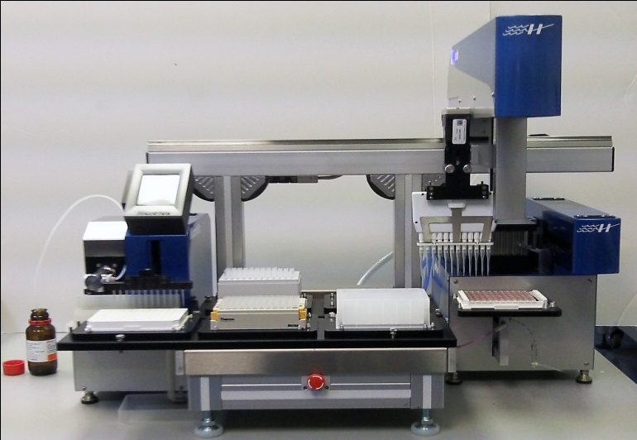
Classic Designs
Automation was kept as simple as possible to achieve inexpensive and efficient operation.
To perform an established manual format robotically
Examples
  early instruments that automated RIA
  Robotically performed ELISA
Disadvantages
  Inflexible test menu
  Low throughput

Slide 41
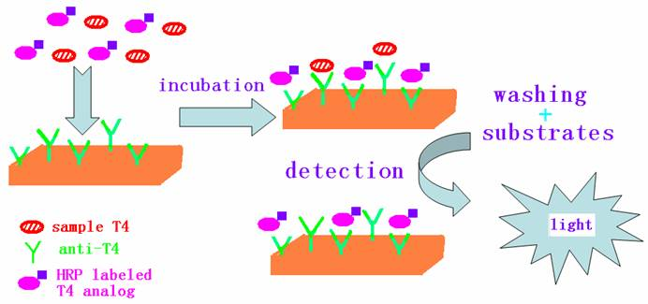
Advanced Designs
To adapt an automation design used in general chemistry to immunoassay
Examples
  EMIT, FIA, chemiluminescence
Advantages
  Large test menu
  High throughput
  Random access selection
  Suitable for a wide range of environment ranging from largest central laboratories to a compact batch analyzer suitable for POCT or a single use home test strip

Slide 42
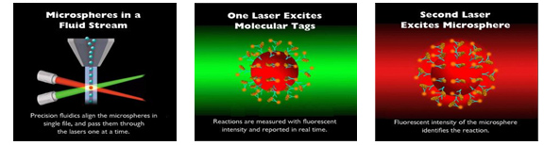
Novel Design
Use of technologies that depart in more basic ways from general chemistry analyzers
Example
  Flow cytometers can be adapted to qualitative or quantitative measurement of soluble antigens by using Latex microspheres in a competitive or immunometric IA

Slide 43
Advantages of Automation in IA
Improved test formats
  Advancement in test formats like CEDIA, EMIT have desirable performance characteristics and are intrinsically suitable for automation.
Improved reproducibility
  Automated platforms may improve the precision of pipetting, mixing, timing, and separation steps, leading to better assay performance.
High throughput
Increased analytical sensitivity
Standardization
  Automation results in standardization of IA with reduced inter laboratory variation

Slide 44
Disadvantages of automation in IA
Compromises in assay design
  for reasons related to the simplicity, cost, and speed of automation. e.g. adding patient sample and detector Ab simultaneously, without an intervening wash step may result in high-dose hook effect.
Errors related to automation design
  These could include, for example, sample-to-sample carryover due to reusable sample probes, sample-to-sample or test-to-test carryover due to reuse of reaction cuvettes and errors caused by deterioration of reagents in reagent lines.
Errors related to automation malfunction
  A major malfunction may cause systematic errors in 1 assay, a group of related assays, or all assays.

Slide 45
Part II
Short Answer Questions:

Slide 46
Q. 11: An immunoassay autoanalyser is installed in your laboratory. Please answer following questions regarding this instrument (one mark each): a. How will you prepare it for 4Q model of instrument qualification for an Accreditation Audit?
B. How will you check the instrument regarding the Sample-to-Sample Carry Over? Which analyte you will select for this purpose and why?

Slide 47
4Q Model of Instrument Qualification
The immunoassay autoanalyzer will be prepared for “4Q” model according to following guidelines
Design qualification- documentation of required specifications of design and its function. It also document qualification of vender or supplier.
Installation qualification- documented verification that system is installed according to written and preapproved specifications
Operational qualification- includes verification that system is operating in accordance with preapproved and written specifications under normal and stressed conditions.
Performance qualification- it includes ongoing monitoring of performance, testing for specified application and periodic updates about the analyzer.

Slide 48
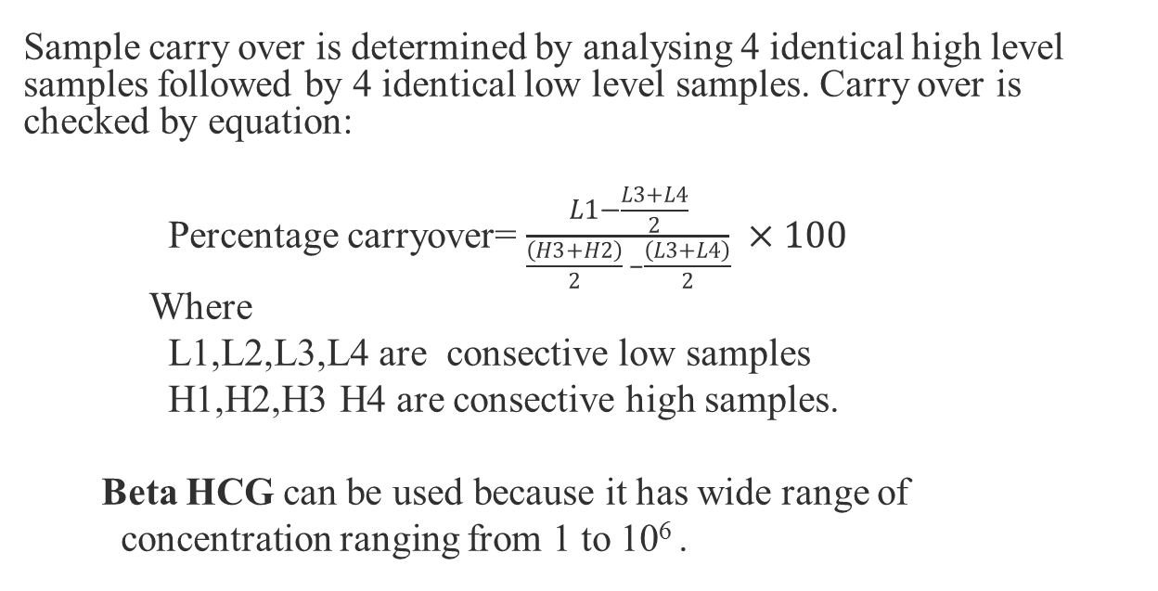
Sample-to-Sample Carry Over
Sample carry over is determined by analysing 4 identical high level samples followed by 4 identical low level samples. Carry over is checked by equation:
Percentage carryover= $\frac{\begin{aligned} \\ L1−\frac{L3+L4}{2}\end{aligned}}{\frac{\left(H3+H2\right)}{2} –\frac{\left(L3+L4\right)}{2}} ×100$
Where
L1,L2,L3,L4 are consective low samples
H1,H2,H3 H4 are consective high samples.
Beta HCG can be used because it has wide range of
concentration ranging from 1 to 10⁶ .

Slide 49
Situation with Greater Risk of Sample Carry Over
The risk of carryover altering patient’s results is greater if a primary specimen collection tube is initially processed on the chemistry analyser and then transferred to an immunoassay analyser for additional testing.
Sample probe washing on a clinical chemistry instrument is sufficient to prevent carryover for chemical analyte, but may not be adequate for immunoassay analyte.

Slide 50
Q. 12: Director General Health of your province wants to replace semi-automated analysers with fully-automated Chem Path Analysers in 10 major hospitals of the province. He has sought your opinion regarding a transparent procurement procedure (one mark each): a. What are the TWO systems of procurement various firms in Pakistan offer for these autoanalysers? b. Which system of procurement you will like to adopt. Give its THREE merits and/or demerits (total three).

Slide 51
Systems of Procurement
Slides Courtesy of Dr Amina Tariq (AFIP Rwp)

Slide 52
Types
Procurement on reagent rental basis (RR)
Lease agreement between diagnostics companies and laboratories in which lease cost is built into the reagents i-e an analyzer will be placed in a laboratory in exchange for the guaranteed purchase of reagents over a period of time.
Procurement on cost-per-test contracts (CPT)
Analyzer would be placed in the laboratory with the agreement that the laboratory would pay a specified amount per test run on the analyzer, based on the laboratory’s estimated test volume by type.
Direct Insrtument Purchase

Slide 53
Advantages of RR and
CPT Contracts
  Prevent the initial high cost of the instrument used from capital equipment budget rather it will appear in operating budget
  Continuous supply of reagents for the contract period will be ensured
  Some contracts also include service/maintenance expenses in the cost, providing additional savings for the laboratory

Slide 54
Advantages of RR and
CPT Contracts (cont)
  When a contract has expired, laboratories can simply replace older analyzers with new instruments that offer them the most extensive, cutting-edge test menus.
  Since laboratories are not absorbing the cost of the analyzer to begin with, they are able to update technology much more readily
  Guaranteed income for diagnostic manufacturers as well: a true win-win situation in diagnostics markets that has typically seen modest growth at best in recent years

Slide 55
Disadvantages of RR and
CPT Contracts
  Consumer will be bound to purchase reagent kits from that vendor only
  Reagent cost is 10-15% higher for the consumer on reagent rental basis than when purchased (but some vendors offer market prices too!!)
  Not very profitable for smaller regional reference laboratories and physician office laboratory settings.

Slide 56
13. A Chemical Pathologist working in an active diagnostic service has to be familiar with various autoanalysers offered by different manufactures. Please fill in the empty cells in the following table after gathering information from any source (0.5 mark for each analyser):
Name of the autoanalyser | Manufacture | Working principle | Group of Analytes which can be tested | Open or Close
Selectra XL® | Elitech group | Photometry and indirect ISE (dry electrode) | Clinical chemistry(LFT, RFT, muscle enzymes) Electrolytes | Open channels
Modular P-800® | Roche | Spectro-photometry and indirect ISE | Clinical chemistry(LFT, RFT, muscle enzymes) Electrolytes | Mainly closed but few channel can be opened
Immulyte 2000® | Seimens | Chemilumine-scence immunoassay technique | Immunoassaye.g. thyroid profile, fertility profile, tumor marker, cTn | close
Access 2® | Backman coulter | Chemiluminescence immunoasssay | Immunoassaye.g. thyroid profile, fertility profile, tumor marker, cTn | close

Slide 57
More Commonly Used Autoanalysers
(Commercial Details)
Slides courtesy of Dr Amjad Pervaiz, Dr Rubina Rashid and Dr Sadia Kirn (All from AFIP Rwp)

Slide 58
Name of the autoanalyser | Manufacture | Working principle | Group of Analytes which can be tested | Open or Close
D x I-800 | Beckman Coulter | Chemiluminiscence | hormone assay, TDM, Tumor marker | closed
Vitros Immunodiagnostic | Johnson and Johnson | Chemiluminiscence | hormone assay, TDM, Tumor marker | closed
Cobas 221 | Cobas/Roche | ISE , oximetery | ABGs, electrolytes, bilirubin, Carboxy Hb, Urea etc. | Closed
Centaur | Siemens | Chemiluminiscence | hormone assay, TDM, Tumor marker | closed
Architect | Abbott Diagnostics | Chemiluminiscence | hormone assay, TDM, Tumor marker | Closed
Advia 1800 | Siemens | Photometry and indirect ISE (dry electrode) | Clinical chemistry(LFT, RFT, muscle enzymes) Electrolytes | Closed

Slide 59
Q. 14: Total Laboratory Automation (TLA) is the most recent and most exciting development in automation of Chemical Pathology Laboratories. Suppose you are working in a Tertiary Care Hospital with a workload of 5000 patient samples per day in the Chem Path Lab. Your HOD is a Non-Chemical Pathologist. He has asked you to prepare a preliminary report of installation of TLA in your lab with following main points (one mark each): a. Name THREE vendors who offer TLA in Pakistan. b. Do we need to allocate large funds for installation of TLA, if not why? c. Name FOUR most important features which should be the part of the TLA installed in your lab. d. Name TWO site facilities which are mandatory for successful running of TLA in addition to the proper lab space. (Please keep in mind the peculiar problems in Pakistan).

Slide 60
Total Laboratory Automation (TLA)
Slides Courtesy of Dr Safia Anwar and Dr Saima Bashir (AFIP Rwp)

Slide 61
What is TLA
TLA encompasses robotic automation of all the processes involved in a laboratory test.
Currently it has been installed in almost all of state-of-the-art laboratories in the world including three well-reputed hospitals of Pakistan.
It plays a vital role in minimizing human errors which have always been a nightmare for an efficient medical laboratory.

Slide 62
TLA in Pakistan
AKU hospital Karachi---------------Siemens (by Hoora Pharma) since 2011
DUHS Karachi-------------------------Abbott since Jul 2012
Shoukat Khanum Lahore------------Roche Diagnostics since 2011

Slide 63
Why TLA
Increasing workload,
Keep pace with rapidly developing medical field
Increasing Resources constrains
Pressing need to maintain high quality
Dearth of efficient biomedical support.

Slide 64
The Goals
Improving quality,
Lowering laboratory costs,
Reducing turnaround times,
Improving productivity,
Avoiding labelling and accessioning errors
Minimizing repetitive manual tasks for staff

Slide 65
Types of Lab Automations
Sub total Automation (Modular automation)
Total lab automation
Combined

Slide 66
TLA as a highly workable solution
TLA is automation of all the processes taking place in a medical diagnostic lab.
It works 24/7
Results of tests which are reported in days may be available in hours
Chances of human errors are reduced to nearly zero

Slide 67
TLA as a highly workable solution (cont)
Totally free of cost installation
Provision of reagents /consumables at present rates
Uniformity of tests because of single vendor dealing
Technical support to be provided by the installation firm
Marked reduction in manpower requirement

Slide 68
Parts of TLA
Pre-analytical | Analytical | Post-analytical
Accessioning | Rack loading | Sorting to bench
Tube sorting | Loading analyzer | Recapping
Centrifuging | Analytics | Archiving
Decapping | Resulting | Retrieving
Aliquoting

Slide 69
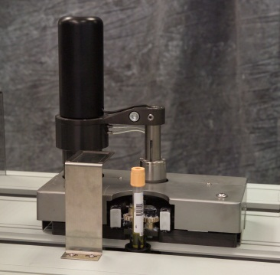
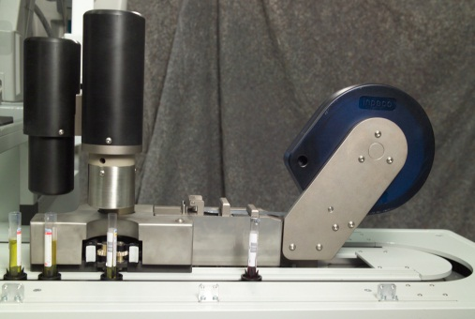
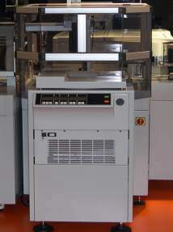
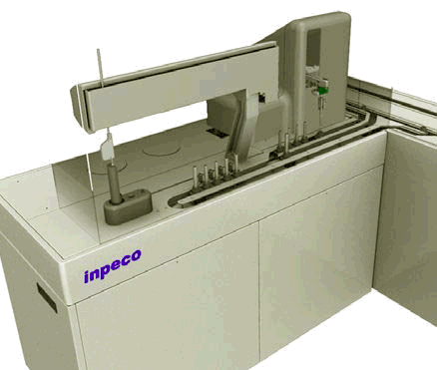
Preanalytical automation
Decapper Module
Resealer Module
Centrifuge Module
Aliquoter Module

Slide 70
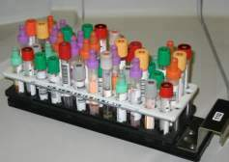
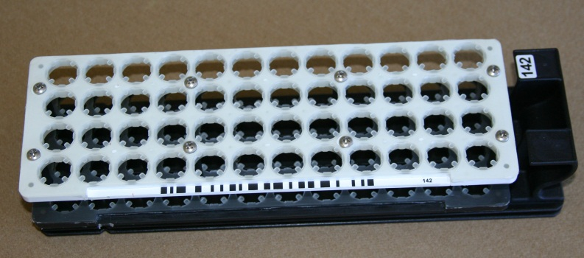
Sample tubes
Multiple Tube Sizes
  13 × 75 mm
  13 × 100 mm
  16 × 75 mm
  16 × 100 mm

Slide 71
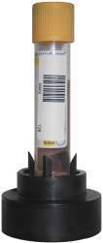
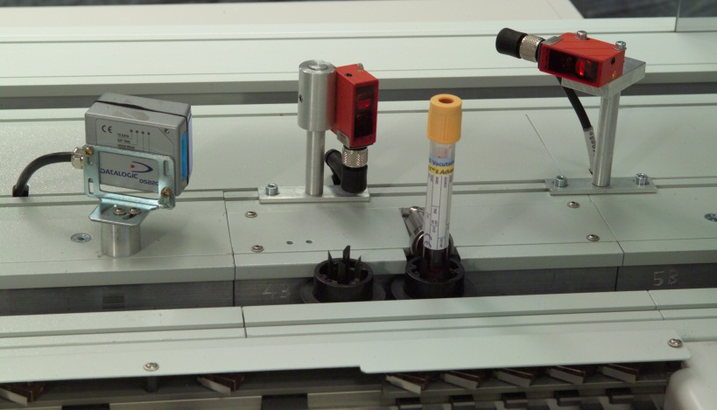
Tube identification
RFID (Radio Frequency ID) technology for tube identification
  Constant tracking of all specimens through the system
  Eliminates the need for multiple
  bar-code readers
  Provides ability to take real-time action
ID Tube
TAG

Slide 72

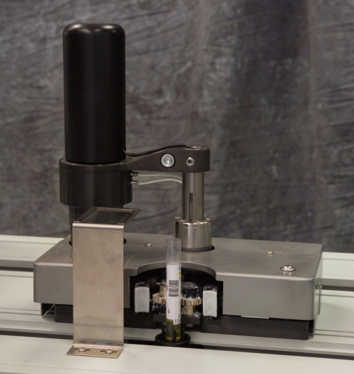
Decapper module
Simple & Reliable design
600 Tubes per Hour
Screw-top or Stopper Type Caps
BD, hemogard, greiner, starstedt
Automatic waste containment

Slide 73
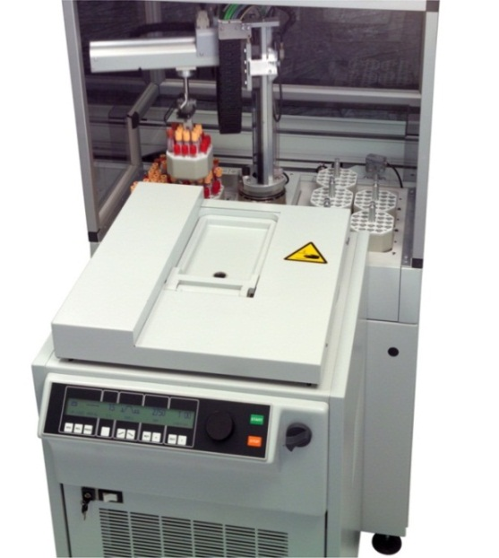
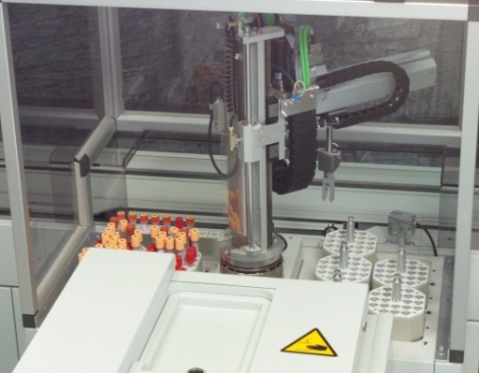
Centrifuge module (Contd)
80 Tube Capacity
320 Tubes per Hour
Hettich Refrigerated Centrifuge
Programmable Spin Time
Automatic Balancing
Automatic Loading / Unloading
STAT Priority Unloading
Staging Area Enables
Multitasking Capability
Option for Multiple Centrifuges
Staging Area

Slide 74
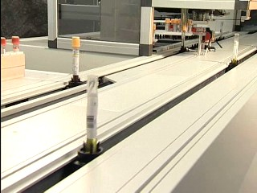
Sample transport module
Quiet & Clean Design
Minimal Moving Parts / Motors
Connects APS Components and Analytics
Flexible Design to Support Multiple Disciplines

Slide 75

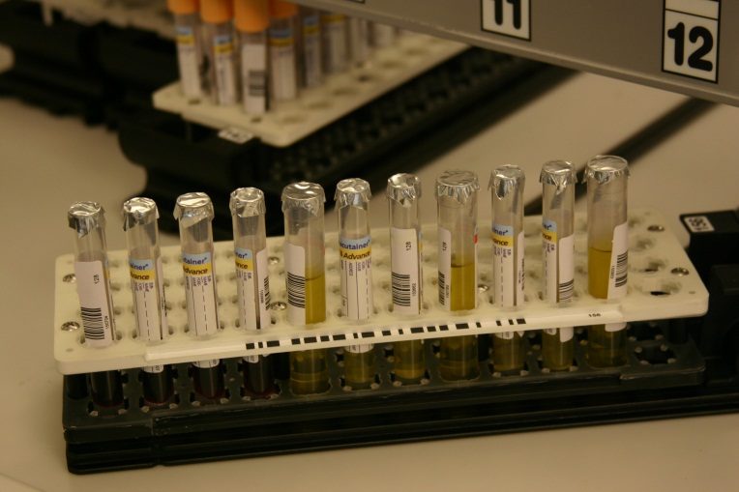
Resealer Module
600 Tubes per Hour
Utilizes “Foil-Seal” Technology
Improves Reliability
Accommodates Multiple Tube Sizes

Slide 76
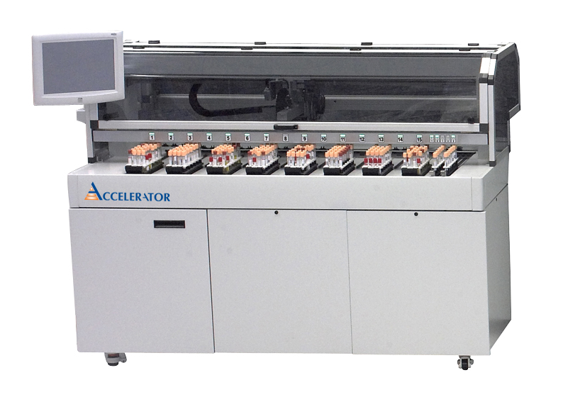
Analytical automation
Single Point of Interaction
300 – 600** Tubes per Hour
Loading / Unloading
Sorting
Archiving / Mapping
Exception Management
720 Tube Capacity
** 600 tubes/hour with tube storage unit on-line

Slide 77
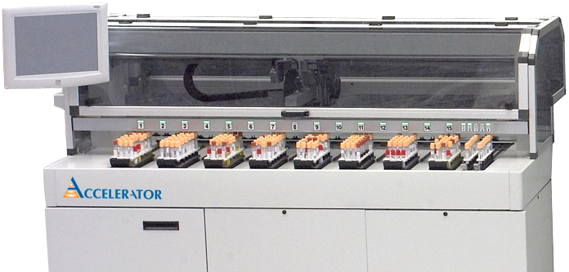
Input / output module
INDICATOR LIGHTS
OUTPUT BAYS
INPUT BAYS
STAT LOAD BAYS
EXCEPTION BAYS

Slide 78
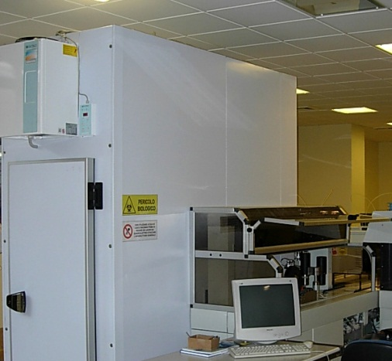
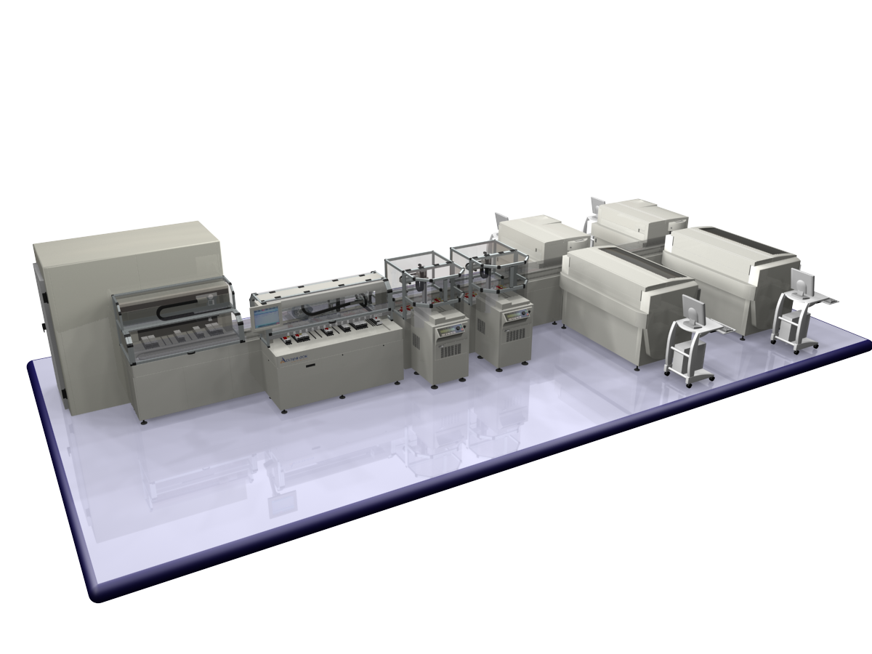
Tube storage module
15,000 Tube Capacity
Refrigerated Storage
Automatic Tube Retrieval
Rerun / Repeat Testing
Reflex / Add-on Testing
Automatic defragmentation

Slide 79
Important consideration
Economical and reliable operation
Efficient sample handling,
Minimum turn around time
Efficient lab work flow
Reduced human resource cost
Up-gradation/ menu extension
Service back up

Slide 80
Required Site Services
Adequate lab space
Uninterrupted power supply
Reagent grade water (by RO and DI)
Humidity, ventilation and Air conditioning (HVAC) control

Slide 81
Possible Reasons of Failure
Incomplete understanding of current environment...processes, costs, customer expectations
Loss in flexibility due to fixed processes and limited throughput
Unplanned and poorly developed ‘workarounds’ required to interface automation with manual processes
Overbuilt and unnecessarily complicated system design
Inadequate technical support
Hidden costs...labor, supplies, maintenance
Failure to optimize current processes prior to automation →never automate a poor process!

Slide 82
Thank You and Best Of Luck

