Slide 1

Pakistan Society Of Chemical Pathologists
Distance Learning Programme In Chemical Pathology
(DLP-2)
Lesson No 13
Vitamins and Minerals
By
Brig Aamir Ijaz
MCPS, FCPS, FRCP (Edin)
Professor of Pathology /
Consultant Chemical Pathologist
AFIP Rawalpindi

Slide 2
Part I
MCQs (One Best Type)

Slide 3
Q. 1 Requirements of vitamins and minerals have been established by various organizations. Which of the following intake is claimed to be sufficient to meet the daily nutrient requirements of 97 percent of the individuals of a population: a. Adequate Intake (AI) b. Population reference intake c. Recommended Dietary Allowance (RDA) d. The Estimated Average Requirement (EAR) e. Upper Tolerable Level (UL)
      c. Recommended Dietary Allowance (RDA)

Slide 4
Q 2. Iodine is an important mineral required for optimum maintenance of thyroid hormones. Which of the following classes of minerals it belongs to: a. Macro-minerals b. Metallic minerals c. Non-essential minerals d. Trace-minerals e. Ultra-trace minerals
      e. Ultra-trace minerals

Slide 5
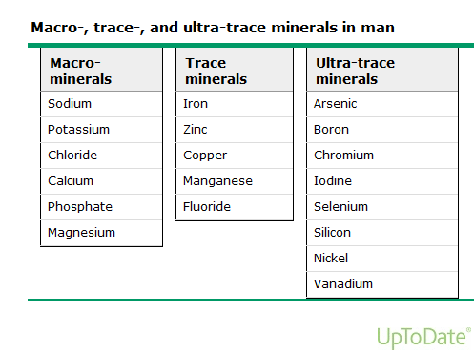

Slide 6
Q 3. Vitamin A status is assessed by measuring Serum Retinol. All of the following conditions can lead to false decrease in Serum Retinol in spite of normal vitamin A status EXCEPT: a. Deficiency of Zinc b. Inter-current Infections c. Protein-calorie malnutrition d. Recent vitamin A intake e. SIRS
.
      d. Recent vitamin A intake

Slide 7
Q 4: Ascorbate concentration can be measured in biological samples for the assessment of vitamin C status by various analytical techniques. Which of the following methods is rarely used due to large sample volume requirement: a. Enzymatic method using ascorbate oxidase b. HPLC c. Leukocyte ascorbate d. Photometric method by dinitrophenylhydrazine e. Urinary ascorbate
      c. Leukocyte ascorbate

Slide 8
Laboratory Assessment of Vitamin C
Slides courtesy of Dr Sumbal Nida, AFIP Rwp

Slide 9
Direct Measurement
Analyte
  Ascorbic acid
  Total vitamin C
  Metabolites
Sample
  Plasma
  Urine
  Tissue

Slide 10
Methodologies
Colorimeteric method
oxidation with
- 2,4-dinitrophenylhydrazine forms red bis-hydrazone(RED)
- 2,4-dichlorophenol indophenol forms colorless substance
Enzymatic method
- utilizes ascorbate oxidase
  ascorbate dehydroascorbate which is coupled with o-phenylene diamine to form a compound which is measured flurometerically

Slide 11
Methodologies (Cont)
HPLC Methods
- more specific
- more time consuming
Leukocyte Ascorbic Acid
- better indicator of body stores
- requires larger sample volume
-difficult for automation
Measurement of urinary concentration of ascorbic acid is useful in diagnosing scurvy

Slide 12
Q 5: A 68 years male is admitted in a state-of-the-art hospital for investigation of macrocytic anaemia. His vitamin B12 and folate results were as following:
• Vitamin B12: 152 pmol/L (reference range: 148 to 221 )
• Folate: 8.6 nmol/L (Normal > 9.1)
Treating physician has sought your opinion to determine which one or both of the vitamins are deficient. The test most helpful in determining whether B12 or folate deficiency (or both) is leading to the macrocytic anaemia in this patient will be: a. Bone marrow aspiration biopsy b. Mean corpuscular volume c. Plasma homocysteine d. Schilling test e. Serum Methylmelonic acid
      e. Serum Methylmelonic acid

Slide 13
Vitamin B12 and Folic acid
Slides courtesy of Dr Qurat-Ul-Ain, AFIP Rwp

Slide 14
Coalmine (Vit B12) and Folic acid (vit B9)
Source
  Vitamin B12 – meat and dairy products
  Folic acid – animal products and leafy vegetables
RDA for adults
  Vitamin B12 – 2 µg/day
  Folic acid – 400 µg/day

Slide 15
Physiological role of Vit B12 and Folic acid
The combined action of both the vitamins leads to DNA synthesis in cells undergoing rapid turnover e.g. hematopoietic and enteric lining cells.
Two important actions of Vit B12 are
  Conversion of methylmalonyl CoA to succinyl-CoA. There is no interaction with folic acid in this pathway
  Transfer of a methyl group from methyl-tetrahydrofolate (methyl-THF) to homocysteine to form methionine with two important effects.
    Reduction in plasma homocysteine level, which is probably toxic to endothelial cells
    Demethylation of THF (folic acid derivative) which is the basic substrate for purine synthesis.

Slide 16
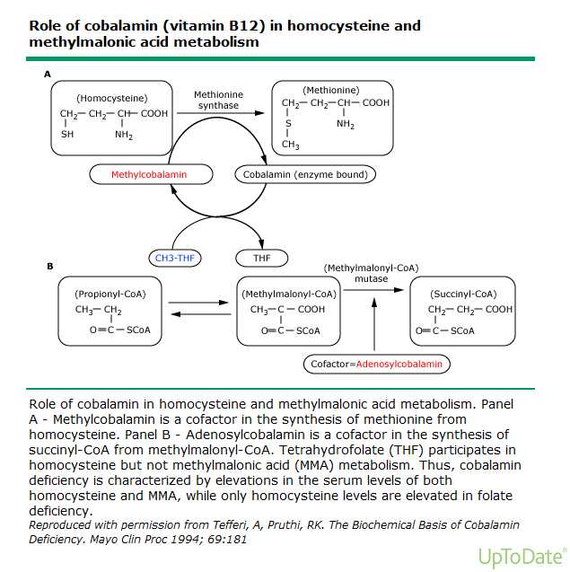

Slide 17
Biochemical evaluation of Vit B12 and Folic acid deficiency
Serum vit B12 and folic acid levels
  In hospitalized patients, samples should be obtained immediately before taking any meal and blood transfusion. Even a single meal can normalize the serum folic acid level
Red cell folate level
  More reliable indicator of tissue folate adequacy as it reflects time average value of folic acid availability
Evaluate for accumulation of specific metabolic intermediates
  Homocysteine levels – increased in both vit B12 and folic acid deficiency
  Methylmelonic acid – increased in vit B12 deficiency only

Slide 18
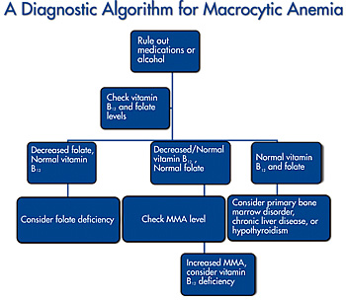
Diagnostic algorithm for macrocytic anemia

Slide 19
Q 6 : A 35 years male has developed weakness in the lower limbs. His routine lab tests revealed abnormal liver function tests (ALT: 645 U/L). He was advised investigations to rule out Wilson`s disease which showed following result:
• Serum Copper: 60 μg/dl (ref range: 70-140)
• Serum Ceruloplasmin: 238 mg/l (220-400)
The patient has been sent back to you with the remarks that Kayser-Fleischer rings have been found in his cornea. Which of the following tests will be most useful now to confirm the diagnosis of Wilson`s disease in this patient: a. Plasma Zinc b. Serum gamma glutammyl transferase c. Serum superoxide dysmutase d. Urinary ceruloplasmin e. Urinary copper
      e. Urinary copper

Slide 20
Copper (Cu)
Slides courtesy of Dr Amina Tariq, AFIP Rwp

Slide 21
Cu metabolism
Cu is absorbed by the intestinal cells; within the enterocyte is an enzyme called ATP7A which releases copper into the portal vein which is then transported to the liver.
In liver lies another enzyme, ATP7B,which has 2 functions:
  Incorporates copper into ceruloplasmin and releases it into the bloodstream.
  Removes excess copper by secreting it into bile.

Slide 22
Wilson Disease (WD)
Wilson disease, also known as hepatolenticular degeneration , is an autosomal recessive disorder of copper metabolism characterized by excessive deposition of copper within the liver, brain, cornea and other tissues
Caused by mutation to ATP7B gene.
More than 500 mutations have been described so far which can be detected in 90% of the pts while 10% have no detectable mutation.

Slide 23
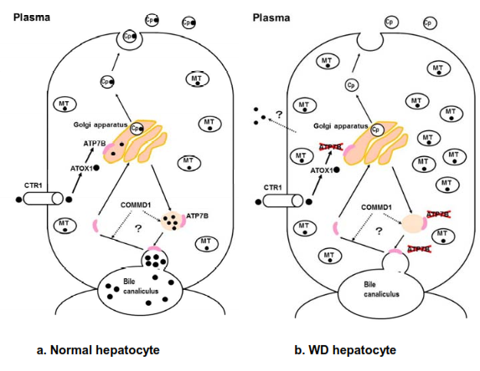
Hepatic Changes in WD
In hepatocytes affected by WD, Cu cannot be transported from the cytosol to the Golgi apparatus; so Cu accumulates in the cytosol.
Cu deficiency in the Golgi apparatus results in reduced secretion of Cu into the blood as well as biliary excretion of Cu is disturbed.
Accumulated Cu in the hepatocyte is released into the blood as non-ceruloplasmin-bound Cu

Slide 24
Biochemical Tests for WD
  Serum ceruloplasmin---Low (<20 mg/dl in WD)
  Serum free copper—High (>250 ug/l in WD)
  24 h urinary copper—High (>50 ug/24h)
  Penicillamine challenge test—standardized for children only
  Hepatic copper content– High (>250 ug/g dry weight)
  Transaminases—raised due to hepatocyte injury

Slide 25
Menkes disease (MD)
Menkes disease, also known as kinky hair disease, is an X-linked neurodegenerative disease of impaired Cu transport.
Defective ATP7A gene is expressed in almost all cell types except hepatocytes.
Transport of dietary Cu from intestinal cells is impaired, leading to the low serum Cu levels.
Abnormal Cu transport in other cells leads to:
  Paradoxical Cu accumulation in duodenal cells, kidney, pancreas, skeletal muscle, and placenta.
  Decreased activity of cuproenzymes.

Slide 26
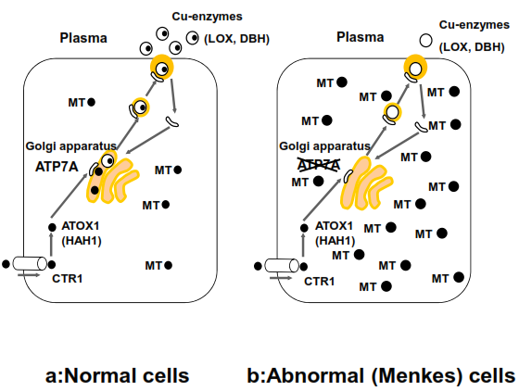
Cellular Changes in MD
In cells affected by Menkes disease, copper cannot be transported from the cytosol to the Golgi apparatus and thus cannot be excreted from the cells.
Copper deficiency in the Golgi apparatus results in a decrease in the activities of secretory copper containing enzymes

Slide 27
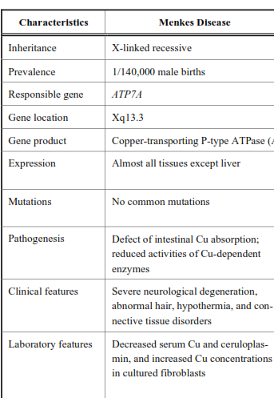
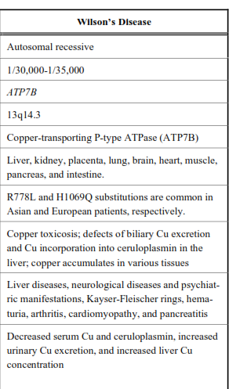

Slide 28
Q 7: A 54 male patient of type 2 diabetes mellitus is on parenteral nutrition and insulin therapy. Supplements of which of the following minerals has been shown to be helpful in reducing insulin dose in this patient: a. Boron b. Chloride c. Chromium d. Iron e. Zinc
      c. Chromium

Slide 29
Chromium (Cr)
Slides courtesy of Dr. Amjad Pervaiz, AFIP Rwp

Slide 30
Cr and action of Insulin
Trivalent chromium(Cr+3) is an essential trace element
Enhances the action of insulin on its receptor
So its deficiency is reportedly associated to insulin-resistant glucose intolerance and neurological deficits

Slide 31
Proposed mechanism for activation of insulin receptor by Cr
The inactive form of insulin receptor (IR) is converted to active form by binding insulin (I)
This triggers a movement of Cr (in the form of Cr-transferrin,Cr-Tf) from the blood into insulin-dependent cell
Cr (Cr+3) binds to Apo-chromodulin to form Holochromodulin
Finally the Holo-chromodulin binds to insulin receptor(IR), further activating the receptor Kinase activity

Slide 32
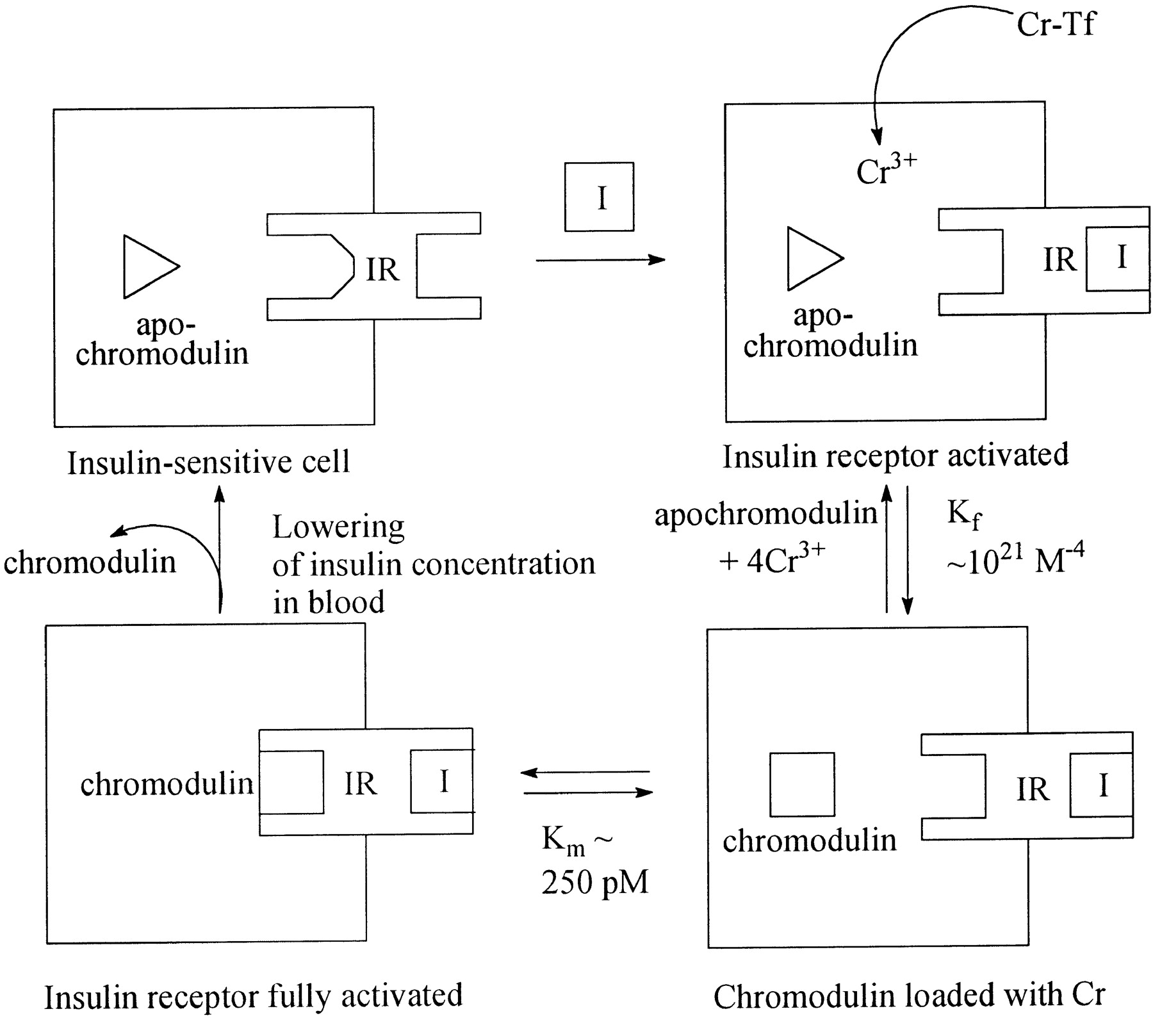
Proposed mechanism for the activation of insulin receptor kinase activity by chromium in response to insulin.
Vincent J B J. Nutr. 2000;130:715-718
©2000 by American Society for Nutrition

Slide 33
Q 8: Rapidly progressive and fatal cardiomyopathy reported in some neighboring counties of China is known to be due to a deficiency of which of the following vitamins / minerals: a. Arsenic b. Boron c. Riboflavin d. Selenium e. Thiamine
      d. Selenium

Slide 34
Selenium (Se) and Keshan`s Disease
It was documented in Keshan and its neighbouring counties in China that a fatal cardiomyopathy is caused by Se deficiency
Supplementation of diet with Se greatly controlled the disease
A classical example of “disease-mineral relationship”.
How many such relationship are waiting for your research??

Slide 35
Q 9: Which of the following minerals has been suggested to be beneficial in children with diarrhea in developing countries: a. Copper b. Fluoride c. Iron d. Manganese e. Zinc
      e. Zinc

Slide 36
Zinc (Zn)
Slides courtesy of Dr Sadia Kiran, AFIP Rwp

Slide 37
Functions of Zn
It is second to iron as the most abundant trace element in the body.
The key roles of Zn is in proteins and nucleic acid synthesis.
This role explains the failure of growth and impaired wound healing observed in individuals with Zn deficiency.

Slide 38
Role of Zn in Hormone Synthesis
Zn has a role in the synthesis and action of many hormones, via zinc transcription factors.
Testosterone
Free T4
IGF-1
Thymulin, the thymus specific hormone that is involved in
T-cell function

Slide 39
Signs and symptoms of deficiency Zn Deficiency
Depressed growth with stunting
Increased incidence of infection
Diarrhea
Skin lesions
Alopecia

Slide 40
Estimation of Zn in Plasma
Plasma Zn concentrations are most commonly measured by Atomic Absorption.
It is essential to consider plasma Zn results along with plasma albumin and plasma CRP or another marker of the APR.
A guidance reference interval is 12 to 18 umol/L

Slide 41
Q 10: A recent study has shown long-term intake of diet high in a vitamin / mineral was associated with loss of Bone Mineral Density and increased risk of osteoporotic fractures. This association was found with: a. Lithium b. Selenium c. Vitamin A d. Vitamin D e. Zinc
      c. Vitamin A

Slide 42
Vitamin A and Bone Metabolism
Slides courtesy of Dr Saima Bashir, AFIP Rwp

Slide 43
Vitamin A inhibits Osteoblasts
Excess intake of Vitamin A appears to increase the risk of hip fracture in women.
Vitamin A inhibits osteoblast activity, stimulate osteoclast formation and counteract the ability of vitamin D to maintain normal serum calcium concentrations thereby leading to accelerated bone resorption and fractures

Slide 44
Molecular basis of counteractive actions of Vitamins A and D
With the recent developments in understanding the molecular mechanism of action of vitamins A and D, there is the possibility that these two vitamins in some way interact at the molecular level.
At the molecular level both vitamin A and D require RXR(retinoid X receptor) proteins to function as a partner in heterodimer formation in preparation for transcriptive action.
Large doses of vitamin A, 9-cis-retinoic acid can dominate or utilize much of the RXR proteins that are available, it follows that the action of vitamin D might be compromised.

Slide 45
Part I
Short Answer Questions:

Slide 46
Q. 11: Vitamins and minerals can be measured directly in biological samples but some indirect or functional methods of assessment of their status are also available. Please write the name of at least ONE indirect or functional method of assessment of following vitamins / minerals (Example of thiamine is given for your guidance): (0.5 mark each):
Example: Thiamine: erythrocyte thiamine transketolase (ETKA) a. Biotin b. Cobalt c. Riboflavin d. Selenium e. Vitamin K (Biochemical Method only) f. Vitamin B6

Slide 47
Indirect (or Functional) Methods of Measurement
Biotin: Carboxylase activation index expressed as ratio of Propionyl-CoA carboxylase activity in lymphocytes given supplement of biotin to those without biotin supplement.
Cobalt: vitamin B12 or Cobalamin measurement
Riboflavin: EGR activation coefficient (EGRAC) expressed as ratio of stimulated Erythrocytes Glutathione Reductase (EGR) with FAD added to basal EGR with no added FAD
Selenium: Tissue/blood glutathione peroxidase activity
Vitamin K (Biochemical Method only): Des-gamma-carboxy-prothrombin (DCP) or PIVKA-II (protein induced by vitamin k absence) immunoassay
Vitamin B6: tryptophan load metabolite excretion test

Slide 48
  Q12 a. What could be the possible cause of his normal Plasma Ceruloplasmin level in spite of presence of Wilson`s disease?
  A possible cause of normal ceruloplasmin levels in spite of Wilson disease in this patient could be that Ceruloplasmin is an acute phase reactants. The patient is having hepatocellular damage and inflammation as manifested by raised ALT. b. His serum copper level was also low which did not help in reaching a diagnosis. Can you carry out a calculated test based on his serum copper and plasma ceruloplasmin levels, which can be helpful in this patient?
  In this patient calculation of nonceruloplasmin-bound copper can be quite helpful. It is calculated as following (ug/L)
  Serum copper (ug/L) – (3.15 x serum ceruloplasmin [mg/L])
  Where 3.15 is the ug of copper per mg of ceruloplasmin
  Cutoff: Nonceruloplasmin-bound copper >200-250 ug/L is suggestive of Wilson disease. Other causes include acute liver failure, chronic cholestasis and copper intoxication.

Slide 49
Q. 12: Vitamin D deficiency has become endemic all over the world including Pakistan. Lab persons need to be well-versed with various aspects of Vitamin D analysis. Please answer following questions in this regard: (one mark each): a. Mostly 25-hydroxy vitamin D (25-OHD) is measured to assess vitamin D status while 1,25-dihydroxyvitamin D is the active form of vitamin D. Please give THREE reasons for measuring 25-OHD and NOT 1,25-dihydroxyvitamin D. b. During antenatal visit, a 24 years pregnant female is advised vitamin D in a dose of 800 units daily, although she does not show any signs or symptoms suggestive of Vitamin D deficiency. Does she require 25OHD testing, if yes when it should be done? c. A 52 year female has been advised 50,000 international unit of Vitamin D per week for six weeks due to her post-menopausal osteoporosis. Does she require 25OHD testing, if yes when it should be done? d. Various commercial firms offer total 25OHD or 25OHD3 assays. Which assay you will prefer and why? e. Name TWO analytical techniques which are said to be the Gold Standard for Vitamin D assay.

Slide 50
Q. 12: a. Mostly 25-hydroxy vitamin D (25-OHD) is measured to assess vitamin D status while 1,25-dihydroxyvitamin D is the active form of vitamin D. Please give THREE reasons for measuring 25-OHD and NOT 1,25-dihydroxyvitamin D.
1. 25-OHD is the main circulating form of vitamin D
2.25-OHD has lesser variability on day-to-day basis, with sun exposure and with dietary intake due to its longer half-life (2-3 weeks) in contrast to 1,25-OHD (t ½ = 4-6 h)
3. PTH and Ca homeostasis maintains 1,25(OH) D synthesis. So it is said that 25OHD needs to decrease to around 10 nmol/L for 1,25(OH) D to decrease significantly

Slide 51
Q. 12: b. During antenatal visit, a 24 years pregnant female is advised vitamin D in a dose of 800 units daily, although she does not show any signs or symptoms suggestive of Vitamin D deficiency. Does she require 25OHD testing, if yes when it should be done?
No, she does not require 250HD testing at this stage

Slide 52

Question -13 (b)
Vitamin D and pregnancy
Slide courtesy of Dr Shagufta Yousaf
PNS SHIFA Karachi

Slide 53

Should you test all pregnant patients for deficiency?
“there is insufficient evidence to support a recommendation for screening all pregnant women for vitamin D deficiency.”
American College of Obstetrics and Gynaecology (ACOG) does not recommend that vitamin D be measured routinely in pregnant women. A Committee Opinion published in July 2011, ACOG

Slide 54
Q. 12: c. A 52 year female has been advised 50,000 international unit of Vitamin D per week for six weeks due to her post-menopausal osteoporosis. Does she require 25OHD testing, if yes when it should be done?
1. Yes 25-OHD testing is required as there is risk for development of vit D deficiency in postmenopausal women.
2. Testing for vitamin D should be done when patient presents with signs and symptoms,
3. Testing should also be done after initiation of therapy to see response of treatment at 3-4 months till steady state is reached
4. It is also to monitor the toxicity.25OH vitD if values >75nmol/l are achieved after therapy then no further testing is required
(Please see following slides based on recommendations of National Osteoporosis Society and UpToDate)

Slide 55
Groups requiring Vitamin D Supplements but NOT requiring Vitamin D Testing
• all pregnant and breastfeeding women, especially teenagers and young women
• older people, aged 65 years and over
• people who have low or no exposure to the sun, for example those who cover their skin for cultural reasons, who are housebound or who are confined indoors for long periods
• people who have darker skin, for example people of African, African-Caribbean or South Asian origin, because their bodies are not able to make as much vitamin D.
Recommendations:
• All pregnant and breastfeeding women should take a daily supplement containing 10 µg (400 IU) of vitamin D, to ensure the mother’s requirements for vitamin D are met and to build adequate foetal stores for early infancy.
• People aged 65 years and over and people who are not exposed to much sun should also take a daily supplement containing 10 µg (400 IU) of vitamin D.

Slide 56
Groups requiring Vitamin D Testing
Patients with bone diseases (a) that may be improved with vitamin D treatment or (b) where correcting vitamin D deficiency prior to specific treatment would be appropriate
This group primarily comprises patients who have osteomalacia or osteoporosis.
Patients with osteomalacia who often complain of multiple symptoms including bone, joint and muscle pain, hyperalgesia, muscle weakness and a waddling gait. There is good evidence that correcting vitamin D is essential in osteomalacia, but it is also likely to be beneficial in osteoporosis.
There are other bone diseases where correcting vitamin D deficiency before drug treatment is recommended, such as when treating Paget’s disease with a bisphosphonate.
Correction of vitamin D deficiency is also required before starting osteoporosis treatment with a potent antiresorptive agent (zoledronate or denosumab), to avoid the development of hypocalcaemia.
Nevertheless, routine 25OHD testing may be unnecessary in patients with osteoporosis or fragility fracture, where a decision has been made to co-prescribe vitamin D supplementation with an oral antiresorptive treatment.

Slide 57
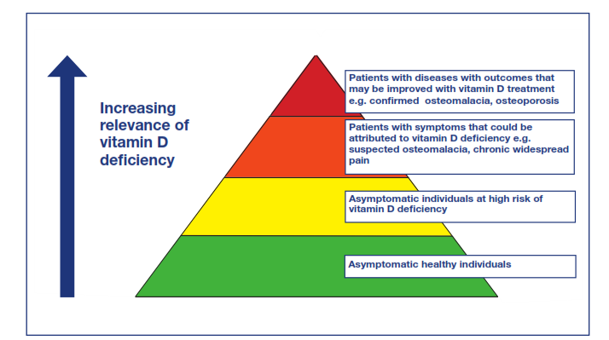
Indications of Vitamin D Testing
(with increasing relevance)
NOS : Vitamin D and Bone Health: A Practical Clinical Guideline for Patient Management

Slide 58
Q. 12: d. Various commercial firms offer total 25OHD or 25OHD3 assays. Which assay you will prefer and why?
1. Total 25-OHD will be preferred because it will measure both
25-OHD₂ that is of plant origin and is present in most pharmaceutical preparations and vitamin D fortified food
2. 25OHD₃ that is of animal origin and is synthesized in skin from cholesterol by action of sunlight and may also be present in pharmaceutical preparations
3. 25-OHD3 will only measures stored form of D3 origin and may give falsely low results in those taking D2 fortified diet or pharmaceutical preparation.

Slide 59
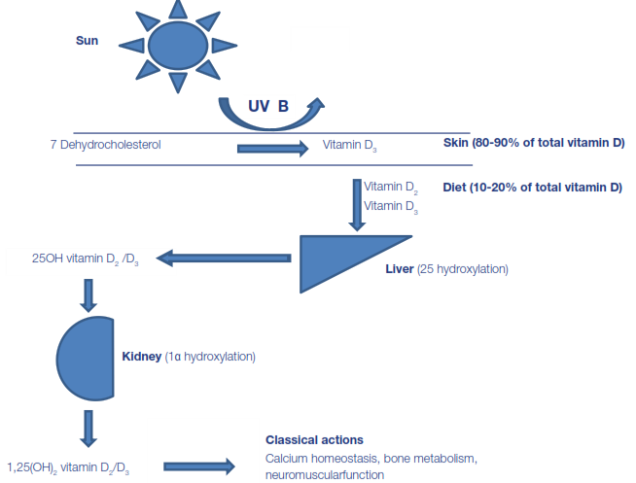
Types of Vitamin D

Slide 60
Some important points to remember about 25-(OH) D and 1,25 (OH)2 D₃:
A very useful slide courtesy of Dr Sabiha Waseem (Canada)

Slide 61
Indications of 25-(OH) D and
1,25 (OH)2 D₃ Testing
25-(OH)D is useful in evaluating hypocalcemia, diagnosis of vitamin D deficiency, differential diagnosis of causes of rickets and osteomalacia, monitoring vitamin D replacement therapy, diagnosis of hypervitaminosis D and other disorders of mineral metabolism
Metabolic form of Vit D [1,25 (OH)2 D3] is important to measure alongwith PTH and Ca when diagnosing Primary hyperparathyroidism and different types of rickets when monitoring patients with CKD when assessing patients on 1,25 (OH)₂ D₃ therapy

Slide 62
Q. 12: e. Name TWO analytical techniques which are said to be the Gold Standard for Vitamin D assay.
HPLC with uv absorption
LC- MS / MS

Slide 63
Analysis of 25OHD
Slides courtesy of Dr Fawad Sana, PNS SHIFA Karachi

Slide 64
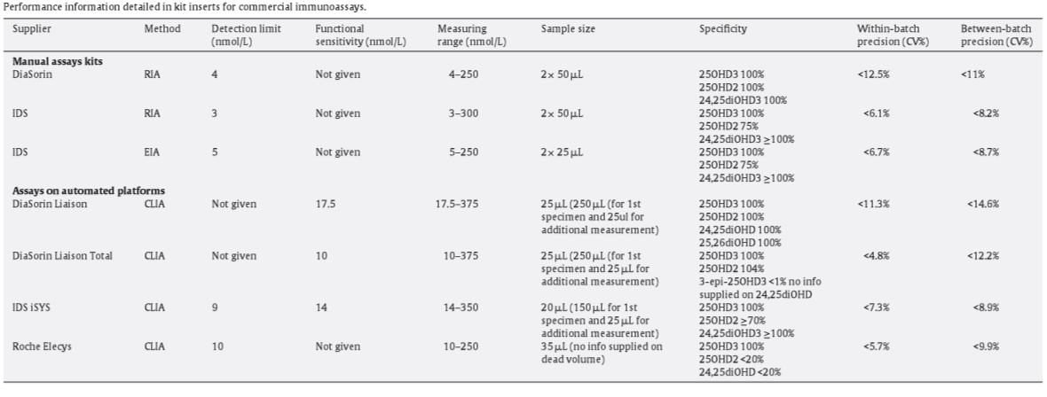

Slide 65
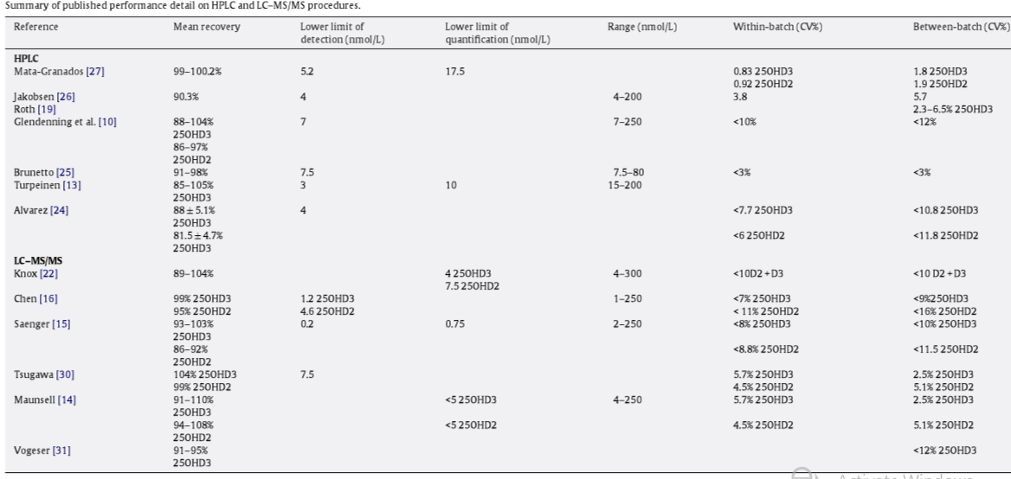

Slide 66
Thank You and Best Of Luck

