Slide 1

Pakistan Society Of Chemical Pathologists
Distance Learning Programme In Chemical Pathology
(DLP-2)
Lesson No 14
Disorders of Adrenals
By
Brig Aamir Ijaz
MCPS, FCPS, FRCP (Edin)
Professor of Pathology /
Consultant Chemical Pathologist
AFIP Rawalpindi

Slide 2
Part I
MCQs (One Best Type)

Slide 3
Q. 1 A patient is taking oral steroids for the last many weeks. Which one of the following metabolic effects is most likely to be found in this patient: a. Increased glucose-6 phosphatase b. Increased hormone sensitive lipase c. Increased nuclear factor KappaB d. Low interleukin1 e. Low liver glycogen synthase
      a. Increased glucose-6 phosphatase

Slide 4
Metabolic Effects of Cortisol through Glucocorticoid Receptors
Increased glucose-6 phosphatase: Diabetogenic effect
Decreased hormone sensitive lipase:
Increased free fatty acids
Decreased nuclear factor KappaB:
Immunosuprression
Repression of genes of interleukin1:
Immunosuprression (indirectly reducing IL-1)
Increased liver glycogen synthase
(Effect on glucose-6 phosphatase is much stronger than effect on IL-1)

Slide 5
Q 2. Mineralocorticoid receptors (MR) have affinity for many steroid hormones. Which of the following steroids DO NOT bind with MR: a. 11-deoxycorticosterone b. 18-hydroxycorticosterone c. Corticosterone d. Cortisol e. Cortisone
      e. Cortisone

Slide 6
Cortison and MR Affinity
MR have affinity with aldosterone and many other hormones leading to their mineralocorticoid effect.
Cortisone is one exception
Cortisol is converted to cortisone in normal metabolism (catobolism) of cortisol through an enzyme 11 beta hydroxysteroid dehydrogenase -2 (HSD 11B-2).
Many substances are known to suppress this enzymes and lead to hypertension e.g. Liquorice (malathi).

Slide 7
Q 3. Several cytochrome P450 (CYP) enzyme systems are involved in the biosynthesis of adrenal hormones. Which of the following enzymes is predominantly under the control of angiotensin II: a. CYP11A b. CYP11B1 c. CYP11B2 d. CYP17 e. CYP21
.
      c. CYP11B2

Slide 8
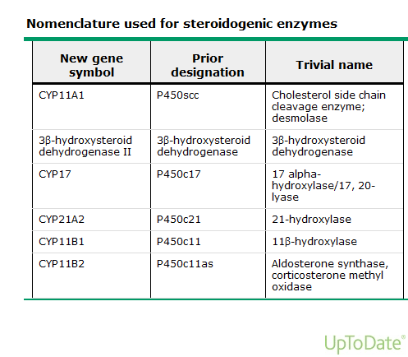

Slide 9
Q 4: A known case of Addison Disease has pigmentation on various parts of the body. The most probable hormone responsible for this pigmentation in this patient is: a. Alpha MSH b. Beta MSH c. Gamma MSH d. Increased ACTH e. Pro-gamma MSH
      d. Increased ACTH

Slide 10
Addison`s Disaese
Slides courtesy of Dr Sobia, AFIP Rwp and Dr. Sabiha Waseem, Canada

Slide 11
Pathogenesis
Primary adrenal insufficiency, also known as Addison disease, results from progressive destruction or dysfunction of the adrenal glands caused by a local disease process or systemic disorder.

Slide 12
Granulomatous disease Causing Adrenal insufficiency
Tuberculosis
Histoplasmosis
Sarcoidosis
Fungal infection
Cytomegalovirus

Slide 13
Autoimmune disease
Causing Adrenal insufficiency
Sporadic
Polyglandular autoimmune type 1(addisons disease, candidiasis, hypoparathyroidism, primary gonadal failure)
Polyglandular autoimmune type 2 (addison disease,
primary hypothyroidism, primary hypogonadism, diabetes and pernicious anemia

Slide 14
Other Causes of
Adrenal Insufficiency
Exogenous steroids
Neoplastic infiltration
Haemochromatosis
Amyloidosis
Congenital adrenal hypoplasia
ACTH resistance syndromes
HIV
Abdominal irradiation
Intraadrenal haemorrhage
Adrenoleukodystrophies
Following bilateral adrenalectomy

Slide 15
Stages in the development of autoimmune adrenalitis
Stage 1: High plasma renin activity and normal or low serum
aldosterone
Stage 2: Impaired serum cortisol response to ACTH
stimulation
Stage 3: Increased morning plasma ACTH with normal serum
cortisol
Stage 4: Low morning serum cortisol and overt clinical adrenal
insufficiency
Thus, by the time the patient has developed low serum cortisol concentrations, adrenal destruction is essentially complete

Slide 16
Clinical Presentation
Weakness & fatigue
Hyperpigmentation (face & hands)
Weight loss
Anorexia
Nausea &vomiting
Hypotension
Hyperpigmentation (mucosa)
Dizziness
Muscle & joint pain
Emotional instability
Salt craving

Slide 17
Clinical Diagnosis of Adrenal Insufficiency
Confirmation of the clinical diagnosis of adrenal insufficiency is a three-stage process
1. Demonstrating inappropriately low cortisol secretion
2. Determining whether the cortisol deficiency is dependent on
or independent of ACTH deficiency and evaluating
mineralocorticoid secretion in patients without ACTH
deficiency
3. Seeking a treatable cause of the primary disorder (eg,
histoplasmosis involving the adrenal glands or a pituitary
adenoma compromising normal pituitary function)

Slide 18
Routine investigations:
Blood complete picture:
Neutropenia
Relative lymphocytosis
Eosinophilia
Mild anaemia
Serum electrolytes:
Hyperkalaemia
Hyponatraemia
Hypercalcaemia
Others
Raised serum urea, creatinine
Hypoglycaemia
Metabolic acidosis

Slide 19
First line Hormone Tests
Plasma ACTH assay [morning around 0800 (0600 -1000h )
Serum Cortisol With normal wake sleep cycle]
A morning serum cortisol greater than (500nmol/L) 18 mcg/dL(if increased CBG levels are not suspected) excludes diagnosis of adrenal insufficiency, then no further testing is required.
Basal plasma ACTH concentrations >I50 pg/mL with serum cortisol concentrations <10 pg/dL (276nmol/L) are diagnostic of adrenal insufficiency

Slide 20
ACTH Stimulation Tests:
Short synacthen test (low dose, 1µg i/v)
Short synacthen test (250µg)
Long synacthen test (1 mg i/m)
Low dose test (1 mcg) — The low-dose (1 mcg as an IV bolus) ACTH stimulation test criteria for a normal cortisol response after 20 or 30 minutes 400 to 620 nmol/L

Slide 21
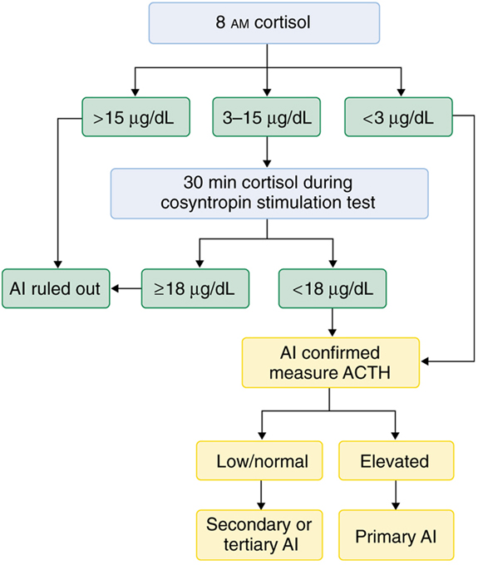
Diagnosis of Adrenal Insufficiency
Notes:
Adapted from http://www.clevelandclinicmeded.com/medicalpubs/diseasemanagement/endocrinology/diseases-of-the-adrenal-gland/

Slide 22
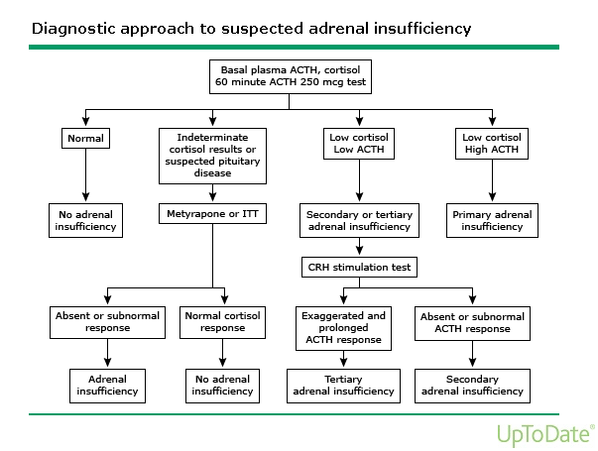

Slide 23
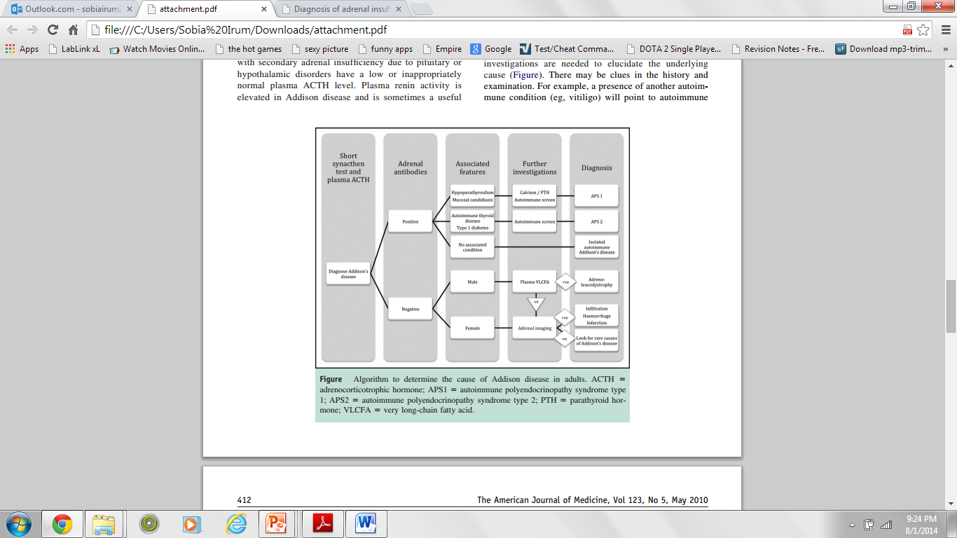

Slide 24
Q 5: A 7 years girl is being investigated for premature adenarche. Which of the following hormones is the best marker of this condition? a. 17 Hydroxyprogesterone b. Androstendione c. Cortisol d. DHEA-S e. Testosterone
      d. DHEA-S

Slide 25
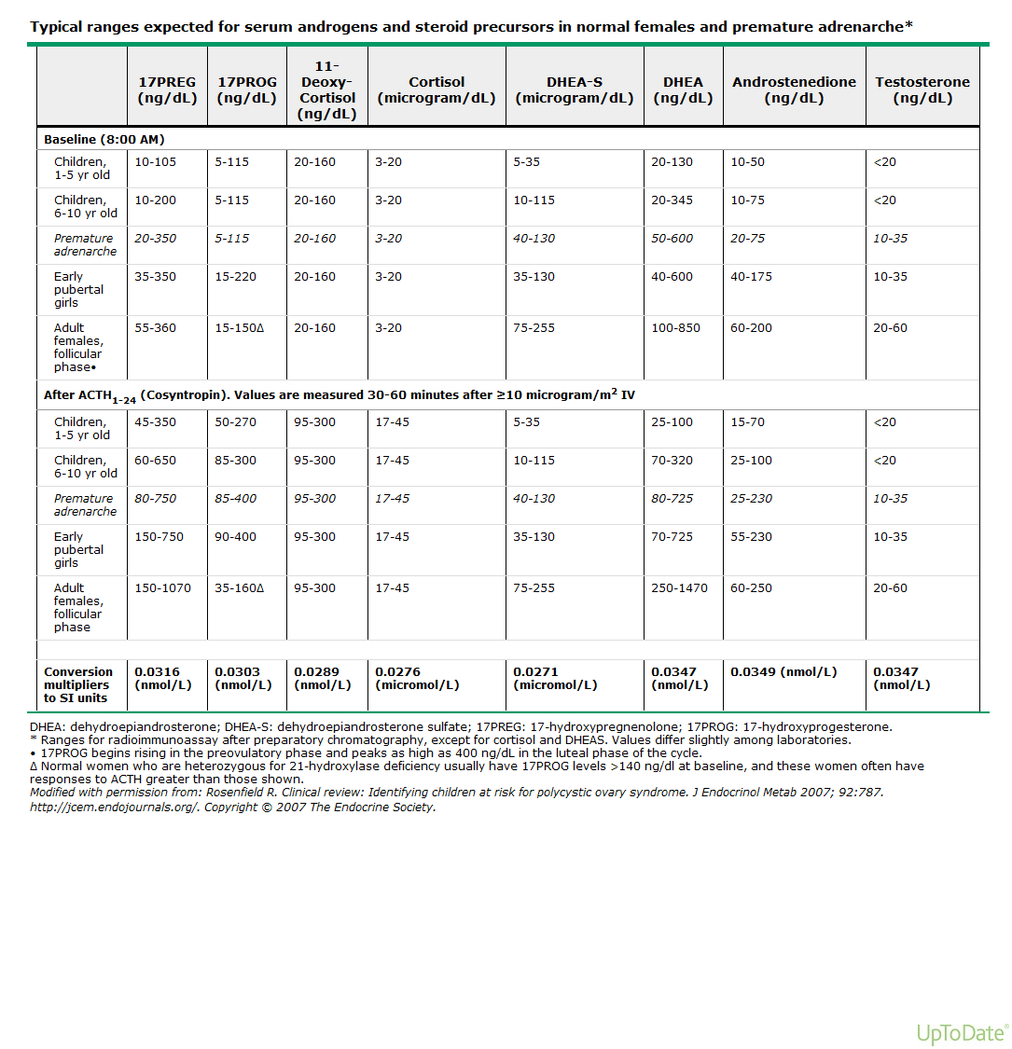

Slide 26
Q 6 : A newborn is suspected of Congenital Adrenal Hyperplasia, which of the following hormones/metabolites will be in the highest concentration in urine of this baby. a. 17 hydroxypregnennolone b. 17 hydroxyprogesterone c. 17 ketogenic steroids d. DHEA-S e. Pregnenolone
      c. 17 ketogenic steroids

Slide 27
Q 7: There are many clinical conditions outside adrenal-pituitary-hypothalamus axis causing hypercortisolism, also called ‘Pseudo-Cushing's Syndrome’. Which of the following is the most important biochemical findings to distinguish actual Cushing Syndrome from ‘Pseudo-Cushing's Syndrome’: a. Increased Cortisol Binding Globulins (CBGs) b. Increased late evening serum cortisol c. Increased morning salivary cortisol d. Increased morning serum cortisol e. Urinary free cortisol just above the reference range
      b. Increased late evening serum cortisol

Slide 28
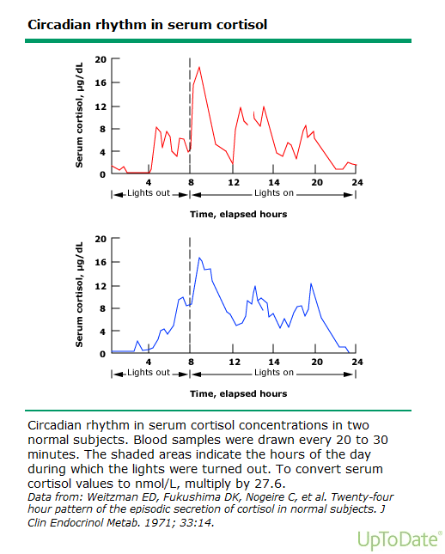

Slide 29
Cushing’s syndrome
Slides courtesy of Dr Qurat-Ul-Ain, AFIP Rwp

Slide 30
Frequency of causes of Cushing's syndrome
Exogenous cause
  Most common cause is Iatrogenic Cushing's due to administration of oral, parentral, topical or inhaled glucocorticoids
Endogenous causes Percent of patients
ACTH-dependent Cushing's syndrome
  Cushing's disease 68%
  Ectopic ACTH syndrome 12%
  Ectopic CRH syndrome <<1%
ACTH-independent Cushing's syndrome
  Adrenal adenoma 10%
  Adrenal carcinoma 8%
  Micronodular hyperplasia 1%
  Macronodular hyperplasia <<1%

Slide 31
Physiological hypercortisolism
Pseudocushing syndrome
Hypercortisolism with some features of cushing’s | Hypercortisolism without any clinical feature of cushing’s
Psychological stress e.g. severe depression | Physical stress e.g. severe bacterial infection, major surgery
Morbid obesity | Malnutrition, anorexia nervosa
Chronic alcoholism | Intense chronic exercise
Pregnancy | Hypothalamic amenorrhea
Glucocorticoid resistance | CBG excess (increased serum but not urine cortisol)
Poorly controlled diabetes mellitus

Slide 32
Clinical Manifestations
Most Specific Nonspecific
Spontaneous Bruising Proximal Myopathy Abdominal striae weight gain with decreasing growth velocity in children | Central obesity with extremity wasting Dorsocervical fat pads (“Buffalo Hump” Round facies (“Moon Face”) | DM HTN Obesity Oligomenorrhea Osteoporosis | Depression Insomnia Psychosis Impaired Cognition Hirsutism Fungal Skin Infections Nephrolithiasis Polyuria

Slide 33
Establishing the diagnosis of Cushing's syndrome
Exclude excessive exogenous glucocorticoid exposure first leading to Iatrogenic Cushing's syndrome
Initial testing with first line tests
  Urine free cortisol (UFC; at least two measurements)
  Late-night salivary cortisol (two measurements)
  1-mg overnight dexamethasone suppression test (DST)
  Longer low-dose DST (LDDST- 2 mg/d for 48 h)
At least two first-line tests should be abnormal to establish the diagnosis of Cushing's syndrome
Additional tests If the results of first line tests are equivocal
  48-h, 2 mg/d LDDST WITH CRH test
  Midnight serum cortisol test
  Desmopressin stimulation test

Slide 34
Determining the cause of Cushing's syndrome
Biochemical tests
Plasma ACTH level (0800 h)
High dose overnight dexamethasone suppression test (HDST)
CRH stimulation test with IPS venous sampling
Ratio of ACTH in IPS vein to peripheral vein
Radiological investigations
  ACTH dependent Cushing's syndrome
    CT/MRI of pituitary gland
    CT/MRI of other location with suspicion of ectopic hormone production
  ACTH independent Cushing's syndrome
    CT/MRI of adrenal gland

Slide 35
Determining the cause of Cushing's syndrome

Slide 36
Q 8: A 72 year female, who has ‘Cushingoid features’ has just got her Serum Cortisol report from your lab, showing high serum cortisol. But the most puzzling part of the story is that she is on some steroids preparation, the exact nature of which she does not know (probably not supposed to know, too). Which of the following preparations of steroid can produce such clinical situation: a. Beclometasone b. Dexamethasone c. Fludrocortisone d. Hydrocortisone e. Prednisolone
      d. Hydrocortisone

Slide 37
Q 9: A 32 year male was admitted in a tertiary care hospital with an attack of profuse sweating, tachycardia, headache and hypertension (BP: 210/145 mmHg). His routine investigations (serum urea, creatinine, electrolytes, LFTs, Uric Acid and X-Ray Chest and ECG) were carried out during the next 2 days but all of them were within normal limits. His BP also became markedly reduced after 36 hours (125/90mmHg). Which of the following urine tests will be most helpful in reaching / excluding a diagnosis in this patient? a. 17-hydroxycorticosteroids b. 5-Hydroxyindoleacetic acid c. Free cortisol d. Metanephrines e. Vanillylmandelic acid
      d. Metanephrines

Slide 38
Pheochromocytoma
Slides courtesy by Dr Majid Latif AFIP Rwp

Slide 39
Epidemiology
Catecholamine producing tumors that derive from chromaffin cells of adrenal medulla are called pheochromocytomas.
Most pheochromocytomas are benign. Only 10-15% are malignant
About 10% pheochromocytomas are found in the extra- medullary tissue where they are called paraganglionomas.
About 10% patients with pheochromocytomas may have multiple tumors . These tumors may be part of MEN2a or MENb

Slide 40
Presentation
Tumors are usually suspected because of signs and symptoms of catecholamine excess i.e. hypertension, palpitations, headache, excessive sweatiness
May present as incidental finding of an adrenal mass during imaging procedures

Slide 41
Screening and Diagnosis
Screening
Measurement of excess urinary VMA or metanephrines (metepinephrine and normetepinephrine)
Diagnosis
Diagnosis is based on measurement of urinary or plasma catecholamines
The measurement of plasma or urine fractionated metanephrines provides a more reliable diagnostic tests because the secretion of catecholamines from the tumor is episodic but metabolism to metanephrines within the tumor is continuous

Slide 42
Pentolinium Test
Additional investigations are rarely necessary but when the results of catecholamines are equivocal, pentolinium test may be useful
Pentolinium is a sympathetic ganglion blocking drug that reduces catecholamine secretion in normal subjects but not in patients with pheochromocytomas, in such patients secretion is autonomous.
Blood is taken for catecholamine measurements before and 15 min after giving 2.5mg pentolinium i.v.

Slide 43
Collection and Storage of Samples For Catecholamines
Urine samples are best preserved by adding HCl to maintain the urine acid.
For longer storage aliquotes are best kept frozen at -80 C to minimize auto-oxidation and deconjugation
Blood samples are best collected into tubes containing heparin or EDTA and stored on ice before centrifugation at 4 C for separation of plasma for further storage at -80 C
Interferences
Constituents of a number of common foods such as bananas, vanilla, tea, coffee can interfere with the the assay for VMA and should be restricted 3-4 days before and during urine collection

Slide 44
Q 10: A patient has been referred to you by your Radiologist colleague with an MRI report of an ‘adrenal incidentaloma’. Which of the following hormonal tests will be most helpful in this patient: a. ACTH stimulation test b. Overnight one mg dexamethasone test c. Plasma epinephrine levels d. Plasma renin levels e. Serum DHEA-S level
      b. Overnight one mg dexamethasone test

Slide 45
Part I
Short Answer Questions:

Slide 46
Q. 11: As a newly appointed Consultant Chemical Pathologist of a modern Middle East Hospital, you have been given the task to establish an “Adrenal Clinic” in collaboration with the Endocrinologists. Please answer following questions in this scenario (one mark each): a. What should be first test(s) to be performed in a patient of Adrenal Insufficiency during the initial visit of the patient? b. What should be the time of sample collection for Adrenal Insufficiency and Cushing Syndrome? (0.5 mark each) c. Will you like to include Plasma CRH levels in the investigation of Adrenal-Pituitary-Hypothalamus axis? Please give ONE reason of your answer. d. Name THREE most important causes of ‘Pseudo-Cushing's Syndrome’ you will like to note in a patient before starting lab investigations of Cushing Syndrome. e. What are THREE first line tests to be done in a suspected patient of Cushing Syndrome? f. Write THREE precautions you will like to include in your SOP for “Sample Collection of ACTH”. g. Why plasma ACTH level may not correctly measure “Ectopic ACTH” and what is the solution of this problem?

Slide 47
a. What should be first test(s) to be performed in a patient of Adrenal Insufficiency during the initial visit of the patient?
Simultaneous measurement of serum cortisol and plasma ACTH at 0800 h (range: 6-10 am) in chronic adrenal insufficiency cases.
In acute adrenal insufficiency sample for both analytes are taken at time of presentation before starting treatment

Slide 48
b. What should be the time of sample collection for Adrenal Insufficiency and Cushing Syndrome?
For adrenal insufficiency – in the morning at 0800 h (range: 6-10 am)
For Cushing syndrome – late evening sample 1 h after usual time of sleep

Slide 49
c. Will you like to include Plasma CRH levels in the investigation of Adrenal-Pituitary-Hypothalamus axis? Please give ONE reason of your answer.
No. I will not include Plasma CRH levels in the investigation of Adrenal-Pituitary-Hypothalamus axis
The concentrations of CRH is much lower and do not correlate well with those in the hypothalamic-hypophysial portal plasma.
CRH is also contributed from non-hypothalamic sources (e.g. the gastrointestinal tract).

Slide 50
d. Name THREE most important causes of ‘Pseudo-Cushing's Syndrome’ you will like to note in a patient before starting lab investigations of Cushing Syndrome.
Physical stress like severe bacterial infection or other systemic illness
Psychiatric conditions such as depression, panic disorders and psychotic conditions
Severe obesity
Alcoholism

Slide 51
e. What are THREE first line tests to be done in a suspected patient of Cushing Syndrome?
24 h urinary free cortisol (UFC)
Late night salivary cortisol
1mg Overnight Dexamethasone suppression test

Slide 52
f. Write THREE precautions you will like to include in your SOP for “Sample Collection of ACTH”.
ACTH blood samples should be drawn into plastic tubes with EDTA & it should reach the lab within 30 min of specimen collection.
Sample should be kept on ice until centrifugation, separation, and freezing of the plasma sample.
Refrigerated centrifuge should be used for separation of plasma
Sample must be drawn before initiating glucocorticoid therapy or, in patients already being treated or at least 24 hours after the last dose of a short-acting glucocorticoid & even longer after long-acting glucocorticoids

Slide 53
g. Why plasma ACTH level may not correctly measure “Ectopic ACTH” and what is the solution of this problem?
In ectopic ACTH production, immunoreactive ACTH is present in form of incompletely processed or unprocessed POMC in circulation but the monoclonal or affinity-purified polyclonal antibodies used in two-site sandwich ACTH immunoassay do not react with POMC resulting in falsely decreased levels of ACTH.
POMC immunoassay can be used for accurate POMC measurement.

Slide 54
Q. 12: Let`s suppose your ‘Adrenal Clinic’ is now functional in the Middle-East. Once a few months you are referred a ‘difficult case’ for the diagnosis. Three of such cases are given below which may or may not involve some complicated metabolic defect (one mark each):
(Please see next slides for questions and answers)

Slide 55
  Q.12 a: A male (46,XY) neonate presents with feeding difficulties and vomiting. His electrolyte report shows hyponatremia, and hyperkalemia. His external genitalia are nearly like a normal female but with blind vagina. His hormonal profile showed:
Cortisol : Mildly decreased
Serum Progesterone: Low
Serum Pregnenolone: High
Serum 17-hydroxypregnenolone: High
Serum DHEA-S : High
Serum androstenedione : Low
Testosterone and estradiol: Lower than pre-pubertal levels
What is the most probable biochemical defect in this patient?
  Answer: 3 β hydroxysteroid dehydrogenase deficiency due to following findings
  Clinical Findings
  Early presentation in neonatal or infancy in most cases
  Genotypic male with female like external genitalia (male pseudohermaphroditism)
  Feeding difficulties and vomiting
  Biochemical findings – typical presentation with deficiency of all hormones of adrenal cortex; glucocorticoid, mineralocorticoid and androgens
  o Hyponatremia and hyperkalemia due to cortisol and aldosterone deficiency
  o Decreased serum cortisol results in activation of HPA axis
  o Substrate for 3 β hydroxysteroid dehydrogenase enzyme i.e. serum pregnanolone, 17-OH pregnanolone and DHEA are increased due to enzyme deficiency
  o Low levels of serum progesterone, androstenedione and sex steroid also revealed deficiency of same enzyme as these are formed by action of 3 β hydroxysteroid dehydrogenase.

Slide 56
  Q.12b: A 13 year female (46,XX) patient presented with primary amenorrhea and absent secondary sexual characteristics. She has hypertension (BP: 170/130 mm Hg). Her routine biochemical profile carried out at multiple occasions sometimes indicated hypokalaemia. Her hormonal profile showed:
Cortisol : Mildly decreased
Serum Progesterone: High
11-deoxycorticosterone: High
11-deoxycortisol: Low
DHEA-S and androstenedione : Low
Testosterone and estradiol: Low
Plasma renin: Low
What is the most probable biochemical defect in this patient?
  Answer: • 17 α hydroxylase deficiency due to following
  Clinical findings
  Female with typical presentation at puberty with hypogonadism (absent puberty), hypertension and hypokalemia
  Biochemical findings
  Decreased cortisol and its precursors (11 deoxycortisol) and decreased adrenal androgens and sex steroids are typical biochemical findings of 17 α hydroxylase deficiency.
  Decreased serum cortisol results in activation of HPA axis
  Substrate for 17 α hydroxylase i.e. serum progesterone is high with increased formation of 11 deoxycorticosterone
  As 11 deoxycorticosterone has mineralocorticoid activity, it results in suppression of rennin thus low plasma renin and serum aldosterone levels

Slide 57
Congenital Adrenal Hyperplasia
Some slides courtesy by Dr Nudrat Fayyaz, QAMC Bwp

Slide 58
Definition
Congenital adrenal hyperplasia (CAH) refers to any of several autosomal recessive disorders resulting from mutations of genes for enzymes mediating the biochemical steps of production of cortisol from cholesterol by the adrenal glands

Slide 59
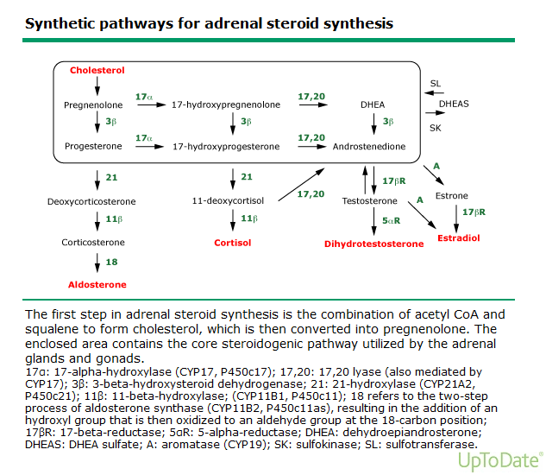

Slide 60
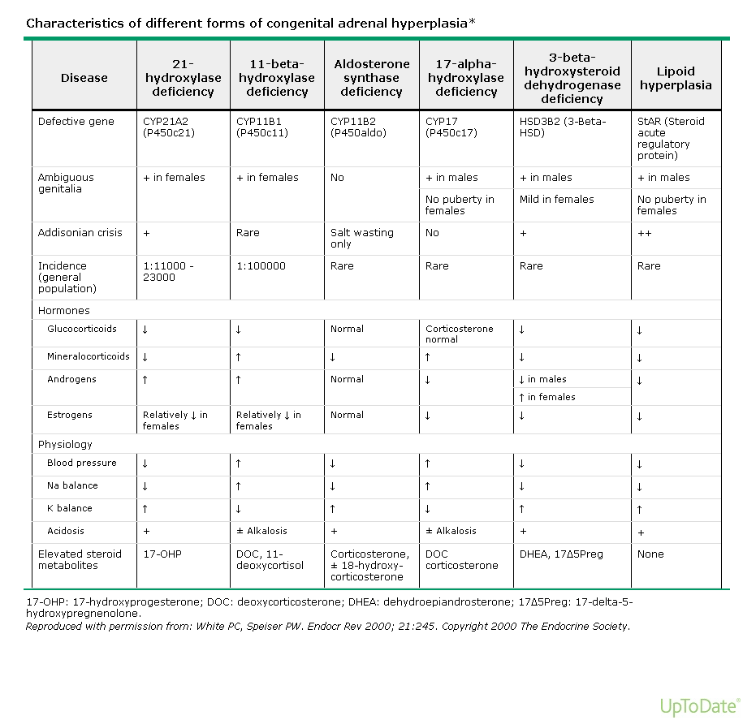

Slide 61
Congenital Lipoid Adrenal Hyperplasia
Absence of Steroidogenesis
Accumulation of Cholesterol in Adrenal Cells
Incompatible with life

Slide 62
Lab Studies
In classic 21-hydroxylase deficiency, laboratory studies will show very high concentrations of 17-hydroxyprogesterone (greater than 242 nmol/L in random blood sample; with the normal being less than 3 nmol/L at 3 days age in a full-term infant).
Salt-wasting patients tend to have higher 17-hydroxyprogesterone levels than non-salt-wasting patients

Slide 63
  Q.12c: A 55 years female being investigated for Cushing Syndrome has following lab results:
Serum Cortisol in overnight 1 mg dexamethasone suppression test: 35 nmol/L (Normal Cut-off value: <50 nmol/L)
Urine free cortisol: 230 nmol/day (ref range: 27 to 150)
What TWO questions you will like to ask from the patient to explain the result. Please note that altered CBG and ‘Pseudo-Cushing's Syndrome’ have already been ruled out in this patient
  Answer:
  History of intake of water more than 5L/day.
  Application of vulvovaginal hydrocortisone.

Slide 64
Thank You and Best Of Luck

