Slide 1
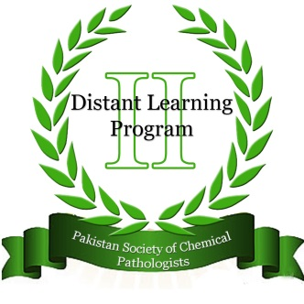
Pakistan Society Of Chemical Pathologists
Distance Learning Programme In Chemical Pathology
(DLP-2)
Lesson No 20
Biochemical GeneticsBy
By
Prof (Brig) Aamir Ijaz
Consultant Chemical Pathologist / Prof of Pathology,
AFIP Rawalpindi

Slide 2
Acknowledgement
We are thankful for value contributions in this presentation from following participants of DLP-2:
Dr. Asma Naseer Cheema
Assist Prof Chemical Pathology
AJK Medical College, Muzzaffarabad
Dr Zujaja Hina Haroon
Consultant Chemical Pathologist
AFIP Rawalpindi
Dr Sajida Shaheen,
Consultant Chemical Pathologist, PNS RAHAT Karachi
Dr Sabiha Waseem , Canada

Slide 3
Part I
MCQs (One Best Type)

Slide 4
Q.1: Human genome is contained in 23 pairs of homologous chromosomes. How many molecules of DNA are present in one human chromosome?
a. 23 billion
b. 3.2 billion
c. Four million
d. One
e. One billion
d. One

Slide 5
DNA Molecule
One chromosome contains one DNA molecule!!!
It’s a giant anion
DNA from a single cell measures approximately 2 meters in length

Slide 6
Human DNA
• Diploid genome (two sets of chromosomes)
• Packaged in 23 pairs of chromosomes
• 22 homologous pairs (autosomes)
• 2 sex chromosomes (XX or XY)
• 6 billion bases
• 50,000–100,000 genes

Slide 7
Human DNA
• Less than 10% codes for protein
• Heterochromatin: densely packed region of chromosomes (centromeres), not transcribed
• Euchromatin: less densely packed, transcribed regions
• Approximately 75% of the genome is unique or single copy

Slide 8
Q 2. The famous discovery of “The Double Helix” by Watson and Crick pertained to which part of the chromatin:
a. Chromatin loop
b. DNA string winding the histone octamers
c. Leading strand of DNA
d. Linker DNA
e. Whole DNA string
      e. Whole DNA string

Slide 9
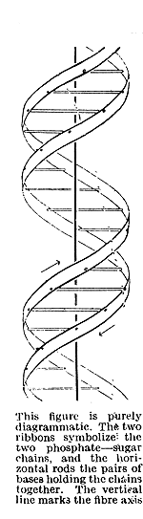
The Structure of DNA
The original structure of DNA proposed by Watson and Crick in their 1953 paper (Nature 171:737)

Slide 10
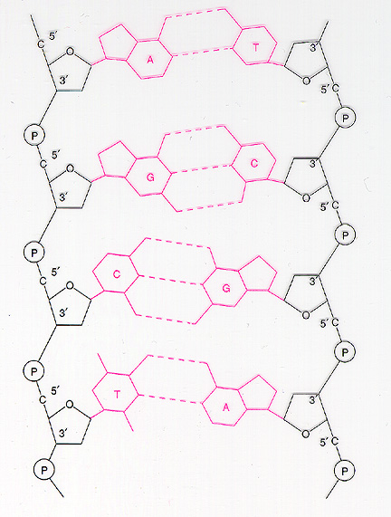
DNA
DNA has a double helix structure which composed of
  sugar molecule
  phosphate group
  and a base (A,C,G,T)
DNA always reads from 5’ end to 3’ end for transcription and replication
  5’ ATTTAGGCC 3’
  3’ TAAATCCGG 5’

Slide 11

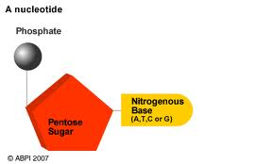
Sugar +Base = nucleoside
nucleoside
Phosphate+ sugar + Base = nucleotide

Slide 12
DNA Structure
• Consists of a pair of antiparallel strands
(5´ → 3´ and 3´ → 5´)
• Alternating deoxyribose and phosphate groups
• Covalent linkage by phosphodiester bonds
• Strands held together by hydrogen bonds

Slide 13
Components of DNA Structure
Nitrogenous Bases
4
Pyrimidines
  – 6-member ring
  – cytosine, thymine, uracil
Purines
  – fused 5- and 6-member rings
  – adenine, guanine
3
N
5
6
2
N
1
6
7
N
1
N
5
8
4
N
2
9
N
3

Slide 14
Nitrogenous Bases
NH₂
O
O
4
4
5
N
5
CH₃
N
3
3
U
C
4
5
N
2
6
3
T
2
6
1
1
N
O
N
O
2
6
1
O
N
NH₂
O
N
N
6
7
N
5
6
5
7
1
N
A
G
8
1
8
9
4
N
9
2
4
N
2
3
3
N
N
NH₂

Slide 15
Pentose Sugars
2-Deoxyribose
Ribose
CH₂OH
OH
CH₂OH
OH
5
O
5
O
C
1
C
1
4
C
4
C
H
H
H
C
C
H
C
C
2
2
3
3
OH
H
OH
OH
DNA
No hydroxyl
RNA

Slide 16
Polynucleotide Chain
NH₂
5´
O
O
N
4
5
3
C
Nucleotide base
P
O
O
2
1
6
O
N
CH₂
5
O
C
4
C
1
Sugar-phosphate
backbone
H
H
C
C
2
3
H
O
O
P
O
O
3´

Slide 17
Difference between RNA & DNA
RNA | DNA
RNA nucleotides contain ribose sugar | DNA contains deoxyribose
RNA has the base uracil | DNA has the base thymine
presence of a hydroxyl group at the 2' position of the ribose sugar. | Lacks of a hydroxyl group at the 2' position of the ribose sugar.
RNA is usually single-stranded | DNA is usually double-stranded

Slide 18
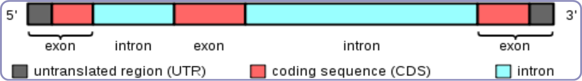
Gene Structure
Most of the genes consist of; short coding sequences or exons are interrupted by a longer intervening noncoding sequence or introns; although a few genes in the human genome have no introns.

Slide 19
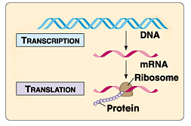
DNA function
Carries the blueprint for life
Duplication for new cells
Make proteins for biological functions:

Slide 20
comparative genome sizes of organisms
organism | Size (bp) | gene number | average gene density | chromosome number
Homo sapiens (human) | 3.2 billion | ~25,000 | 1 gene /100,000 bases | 46
Mus musculus (mouse) | 2.6 billion | ~25,000 | 1 gene /100,000 bases | 40
Drosophila melanogaster (fruit fly) | 137 million | 13,000 | 1 gene / 9,000 bases | 8
Arabidopsis thaliana (plant) | 100 million | 25,000 | 1 gene / 4000 bases | 10
Caenorhabditis elegans (roundworm) | 97 million | 19,000 | 1 gene / 5000 bases | 12
Saccharomyces cerevisiae (yeast) | 12.1 million | 6000 | 1 gene / 2000 bases | 32
Escherichia coli (bacteria) | 4.6 million | 3200 | 1 gene / 1400 bases | 1
H. influenzae (bacteria) | 1.8 million | 1700 | 1 gene /1000 bases | 1

Slide 21
Molecular Diagnostics
“Molecular diagnostics” deals with the detection and/or analysis of nucleic acid molecules (DNA or RNA) to provide clinical information.
It is the Study of gene structure and function at the molecular level.

Slide 22
Application of Molecular Diagnostics
  Research
  Diagnosis
  Transplantation
  Paternity
  Forensic analysis
  Gene therapy
  Drug Design
  ……

Slide 23
Some Terminology
Genome: an organism’s genetic material
Gene: a discrete units of hereditary information located on the chromosomes and consisting of DNA.
Genotype: The genetic makeup of an organism
Phenotype: the physical expressed traits of an organism
Nucleic acid: Biological molecules(RNA and DNA) that allow organisms to reproduce;

Slide 24
Prenatal diagnosis
Amniocentesis:12 - 14 weeks of gestation fetal cells from amniotic fluid is drawn off..
Chorionic villus sampling: 9-10 gestation, placental tissue aspirated via the cervix,
A single cell from an 8 cell stage embryo can be examined directly - used to decide on which embryo to reintroduce into the mother.

Slide 25
Q. 3: The basic units of chromatin are nucleosomes which in turn are made of a single nucleosome core particle and linker DNA. The linker DNA in a chromatin is related to which of the following histones:
a. H1
b. H2A
c. H2B
d. H3
e. H4
      a. H1

Slide 26
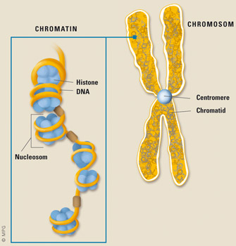
Chemical composition of chromosome:
DNA
Protein
A significant amount of RNA is also associated with chromosome because these are the sites of RNA synthesis.

Slide 27
Chromatin
Chromatin, under the microscope in its extended form, looks like beads on a string (Tasbeeh).
These beads called nucleosomes are the basic unit of chromosome or chromatin fiber.
Each nucleosome is composed of DNA wrapped around eight histone proteins, functions like a spool and called a histone octamer.
Nucleosomes are repeated after every 200 hundred nucleotides.
Positively charged histones are linked with negative charged phosphate groups of DNA.
The histone cores thus act as magnetic forms that promote and guides the coiling of DNA.

Slide 28
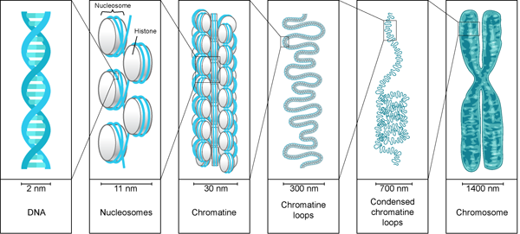

Slide 29
Classes of Histones
Core Histones
Linker Histones
In core histones following families are included
H2A
H2B
H3
H4
Two of each of these core histone proteins assembles to form one octameric nucleosome core particle, and 147 base pairs of DNA wrap around this core particle.
Linker histone included:
H1
H5
The linker histone protein H1 binds the nucleosome at the starting and ending sites of the DNA, thus locking the DNA into place and help in the formation of higher order structure.
H5 histones are individual proteins involve in the packaging of specific region of DNA

Slide 30
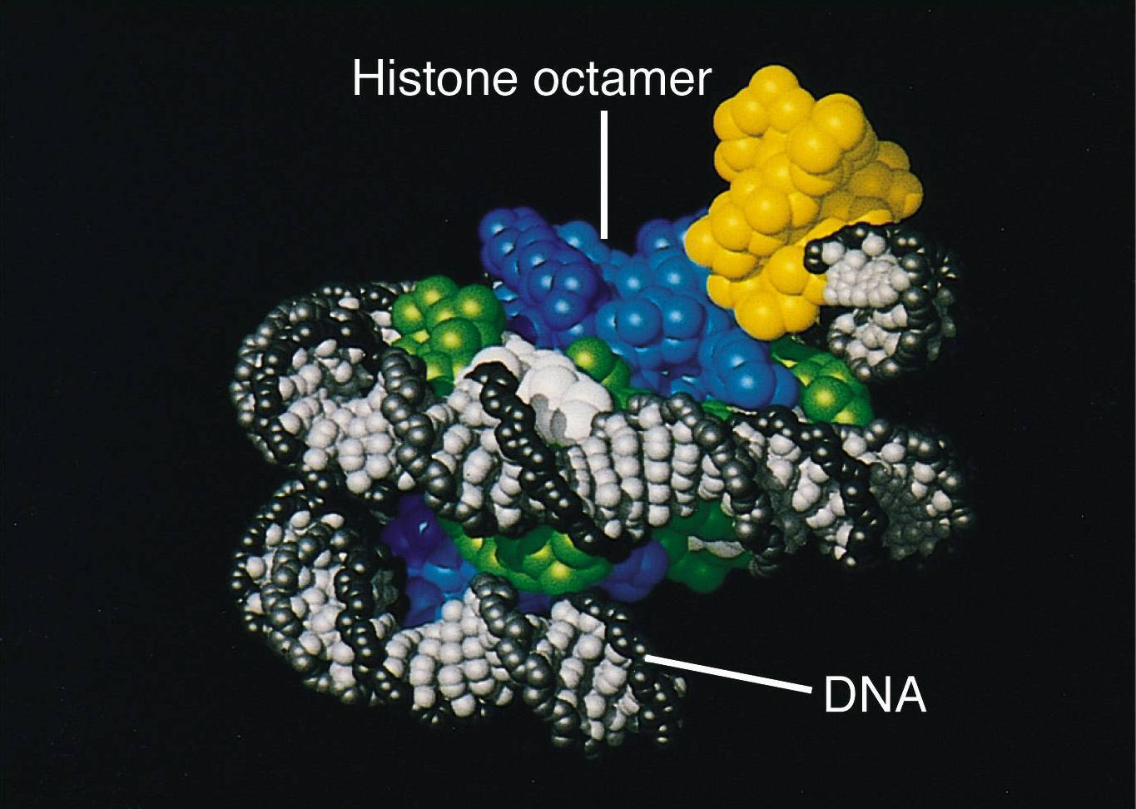

Slide 31
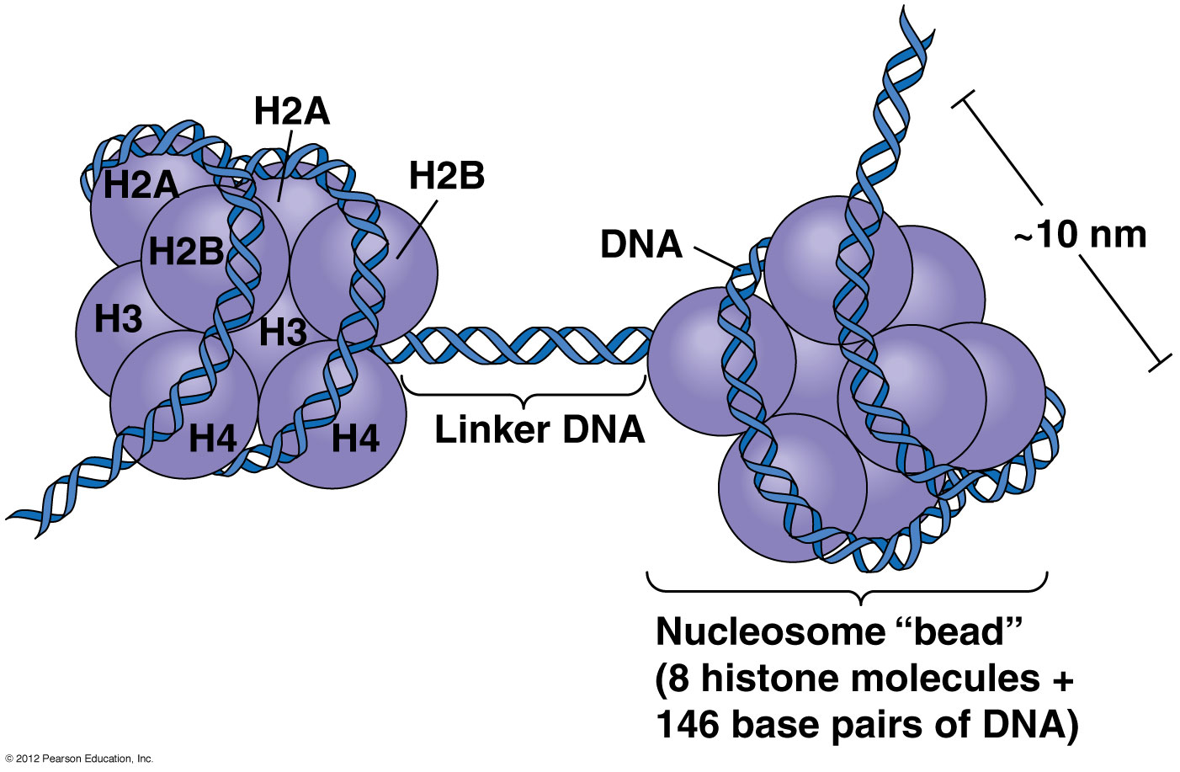
Each histone octamer is made of two copies each of the histone proteins H3, H4, H2A, and H2B.

Slide 32
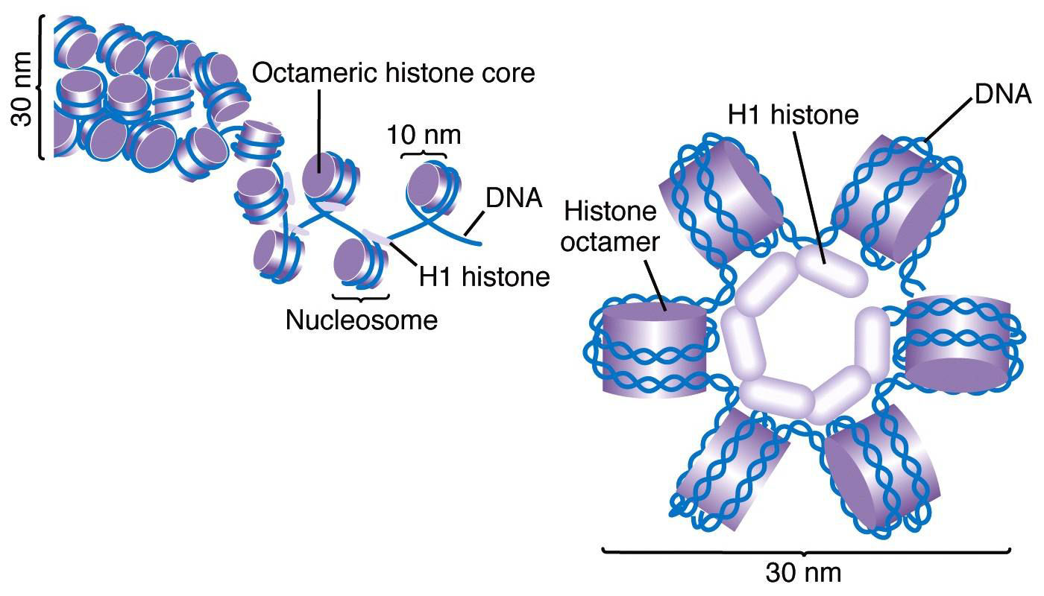
The nucleosomes are then wrapped, into a 30 nm spiral, called a solenoid, where additional H1 histones are associated with each nucleosome to maintain the chromosomal structure. In fact, histone proteins could act as gatekeepers to the DNA, determining which portions of the DNA were available for protein expression

Slide 33
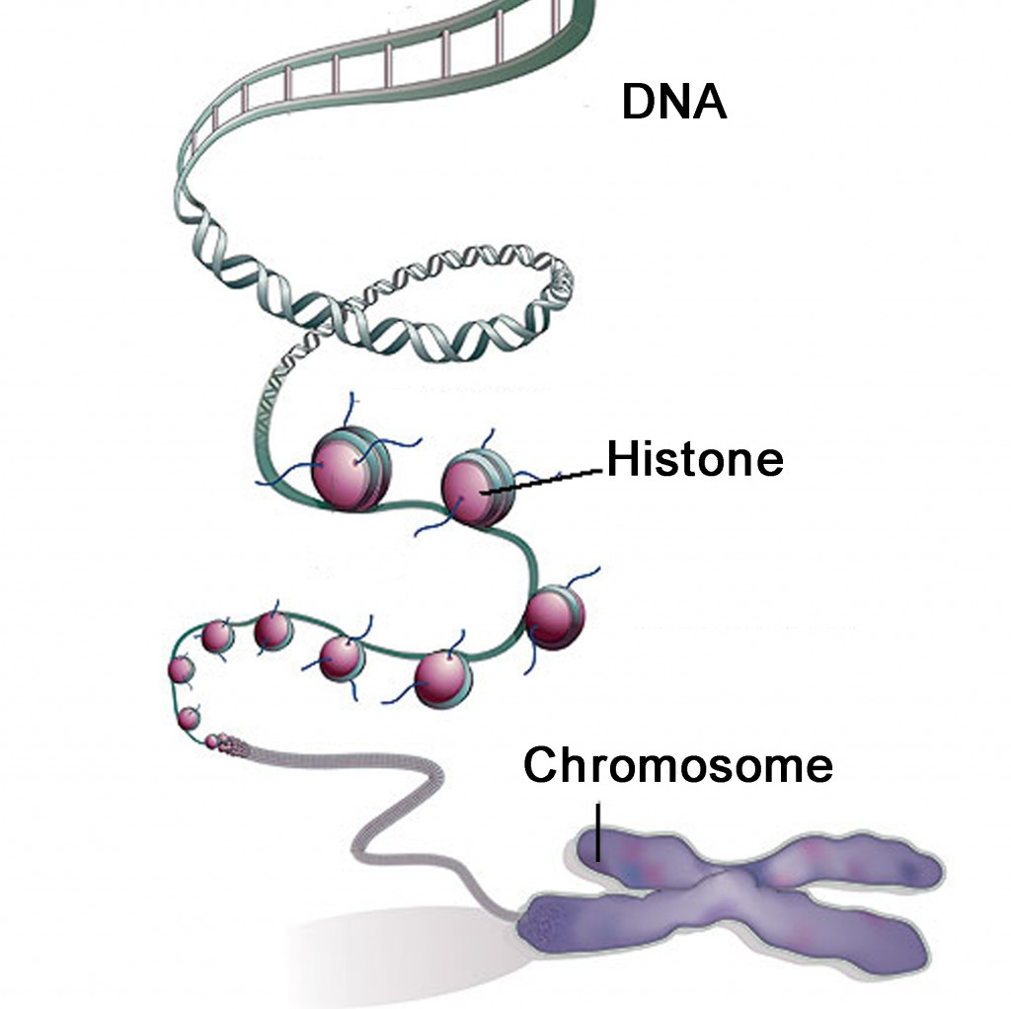

Slide 34
Q.4: The ‘gene’ is essentially defined as a functional product of the genome and its associated regulatory regions. Promoter of the gene, being an important regulator, lies at which of the following position of the gene:
a. At any site in the genome
b. Distant from protein-coding region
c. Immediately 5′ (5 prime) to the start of protein coding sequence
d. Immediately 3′ (3 prime) to the end of protein coding sequence
e. Within the protein-coding region
      a. At any site in the genome

Slide 35
Promoter Regions
Previously it was thought these regions are present only at 5′ side of the protein coding regions
But now these regions have been found at 3′ sides, insides protein-coding regions or even away from theprotein coding region
One promoter may regulate more than one gene
So the very concept of an independent ‘gene’ unit is now staggering

Slide 36
Q: 5. Somatic cell nuclei and germ cell nuclei differ in their enzyme content. Which of the following enzymes make the germ cell “immortal” :
a. DNA Polymerase
b. Endonuclease
c. Ligase
d. RNA Polymerase
e. Telomerase
      e. Telomerase

Slide 37
Telomerase
Telomerase enzyme protects the ends of the DNA strands called ‘telomers’.
In germ cells higher concentrations of telomerase protects these cells from aging, therefore, making them ‘immortal’
With aging there is attrition of telomers in all other tissues

Slide 38
Q. 6: Stop codons present in mRNA signal the end of a growing polypeptide chain but some stop codons have also been associated with amino acid translation in living organisms. Which of the following codons is purely a stop codon:
a. UAA
b. UAG
c. UGA
d. UUG
e. UUU
      a. UAA

Slide 39
Stop Codons of mRNA
Previously three codons were considered acting as only stop codons
UAG and UGA are now known as codons for some amino acids

Slide 40
Q. 7: Maturation of messenger RNA (mRNA), once it is formed as a result of transcription process, involves all of the following phenomena EXCEPT:
a. Addition of 7-methylguanosine at 5′ end
b. Addition of multiple adenine bases at 3′ end
c. Intron splicing
d. Joining of the adjacent exons
e. Pre-initiation complex formation
      e. Pre-initiation complex formation

Slide 41
Maturation of Messenger RNA
Please watch educations videos at following links:
http://www.tv2t.com/watch/3m7sraBh9z4/exons-and-introns-melissa-moore-u-masshhmi.html

Slide 42
Q. 8. Mitochondrial DNA is transmitted between generations through maternal inheritance. Mitochondrial DNA has all of the following properties EXCEPT
a. Abundant in red cells
b. Circular DNA without nuclear membrane
c. Encode 40 genes
d. Important in fossils studies
e. Used in crime investigations
      a. Abundant in red cells

Slide 43
Genetic Units of DNA
Nuclear DNA
  22 autosomes
  2 sex (X,Y) chromosomes
  120 million bases per chromosome
  50,000–100,00 genes
Mitochondrial DNA
  16,569 base pairs
  37 (or 40) genes
  Higher mutation rate
  128 naturally occurring polymorphisms
  Maternal inheritance
Please watch an education clip at following link:
http://www.tv2t.com/watch/ru7Wyt778QQ/chromosome-24-mtdna-lynn-margulis-and-the-mitochondrial-dna.html

Slide 44
Mitochondrial DNA
Please watch an education clip at following link:
http://www.tv2t.com/watch/ru7Wyt778QQ/chromosome-24-mtdna-lynn-margulis-and-the-mitochondrial-dna.html

Slide 45
Q. 9: A 12 years boy has very low IQ, inability to speak and inappropriate bouts of laughter. There is also history of fits. He has got ataxia, microcephaly and dysmorphic facial features. He has been diagnosed a genetic disorder with atypical inheritance, which involves maternally expressed allele of a gene. The exact defect is due to silencing of a gene as a result of excessive DNA methylation.
The boy is most probably suffering from:
a. Angelman syndrome
b. Down Syndrome
c. Kallman syndrome
d. Klinefelter syndrome
e. Prader-Willi syndrome
      a. Angelman syndrome

Slide 46
Q. 10: Micro RNAs are produced after several steps of biogenesis. The enzyme / protein involved in the final step of their maturation is:
a. Argonaute
b. Dicer
c. Drosha
d. Exportin 5
e. RNA polymerase II
      a. Argonaute

Slide 47
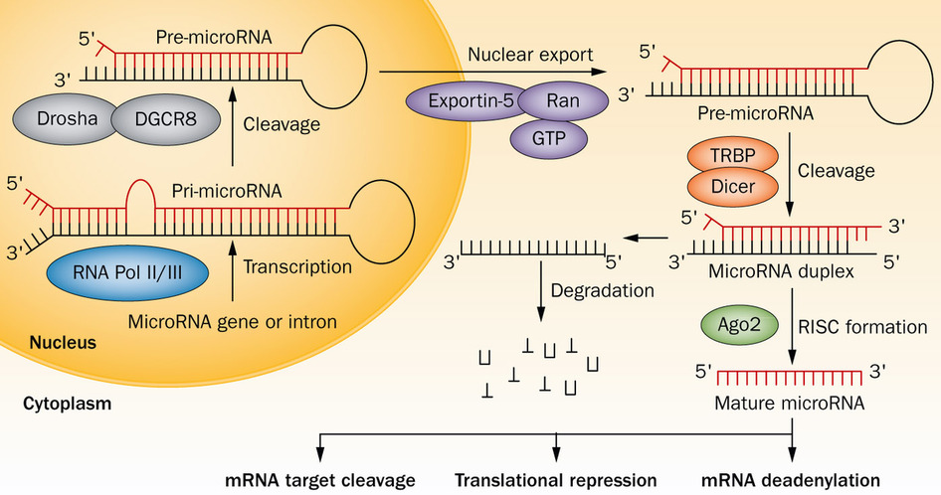
Maturation of Micro RNA

Slide 48
Micro RNA
Please watch educations videos at following links:
http://www.tv2t.com/watch/7Kvgoa32y3g/introduction-to-microrna-anna-m-krichevsky.html
http://www.tv2t.com/watch/dupzE66J8u4/david-bartel-whitehead-institutemithhmi-part-1-micrornas-intro-.html

Slide 49
Q. 11: If the function of gene changes without alteration in its DNA sequence. The process is called:
a. Epigenetic
b. Hybridization
c. Minisequencing
d. Non-Sense Mutation
e. Target Amplification
      a. Epigenetic

Slide 50
Q. 12: Following is true regarding reciprocal translocation EXCEPT:
a. Balanced translocation
b. No change in the arrangement of gene
c. No gain of genes
d. No loss of genes
e. Transfer to non-homologous chromosome
      b. No change in the arrangement of gene

Slide 51
Translocations
A chromosomal translocation occurs when a segment of one chromosome becomes attached to another
In reciprocal translocations two non-homologous chromosomes exchange genetic material called balanced translocations
In simple translocations the transfer of genetic material occurs in only one direction
  i.e. unbalanced translocations

Slide 52
Q. 13: Identity testing is one of the most promising aspects of the genetics. Which of the following variations in the human genome is most commonly employed in identity testing?
a. Human leukocyte antigens
b. Restriction fragment length polymorphism
c. Short tandem repeats
d. Single nucleotide polymorphism
e. Variable number of tandem repeats
      c. Short tandem repeats

Slide 53
Short Tandem Repeats (STR)
A Short Tandem Repeat is a short sequence of nucleotides that are repeated and are directly adjacent to each other (usually 2-6 base pairs long).
The method of STR uses the polymorphic regions that have short repeated sequences of DNA.
STRs are found surrounding the structural center of chromosomes (Chromosomal Centromere)
STRs have become one of the most widely used genomic markers for identification and genetic mapping.
STRs are most beneficial for human identification

Slide 54
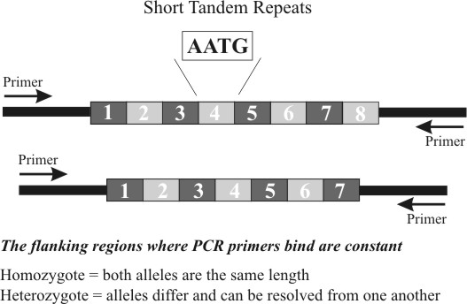

Slide 55
Applications of Human Identity Testing
Forensic cases -- matching suspect with evidence
Paternity testing -- identifying father
Missing persons investigations
Mass disasters -- putting pieces back together
Historical investigations
Involves generation of DNA profiles usually with the same genetic markers and then MATCHING TO REFERENCE SAMPLE

Slide 56
STRs
Please watch educations videos at following links:
http://www.tv2t.com/watch/DbR9xMXuK7c/dna-fingerprinting.html

Slide 57
Human Identification
STRs are used for human identification
What happens is every person gets a copy of each of their parents STR. Since STRs can have many different patterns, it helps with determining the identification of people . Also people have all different numbers of repeats, it is also used to determine an individual.
Also in smaller quantities of DNA and in disintegrating DNA, STRs are still able to help pick up the information and type the DNA.

Slide 58
STR Testing
Capillary electrophoresis works by electrokinetically injecting DNA fragments into glass tubes filled with polymer.
The DNA is pulled by an electric field, separating them into small fragments.
They are then detected by fluorescent dyes that attach to primers in PCR. Sizes are assigned using a labeled DNA standard, which is compared to an allelic ladder.

Slide 59
Variable Number Tandem Repeat (VNTR)
It’s the sequence of the genome that repeats.
They can often be found on chromosomes and the variations in length make it possible for differences between people to be found.
It can also be used to connect children to their parents.
There are two ways to analyze VNTR data.

Slide 60
Restriction Fragment Length Polymorphism (RFLP)
RFLPs involves fragmenting a sample of DNA by a restriction enzyme, which can recognize and cut DNA wherever a specific short sequence occurs.
RFLP occurs when the length of a detected fragment varies between individuals and can be used in genetic analysis.

Slide 61
Advantages and Disadvantages of RFLP
Advantages:
Variant are co dominant
Measure variation at the level of DNA sequence, not protein sequence.
Disadvantage:
Requires relatively large amount of DNA

Slide 62
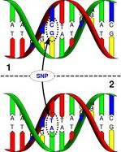
Single-Nucleotide Polymorphism (SNP)
A (SNP, pronounced as snip) is a DNA sequence variation occurring when a single nucleotide — A, T,C, or G — in the genome differs between members of a species or paired chromosomes in an individual.
Used in biomedical research, crop and livestock breeding programs.

Slide 63
Q. 14: When collecting blood samples for PCR, anticoagulant to be avoided is:
a. Acid Citrate Dextrose A
b. Acid Citrate Dextrose B
c. EDTA
d. Heparin
e. Tris-EDTA
      d. Heparin

Slide 64
Q. 15: Which of the following steps is not included in a direct nucleic acid test?
a. Amplification
b. Detection
c. Probe hybridization
d. Sample identification
e. Sample preparation
      a. Amplification

Slide 65
Direct Nucleic Acid Testing
These methodologies use principles that detect RNA or DNA that is currently available in the sample; therefore no multiplication or amplification occurs.
There are usually 4 main steps:
  Sample identification
  Sample preparation
  Probe hybridization
Detection

Slide 66
Examples of Direct NAT
Southern Blot: Employs a restriction endonuclease enzyme to extract DNA from the cells. DNA detection is done using agarose gel electrophoresis.
Fluorescent In Situ Hybridization (FISH): Uses RNA Northern Blot or DNA Southern Blot techniques to detect targets of interest in cytology/histology specimens or other nucleic acid variations.
DNA fingerprinting: Restriction Fragment Length Polymorphism (RFLP): Cuts long DNA into shorter fragments before detection to isolate changes or polymorphisms
Microarrays

Slide 67
Part II
Match the answers
(Extended Matching Questions)

Slide 68
Cytogenetic and Molecular Genetic Techniques
Options
(1) Allele specific oligonucleotide hybridization
(2) Amplification refractory mutation system
(3) Array comparative genomic hybridization
(4) Automated DNA sequencing
(5) Fluorescence in situ hybridization
(6) G-banding with trypsin and Giemsa-banding
(7) Genotyping microarrays
(8) Heteroduplex analysis
(9) Polymerase Chain Reaction
(10) Restriction enzyme digestion
(11) Single strand conformation analysis
(12) Southern and Northern blotting
(13) Spectral karyotyping
(14) Whole genome sequencing

Slide 69
Q.16: The technique can detect a number of known mutations at the same time which makes them attractive for high throughput analyses in multiple genes, for one or many different patients. It is available on a variety of different molecular platforms. These assays are usually automated with a high-throughput and can carry out automated analysis of multiple samples simultaneously, do not require hands-on work after the initiation of the assay run.
(7) Genotyping microarrays

Slide 70
Q.17: The technique involves rapid and highly-specific amplification of DNA fragments. The method uses a large excess of oligonucleotide primer pairs, a template DNA, free deoxynucleotide triphosphates (DNA bases), reaction buffer, and thermo-stable enzyme that drives the reaction.
(9) Polymerase Chain Reaction

Slide 71
Q.18: The technique allows identification of large chromosomal abnormalities, including deletions, duplications, and translocations, as well as smaller chromosomal microdeletions and duplications. Cells are arrested in mitosis, then fixed using a mixture of acetic acid and methanol and then “dropped” on a glass microscope slide where they are affixed. DNA probes are used that match the regions in the chromosomes containing the DNA sequence in question. Immediate detection of the fluorescence signal is possible via fluorescence microscopy.
(5) Fluorescence in situ hybridization

Slide 72
Q.19: This is a simple and technically easy method to detect specific mutation that create or destroy a specific enzyme site. Specific enzymes, usually isolated from bacteria, recognize unique short sequences within a DNA fragment. These enzymes can cleave the DNA strands at that exact site. If a mutation either changes the DNA code to a sequence that creates a new enzyme site or obliterates an existing enzyme site, the mutation can be detected based upon the presence or absence of the site.
(10) Restriction enzyme digestion

Slide 73
Q.20: This method can be applied to the identification of unknown mutations as well as detection of known mutations because this method includes the precise identification of all DNA variations in the target sequence. A DNA sequence of interest is amplified in the presence of a primer and dideoxynucleotide chain terminators. Either the primer or the chain terminators are fluorescently labeled. As the sequence undergoes electrophoresis a laser beam excites the fluorescent nucleotides, producing a signal that can be compiled into a DNA sequence. Thus new mutations continue to be discovered and added to the understanding of mutation spectra and clinical testing is enhanced with the more comprehensive testing.
(4) Automated DNA sequencing

Slide 74
Tools used in
Molecular Diagnosis

Slide 75
Common Tools of Molecular Diagnosis
Nucleic acid fractionation
Polymerase chain reaction
Probes, Hybridization
Vector, Molecular cloning
Nucleic acid enzymes
Microarray
DNA sequencing
Electrophoretic separation of nucleic acid
Detection of genes:
DNA: Southern blotting
RNA: Northern blotting
Protein: Western blotting

Slide 76
Polymerase chain reaction (PCR)
The polymerase chain reaction (PCR) is the best known and most widely applied of the target amplification methods.
PCR allows a single DNA sequence to be copied (millions of times).

Slide 77
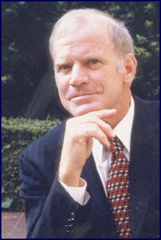
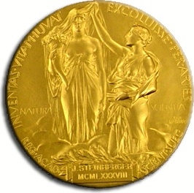
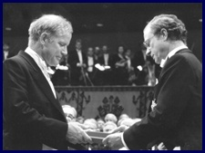
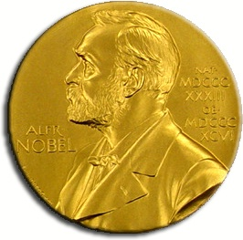
Kary Banks Mullis won 1993 Noble Prize on Chemistry on significant improvement in PCR

Slide 78
Requirements of PCR
The target sequence
Pair of oligonucleotides (referred to as primers)
Deoxynucleotides of each base (collectively referred to as dNTPs)
Thermostable DNA polymerase

Slide 79
Primers of PCR
The primers are usually short, chemically synthesized oligonucleotides, with a length of about twenty bases.
They contain complementary base sequence, to a target DNA, which is then copied by the polymerase.

Slide 80
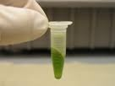
DNA Isolation and Purification in PCR
DNA can be isolated from any nucleated cell.
DNA is a giant anion in solution.

Slide 81
Sources of DNA include for PCR
Blood
Buccal cells
Cultured cells (plant and animal)
Bacteria
Biopsies
Forensic samples i.e. body fluids, hair follicles, bone & teeth roots.

Slide 82
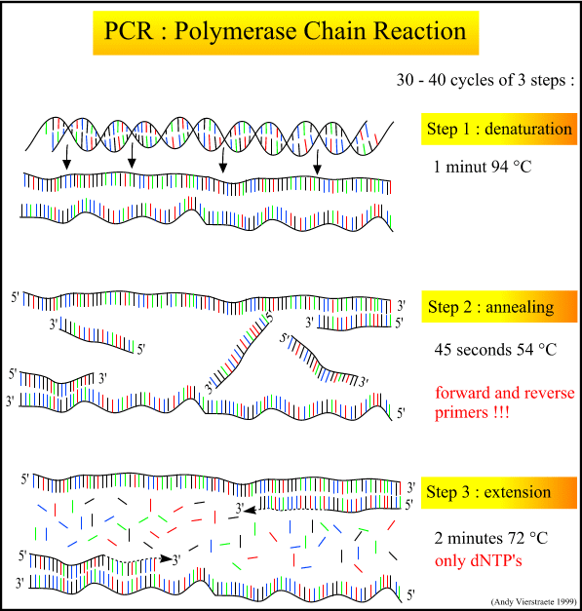
PCR – A Quick Overview
  Denaturation - separate parent strands in preparation new strand synthesis
  Annealing - “stick” primers to the parent strands to prime DNA synthesis
  Extension - addition of nucleotides, one at a time, to the growing end of the DNA strand (3’ end) using the parent strand as the template

Slide 83
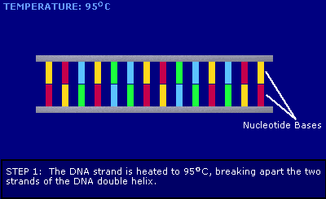
Denaturation

Slide 84
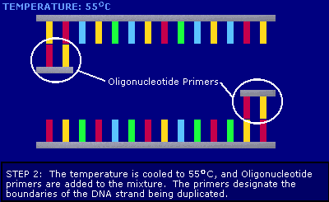
Anealing

Slide 85
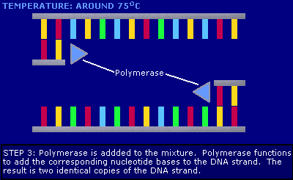
Extension

Slide 86
Summary of PCR
Sample for DNA extraction
Lysis of cells at elevated temperature + detergent + enzyme in salt buffer
Removal of cellular proteins
Precipitation of nucleic acids with ethanol
Quantitation and purity measurement of DNA

Slide 87
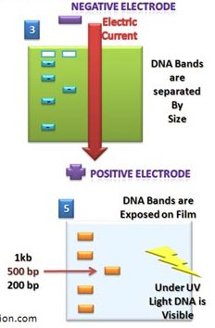
Gel Electrophoresis
DNA, RNA, and proteins can be separated and bands analyzed by means of gel electrophoresis.
In agarose gel electrophoresis, DNA and RNA can be separated on the basis of size by running the DNA through an agarose gel.
Proteins can be separated on the basis of size by using an Polyacrylamide gel ( PAGE gel), or on the basis of size and their electric charge.

Slide 88
Blotting Methods
Southern blotting involves the transfer of DNA from a gel to a membrane, followed by detection of specific sequences by hybridization with a labeled probe
Northern blotting, RNA is run on a gel
Western blotting entails separation of proteins on an SDS gel, transfer to a nitrocellulose membrane, and detection proteins of interest using antibodies.

Slide 89
DNA Microarrays
DNA microarrays comprise known DNA sequences spotted or synthesized on a small chip.
Microarrays show the levels of all the expressed genes in an experimental sample.

Slide 90
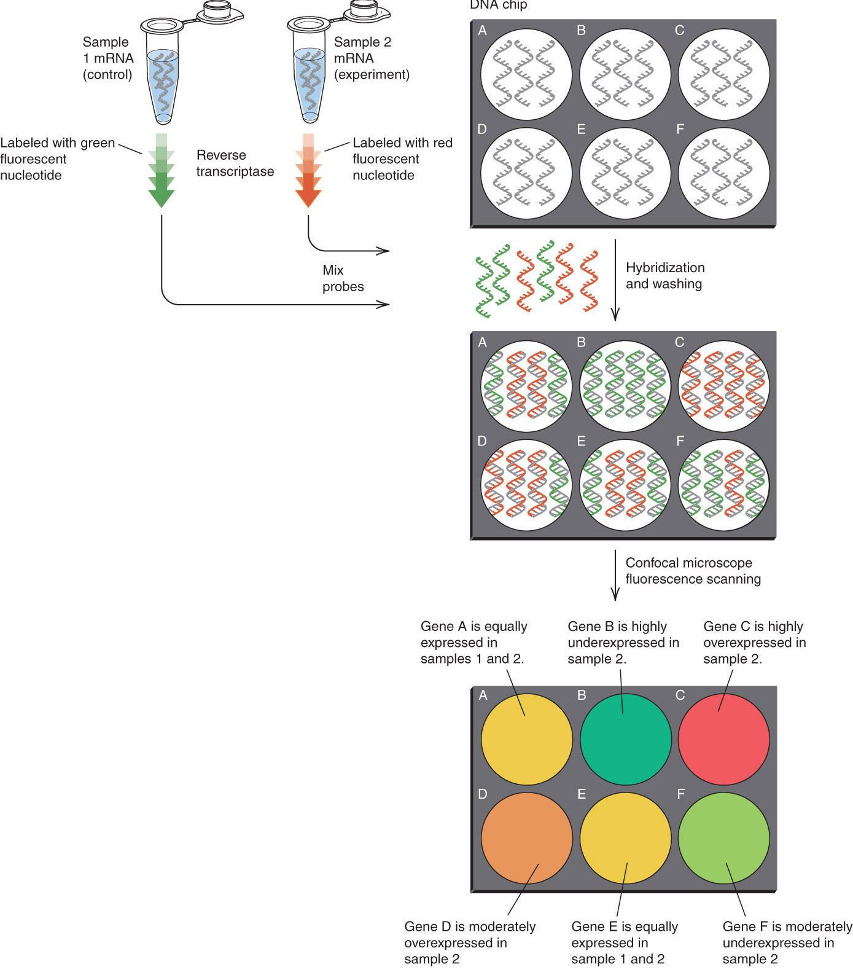
DNA Microarrays

Slide 91
Genotyping microarray
They can interrogate a flexible number of mutations at the same time in one or multiple genes, for one or many different patients at the same time.
Advantages: suitable for high-throughput analysis of specific mutations or polymorphisms in numerous samples. Relatively less hands-on work is required per sample.
Disadvantages : expensive, not suitable for low-volume testing, in particular when the microarrays can be used only one time, regardless of whether only one or many samples are tested
Notes:
Adapted from : http://www.freezingblue.com/iphone/flashcards/printPreview.cgi?cardsetID=233181

Slide 92
Restriction Enzyme Digestion (RED)
RED can be used to detect mutations that create or destroy a restriction enzyme site.
Specific restriction enzymes, usually isolated from bacteria, recognize unique short sequences within a DNA fragment. These enzymes can cleave the DNA strands at that exact site.
If a mutation either changes the DNA code to a sequence that creates a new restriction enzyme site or obliterates an existing restriction enzyme site, the mutation can be detected based upon the presence or absence of the site
Notes:
Adapted from : http://www.freezingblue.com/iphone/flashcards/printPreview.cgi?cardsetID=233181

Slide 93
Advantages and Disadvantages of RED
Advantages: technically easy, Restriction enzyme analysis detects specific mutations and can be applied to many samples concurrently.
Disadvantages: impractical for disorders caused by a large number of different mutations and for the detection of mutations associated with nucleotide sequences that require the use of expensive restriction enzymes. Only a small fraction of existing point mutations actually create or remove a restriction site. Incomplete digestion can produce erroneous results.
Notes:
Adapted from : http://www.freezingblue.com/iphone/flashcards/printPreview.cgi?cardsetID=233181

Slide 94
Automated DNA Sequencing
The most direct approach to mutation detection is automated sequencing.
A DNA sequence of interest is amplified in the presence of a primer and dideoxynucleotide chain terminators.
Either the primer or the chain terminators are fluorescently labeled.
As the sequence undergoes electrophoresis in an automated sequencer, a LASER beam excites the fluorescent nucleotides, producing a signal that can be compiled into a DNA sequence
Notes:
Adapted from : http://www.freezingblue.com/iphone/flashcards/printPreview.cgi?cardsetID=233181

Slide 95
Advantages of
Automated DNA Sequencing
Advantages of this method include the precise identification of all DNA variations in the target sequence. Thus, the method can be applied to the detection of known mutations as well as to the identification of unknown mutations.
For a large number of inherited conditions, new mutations continue to be discovered and add to the understanding of mutation spectra and genotype-phenotype correlations
Notes:
Adapted from : http://www.freezingblue.com/iphone/flashcards/printPreview.cgi?cardsetID=233181

Slide 96
Whole Genome Sequencing
It is most interesting genetic technique
Identification of mutations in the entire genome
The investigator is NOT to choose a gene or chromosome region of interest
Most suitable for unknown mutations
Notes:
Adapted from: http://www.freezingblue.com/iphone/flashcards/printPreview.cgi?cardsetID=233181

Slide 97
Cytogenetics

Slide 98
Introduction
Cytogenetics is the study of chromosome number, structure, function, and behavior in relation to gene inheritance, organization and expression

Slide 99

Techniques used in Cytogenetics
The study of the genetic constitution of cells through the visualisation and analysis of chromosomes.
  G-banding
    (and other traditional techniques)
  Fluorescence in situ hybridization (FISH)
  Molecular techniques
    (QF-PCR, MLPA)

Slide 100
FISH (Fluorescence in situ hybridization)
FISH can be done in metaphase chromosomes or interphase nuclei phases of cell cycle
Metaphase FISH can be used for identification of large chromosomal abnormalities, including deletions, duplications, and translocations, as well as smaller chromosomal microdeletions and duplications
Notes:
Adapted from : http://www.freezingblue.com/iphone/flashcards/printPreview.cgi?cardsetID=233181

Slide 101
Thank You and Best Of Luck

