Slide 1


SHAHZAD AHMAD M.D,F.A.C.E

Slide 2
PARATHYROID DISEASE
M.I.P anyone ?
Advantages of Minimally invasive parathyroidectomy
improved cosmetic results
decreased surgical trauma=less postoperative pain,
shorter operative times
decreased overall hospital stay
Rate of cure comparable to traditional neck exploration
can be performed in the outpatient setting

Slide 3
Contraindications
prior extensive neck surgery
hereditary primary hyperparathyroidism
large goiters,
multigland disease
obesity
suspicion of parathyroid carcinoma.

Slide 4
Why do U/S for Parathyroid

Slide 5
Normal Parathyroid isnt visualized
Adenomas have an Oblong or oval shape
Longitudinal diameter usually 7-15 mm
Usually more hypoechoic than surrounding thyroid
Power doppler usefull in idetifying afferent and efferent blood supply

Slide 6
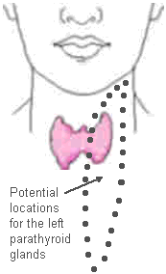
Ectopic Parathyroid 15-20%
can be found in Mediastinum/thymus/submandibular region

Slide 7
Surgeon vs. Radiologist
studies have shown comparable sensitivity for Surgeons localizing parathyroid adenomas compared to radiologist performed ultrasound!!*
Ultrasound by surgeon and MIBI together had a 90% sensitivity for parathyroid adenomas
Ann Surg. 2008;248(3):420 *

Slide 8
54 year old with Hypercalcemia
Ionized calcium 1.43 mmol/liter
iPTH 120 pg/ml
24 hour urine for calcium 324 mg/24 hr
DEXA- distal 3rd T-Score -3.2
negative MIBI scan

Slide 9
u/s showed a right sided intrathyroidal hypoechoic nodule 1.01 x 0.78, with Doppler flow high at the superior pole
fna showed suspicion for papillary structures but no inclusions.

Slide 10
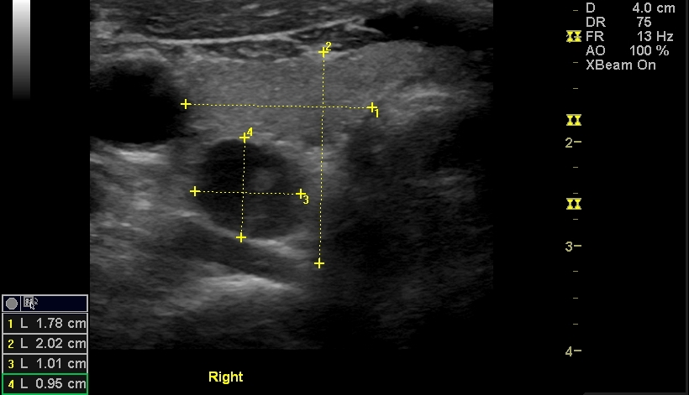

Slide 11
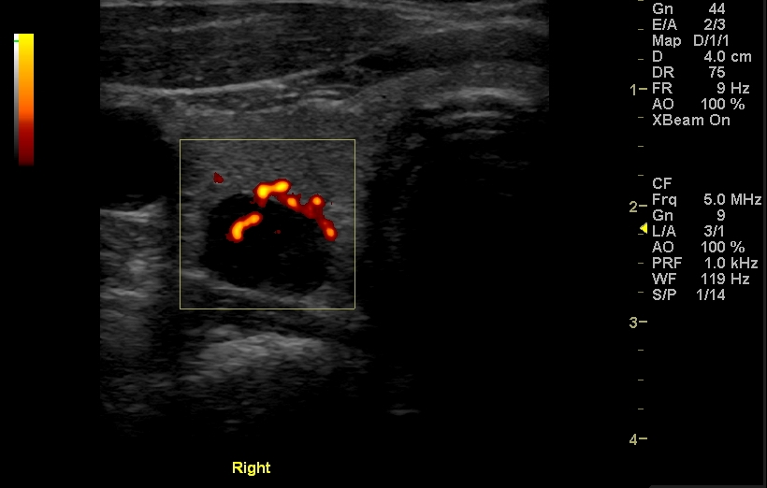

Slide 12
IPTH washout from needle - 18000 pg/ml !!
A positive cutoff value for PTH washout concentration is defined as superior to the PTH serum level
positive predictive value (PPV) 100%
Combining sestamibi s with neck ultrasound provides the highest sensitivity (79 to 95 percent)*
*Clin Radiol. 2010 65(4):278

Slide 13
Incidence of concurrent thyroid pathology in hyperparathyroidism cases?
30% !
FNA with Ipth washout becomes paramount pre-op

Slide 14
New modality that ive been exposed to
4-D CT scan
Planer images emphasizing the contrast washout between an adenoma and surrounding tissue
In a study by Rodgers et al., 4DCT displayed improved sensitivity (88%) over sestamibi imaging (65%) and ultrasonography (57%)

Slide 15
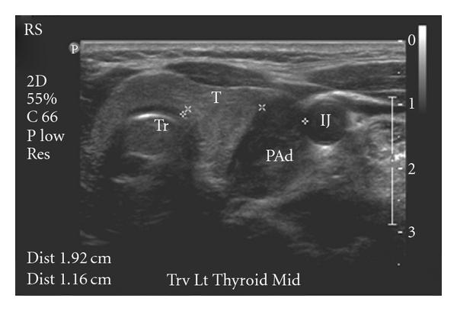
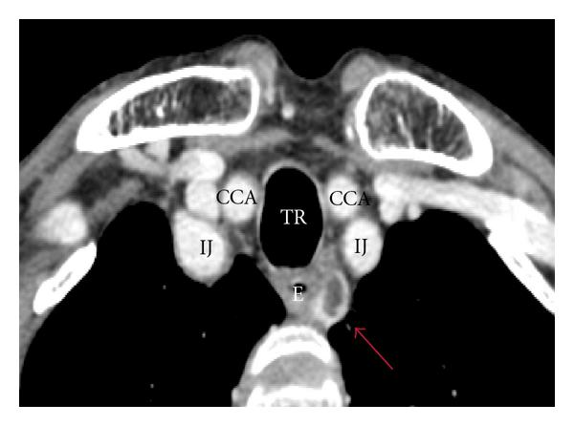

Slide 16
THYROID DISEASE IN PREGNANCY

Slide 17
Thyrotoxicosis in pregnancy
Diagnose hyperthyroidism by using TSH and Total T4 ( adjusted at 1.5 times the non pregnant range)
Graves disease is the most common cause
Important to differentiate it from HCG and pregnancy related changes

Slide 18
Pregnancy and physiologic thyroid changes
T.B.G
hCG and thyroid function
10-20% of women can have a low TSH in the first trimester

Slide 19
No evidence that treating Gestational hyperthyroidism with Antithyroid Drugs is beneficial

Slide 20
Graves disease in pregnancy
Hyperthyroidism complicates pregnancy
Spontaneous abortion
Premature labor
Low birth weight
Stillbirth
Preeclampsia
Heart failure

Slide 21
Diagnosis
Clinical exam by experienced physician is priceless
T.S.I/T.B.I.I titer helpful
5% wont have TSI elevation, esp the mild cases
T3 T4 ratios are helpful

Slide 22
Treatment
Targets. Where do we want the levels to be and what are we following?
What drugs to use? PTU or Tapazole
How much of a dose to use?
potency ratio ?
What about Nursing mothers

Slide 23
26 year old Snowboarding instructor, 22 weeks pregnant
G1P0A0
5 year h/o hypothyroidism after “Thyroid surgery”
TSH 4.40 ( range 0.42-4.50)
Total T4 9.2 ( range 6.21-12.20)
Whats wrong with this picture?

Slide 24
should Patients treated with RAI/surgery prior to pregnancy be monitored?
Why and how?

Slide 25
TBII and TSI will cross placenta
Slow clearence of maternal IGG from neonatal circulation
Thyroid dysfunction may last for months in child after delivery
Check antibody titer at 22-26 weeks,

Slide 26
How should thyroid nodules in pregnant women be managed?
If euthyroid, perform FNA
If TSH supressed, wait untill after delivery/lactation when an I-123 scan be safely performed
Recommendation rating: A

Slide 27
36 y/o G2 P0 with small goiter
2 weeks pregnant
Previous history of 2 miscarriages, family history of thyroid disease
TSH 1.3
FT4 1.1
Thyroid Peroxidase antibody titer 600( normal < 20)

Slide 28
Questions-
What is “normal” TSH during pregnancy?
Can her miscarriage history be related to her positive antithyroid antibody status?
Notes:
28

Slide 29
Adjust thyroid hormone dose to keep
TSH < 2.5 mIU/L
Dosage increment depends on etiology of maternal hypothyroidism
Notes:
29

Slide 30
No Thyroid gland – Increase dose ~ 45%
Hashimotos – increase dose ~ 25 %
Follow TSH every 4-6 weeks to keep TSH < 2.5 mIU/L
Notes:
30

Slide 31
THYROID ANITOBODIES
Recent trial shows that Thyroid hormone replacement in Euthyroid Antibody positive women decreased miscarriage rate !
Negro et al 2006.J clin Endocrinol
Notes:
31

Slide 32
REPLACEMENT THYROID DOSE DEPENDS ON BASELINE TSH LEVEL
0.5 UG/KG/D FOR TSH < 1
0.75 UG/KG/D FOR TSH 1-2
1 UG/KG/D FOR TSH >2 OR TPO AB TITERS >1:1500
Negro et al 2006.J clin Endocrinol
Notes:
32

Slide 33
Post Partum Thyroiditis
1 year of delivery
Transient hyPERthyroidism alone
Transient hypothyroidism alone
or
Transient hyperthyroidism followed by hypothyroidism and then recovery.
P.S distinction b/W postpartum Thyroiditis and Graves' hyperthyroidism may be difficult
If really at sea consider Technicium scan

Slide 34
Beta Blockers are safe in breastfeeding mothers
Consider thyroid hormone replacement for TSH >10

Slide 35
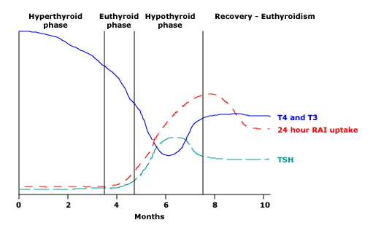
Post Partum Thyroiditis

Slide 36
Post Partum Thyroiditis
Up to 21 percent of postpartum women have postpartum Thyroiditis
Prevalence especially high for people with type 1 DM
Thyroid antibodies

Slide 37
Selenium and thyroid
selenium supplementation in autoimmune Thyroiditis showed a significant decrease of (TPO) antibody levels !!
151 TPO-positive women randomly assigned to receive selenium (200 mcg daily) or placebo
30 % decreased incidence seen

Slide 38
76 year old female referred for eval of secondary hypothyroidism
h/o hypothyroidism for 15 years
Feels shaky/ palpitations/anxiety
TSH- <0.01
Free T4- 0.40 L (0.75-1.54 ng/dl)
She is on armor thyroid

Slide 39
T3 (Cytomel), ARMOUR thyroid, and mixtures of T3 and T4 (ex, Thyrolar), should not be used
potency and bioavailability of desiccated thyroid can vary
wide fluctuations in serum T3
Serum T4 concentrations remain low in patients treated with T3

Slide 40
Combination T4 and T3 therapy?
Some patients remain symptomatic
In several recent placebo-controlled trials
NO DIFFERENCE WAS SEEN !!

Slide 41
Graves disease update
1) what drug to use
2) what's a good dose
3) how long to use it
4) what about RAI 1-131, anything new?

Slide 42
monitoring
32 year old female with recently diagnosed Graves disease
Has tremors/palpitations
Started on methimazole 5 mg
One month later TSH < 0.01, total T4 10.7
Is she adequately treated?
Is there a lab mistake?

Slide 43
Monitoring
Measure both total T4 and total T3
because serum T3 concentrations may remain high even though serum T4 concentrations become normal
T3 to T4 ratio is particularly high in Graves'
REMEMBER TSH can remain suppressed for months even after T4 and T3 have normalized

Slide 44
Back to the patient
I gave her propranolol
Increased her Tapazole to 15
8 weeks later TSH <0.01
Normal T4 and T3
12 weeks later TSH 1.0
NO NEED TO CHECK T3 ANYMORE

Slide 45
For how long should patients be treated?
12-18 months

Slide 46
Does the dose influence the chances of remission?
Probably not

Slide 47
predictors of FAILURE of remission?
Severe disease,
large goiter,
high anti-TSH receptor antibody titers
predictive of failure

Slide 48
REMISSION LIKELY IN
Women
Age >40
High TPO titer

Slide 49
If planning pregnancy after 6 months RAI is preferred
How will this help?

Slide 50
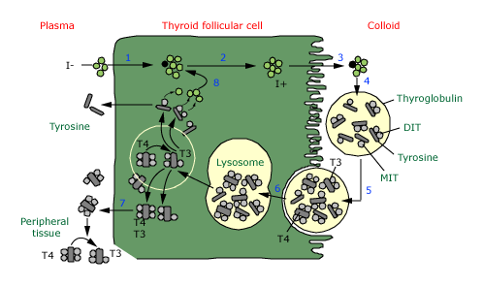

Slide 51
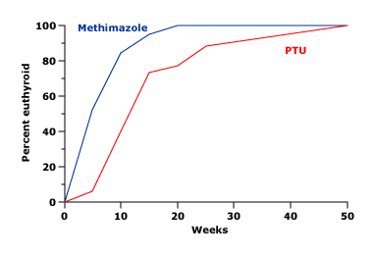
Methimazole acts faster than PTU in Graves Disease

Slide 52
half-life of METHIMAZOLE is 6 hours, PTU is 75 minutes.
Intrathyroidal METHIMAZOLE concentration, remains high for up to 20 hours, considerably longer than that of PTU.

Slide 53
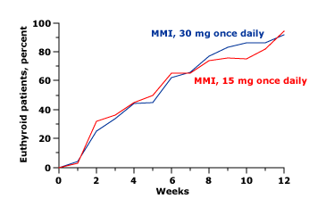

Slide 54
Graves' disease
Patients with very large goiters
Goiters causing upper airway obstruction or severe dysphagia
Radioiodine may exacerbate Graves' ophthalmopathy

Slide 55
Surgery For Graves Disease
Large /Compressive Goiters
more than 80 grams
Intolerence to meds

Slide 56
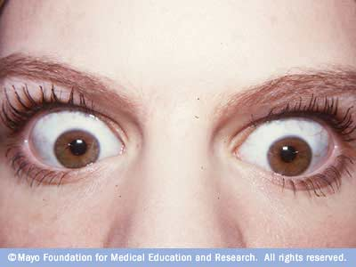

Slide 57
Toxic multinodular goiters:
Brief update on Managment
Surgery or I-131
risk of repeat treatmetn is 1% with surgery, 20% with iodine
Prevelence of hypothyroidism after Surgery vs. I-131
(2% vs. 28%)

Slide 58
Thyroid function in nonthyroidal illness
Thyroid function should not be assessed in seriously ill patients unless there is a strong suspicion of thyroid dysfunction.
If you suspect thyroid dysfunction in a critical patient
Do not just check a TSH !!

Slide 59
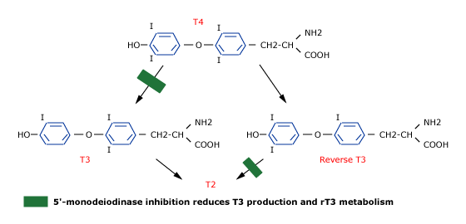
Low T3 is common in critical illness

Slide 60
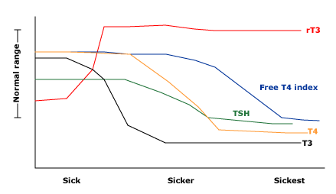

Slide 61
When to measure?
68 year old admitted with pneumonia and sepsis
Develops afib
TSH ,<0.1
Total t3 is low
Does this help?

Slide 62
Low T3 in a hospitalized patient like this with a low TSH tells us he likely has euthyroidal sick syndrome

Slide 63
critically ill patients with low serum T3 and low T4, we
SHOULD NOT BE TREATED with thyroid hormone

Slide 64
75 year old female with palpitations
Screening TSH 0.13 ( 0.5-4.5 mU/liter)
Bilaterally enlarged thyroid gland
h/o htn/ cad/dm
Now what?
u/s-

Slide 65
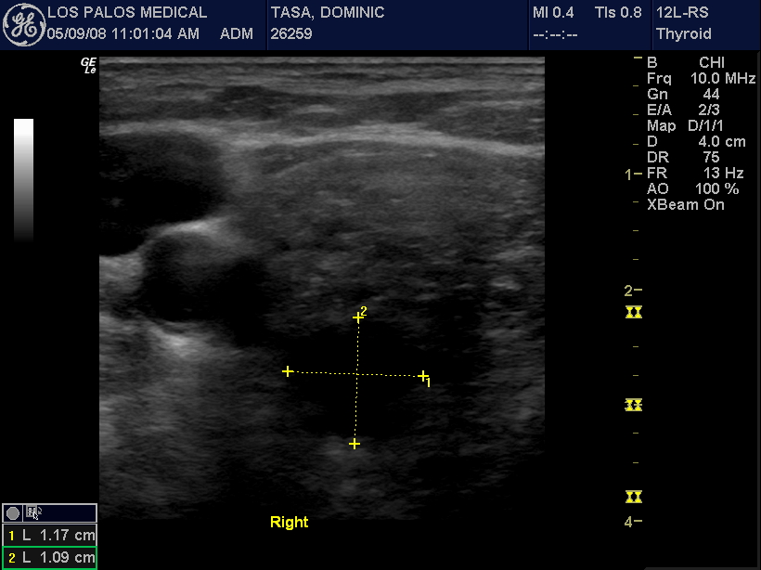

Slide 66
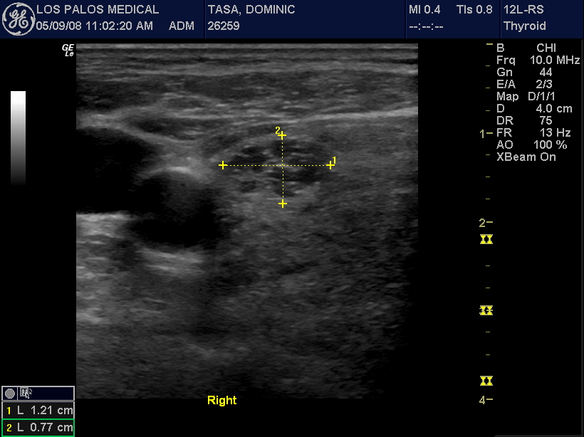

Slide 67
Any other investigation
1-123 uptake and scan-
bilaterally enlarged gland with areas of increased and decreased uptake
Free t4- 1.3 ng/dl ( 0.8-1.8 )
Total t4 7.2
Bone density shows osteopoenia

Slide 68
Whats the diagnosis ?
Subclinical hyperthyroidism

Slide 69
Differential diagnosis
Exogenous
Toxic nodule
Toxic multinodular goiter
Thyroiditis
Graves
over age 55 the cause of hyperthyroidism is -
multinodular goiter 57 %
Graves' disease 6 %

Slide 70
Effects on bone
Premenopausal vs post menopausal
risk of fracture elevated in postmenopausal women with supressed TSH
Cortical Bone More affected
Therapy with Tapazole stabalizes bone mineral density

Slide 71
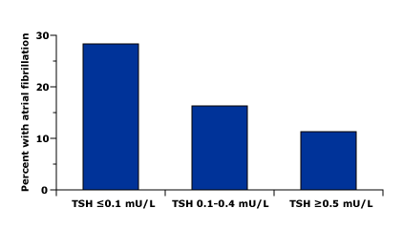
incidence of AFIB over age 60 based on TSH

Slide 72
Effects on mortality
subjects aged 60 years and older mortality from all causes was significantly higher !!
An analysis of seven studies found a 41 percent increase in all-cause mortality in subclinical hyperthyroidism

Slide 73
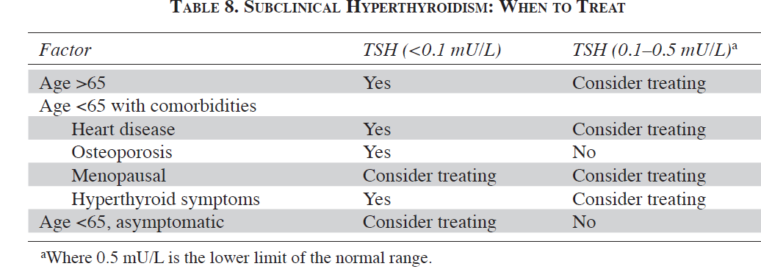
WHO/WHEN TO TREAT

Slide 74
Returning to the patient
Has cardiovascular risk factors
Has a toxic MNG that isnt going to go into a remission
Has osteopenia
I referred her for radioactive iodine ablation with I-131
6 months later her TSH is 0.7
Bone mineral density is unchanged

Slide 75
Thyroid and the heart
Overt hypothyroidism is associated with cardiovascular risk factors
What about subclinical hypothyroidism?

Slide 76
Substantial portion will develop overt hypothyroidism
Women with high TSH + high TPO develop overt hypo at 5 % per year

Slide 77
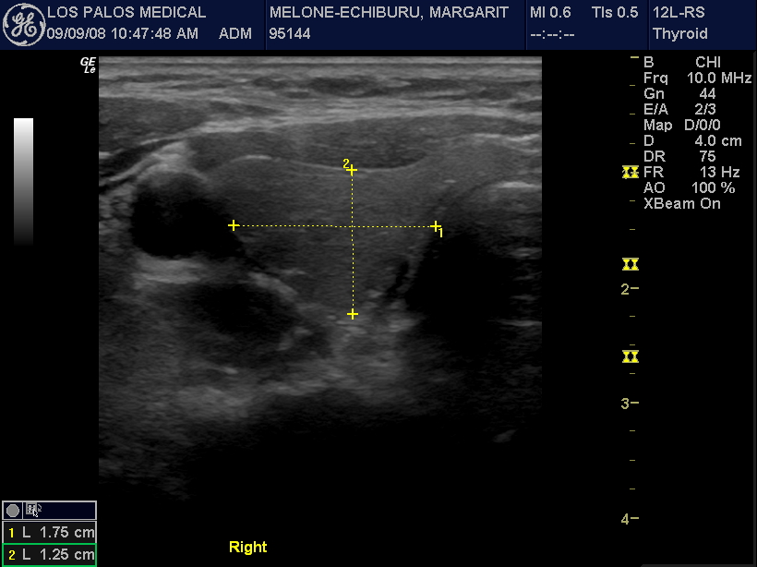
41 year old lady
Normal TSH 2008
u/s

Slide 78
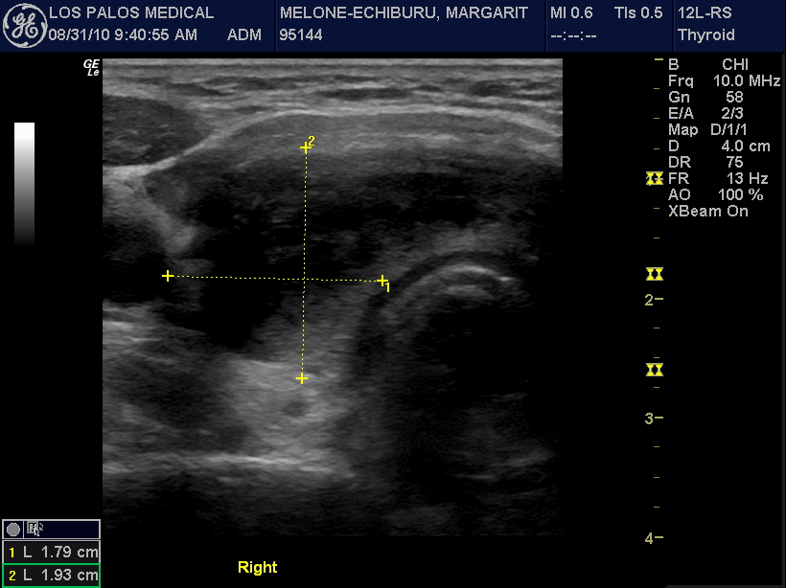
low grade fever, high free t4, anterior neck pain, TPO titer negative

Slide 79
EFFECTS OF THYROID HORMONE REPLACEMENT
SYMPTOMS
Benefit if baseline serum TSH concentration ≥ 10 mU/
LIPID LEVLES
subclinical hypothyroidism, T4 replacement doesnt change lipid levels
Cardiovascular disease

Slide 80
TSH ELEVATIONS NOT ASSOCIATED WITH SUBCLINICAL HYPOTHYROIDISM
recovery from nonthyroidal illness
An unusually large pulse of TSH secretion, especially late in the evening
Assay variability
Adrenal insufficiency
During treatment with metoclopramide or domperidone
TSH-producing pituitary adenomas and resistance to thyroid hormone

Slide 81
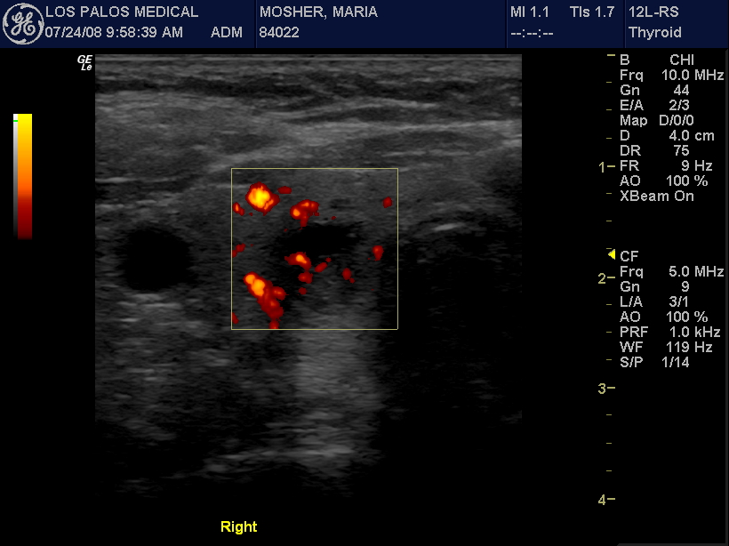

Slide 82
MULTINODULAR GOITERS AND CANCER
45 year old female with a goiter
Normal thyroid function tests
No history of radiation exposure
Had an fna done of her left goiter
This was benign
Here for f/u

Slide 83
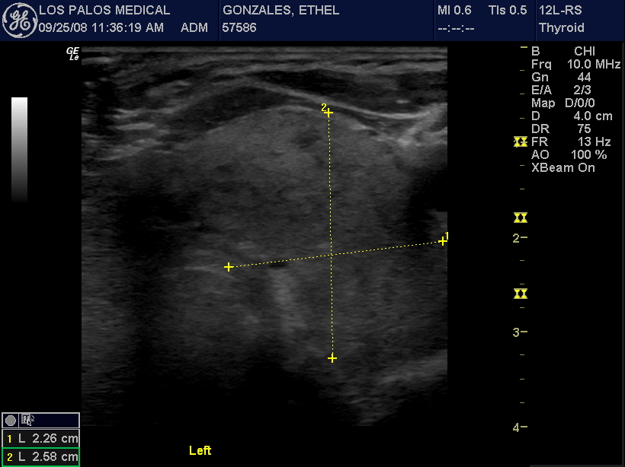

Slide 84
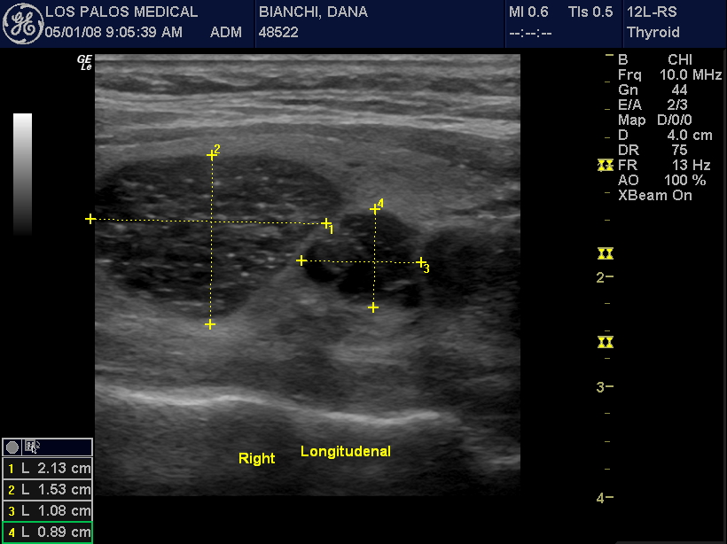

Slide 85
Risk of cancer is similar in multinodular goiter vs. one nodule
Aggressive thyroid cancers may be missed in patients with multinodular goiter
who don’t get routine ultrasounds

Slide 86
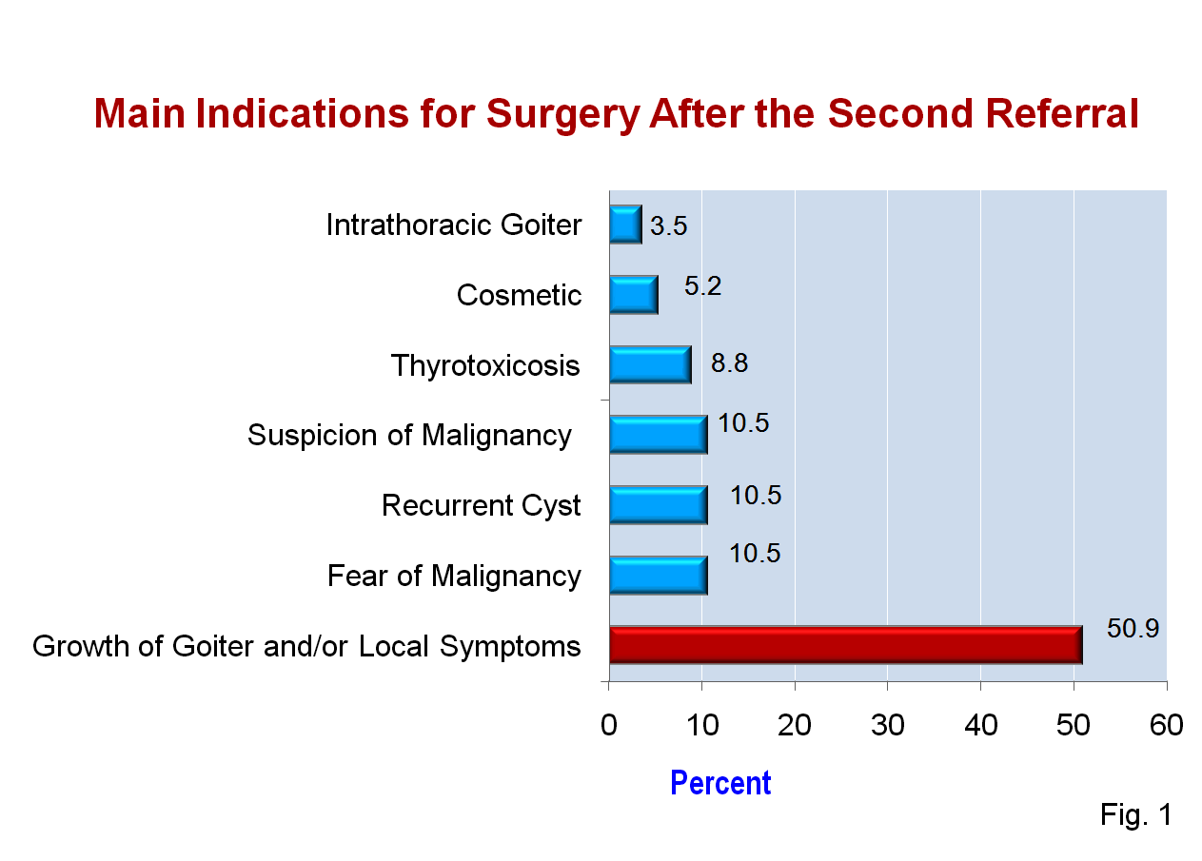
Most (46%) of patients with a MNG required surgery

Slide 87
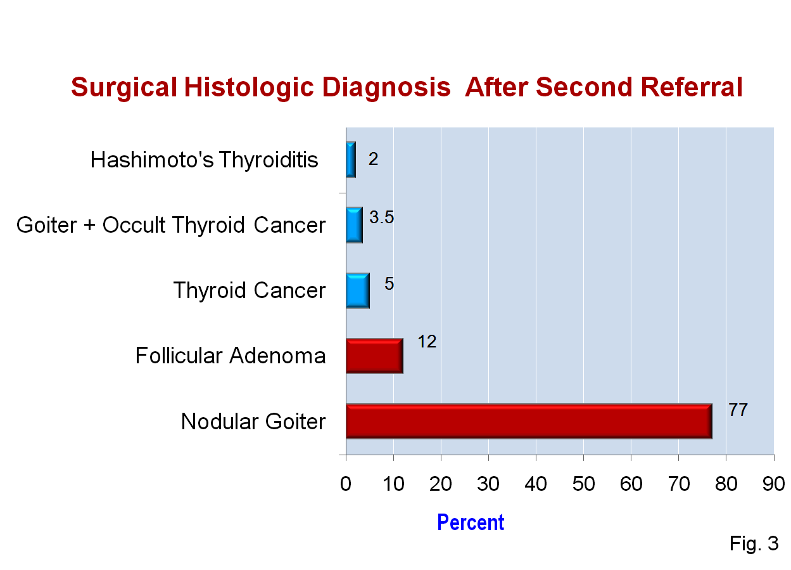

Slide 88
Recent evidence based reviews show
Most patients with cancer had negative biopsies
Patients with history of surgery for benign nodule should have regular ultrasounds
benign thyroid nodules be followed with ultrasound 6 to 18 months after biopsy

Slide 89
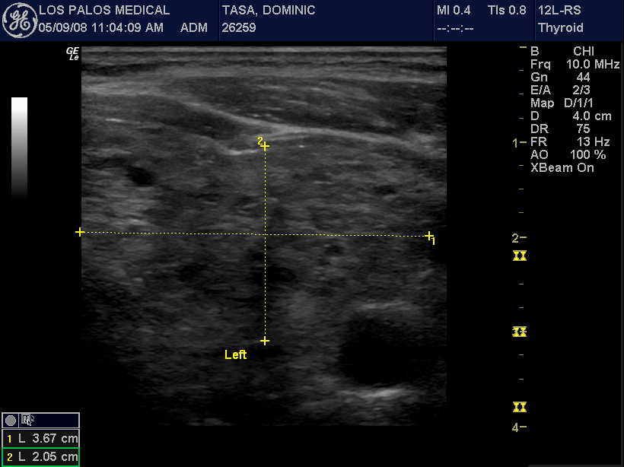

Slide 90
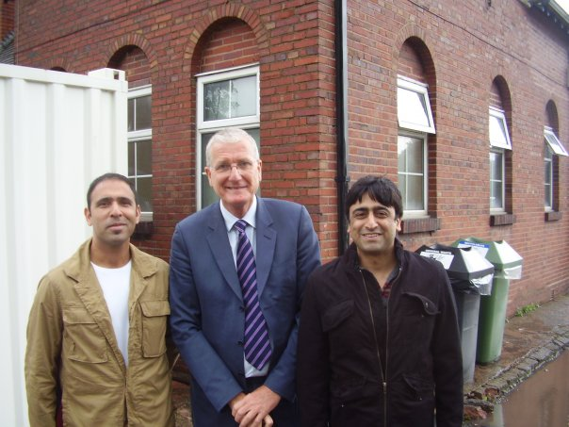
“in God we trust– everyone else must show us the evidence”

