Slide 1
BIOCHEMICAL INVESTIGATIONS IN CHRONIC LIVER DISEASE
COL
MUHAMMAD ASIF NAWAZ
DEPARTMENT OF PATHOLOGY
ARMY MEDICAL COLLEGE, RAWALPINDI

Slide 2
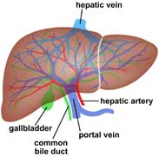
Normal Liver Function
Protein synthesis and degradation:
  albumin, transport proteins, clotting factors,
Carbohydrate metabolism
Lipid metabolism
Bile acid metabolism
Bilirubin metabolism
Hormone inactivation
Drug inactivation and excretion
Storage function

Slide 3
Types of liver disease
Cholestasis: bile duct damage from stones or tumour, primary biliary cirrhosis
Infection: hepatitis A, B, C, EBV, CMV
Chemical damage: drugs and alcohol
Hereditary: Wilsons disease, haemochromatosis
Vascular damage: Budd-Chiari
Autoimmunity: autoimmune hepatitis, primary sclerosing cholangitis
Congenital anomalies: biliary atresia, Caroli’s disease
Metabolic disease: galactosemia, fatty liver disease

Slide 4
Chronic Liver Disease
Chronic Viral hepatitis: B & C
Non-alcoholic fatty liver disease (NAFLD)
Alcohol
Autoimmune – autoimmmune hepatitis, PBC (Primary Biliary cirrhosis), PSC (Primary Sclerosing Cholangitis)
Haemochromatosis
Drugs (MTX, amiodarone)
Cystic fibrosis, a1antitryptin deficiency, Wilsons disease,
Vascular problems (Portal hypertension + liver disease)
Cryptogenic
Others: sarcoidosis, amyloid, schistosomiasis

Slide 5
Liver function tests
Noninvasive method of screening for the presence of liver dysfunction
Pattern of lab test abnormality allows recognition of general type of disorder
To assess the severity and occasionally allow prediction of outcome
To follow the course of the disease, evaluate response to treatment, and adjust treatment when necessary

Slide 6
Common serum liver chemistry tests

Slide 7
Normal values

Slide 8
Transaminases
Most sensitive indicator of liver injury
Participate in gluconeogenesis, transfer of amino groups from aspartate or alanine to ketoglutaric acid to form oxaloacetete or pyruvate.
AST present in cytosol and mitochondria in liver, cardiac muscle, skeletal muscle, kidney, brain, pancreas, lungs, WBC and RBC. AST is an early marker of liver damage
  ALT a cytosolic enzyme, highest concentration in the liver, so liver specific but longer half life

Slide 9
Elevated ALT (SGPT) and AST (SGOT) levels
AST Mild elevations (<10 times UNL)
  chronic viral hepatitis
  nonalcoholic steatohepatitis
  fatty liver
  liver cirrhosis
Moderate and marked elevations(>10 times UNL)
  acute viral hepatitis
  Alcoholic liver disease
  autoimmune hepatitis
  toxic and drug-induced liver necrosis
Shock or ischemia to liver
AST/ALT ratio
  < 1 in most hepatocellular injury
  >1 in alcholic liver diseae, drug induced, malignancy, cirrohosis

Slide 10
Suggested algorithm for evaluating raised transaminases

Slide 11
Enzymes for the detection of cholestasis
Alkaline phosphatase
Present in nearly all tissues - isoenzymes
Localised in the microvilli of the bile canalicus in the liver
Also present in bone, intestine, placenta, kidney and wbc
Elevation may be physiological or pathological
Physiological
In tissues undergoing metabolic stimulation
Third trimester of pregnancy
Adolescence

Slide 12
Suggested algorithm for evaluating a raised s.alkaline phosphatase

Slide 13
Gammaglutamyl transferase
(γ-glutamyl transpeptidase)
Found in hepatocytes and biliary epithelial cells
Sensitive for hepatobiliary disease but ltd by lack of specificity
With other enzyme abnormalities, raised GGT would support a hepatobiliary cause
Can confirm hepatic source for a raised AP
Raised GGT and raised transaminases with ratio of AST to ALT 2:1 or more suggestive of ALD
Medications can cause mild rise
Normal range 0 to 30 IU/L

Slide 14
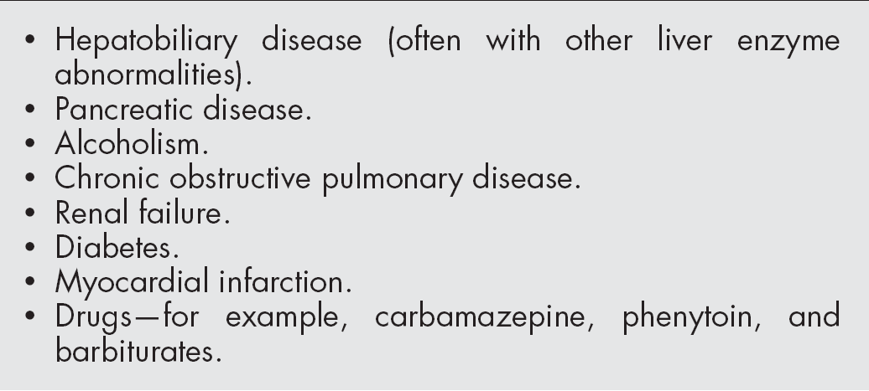
Causes of raised serum gammaglutamyl transferase (SGGT)

Slide 15
5´-Nucleotidase
Normal 0.3 to 3.2 Bodansky units
Spectrum of abnormality similar to that of SAP
Specificity for hepatobiliary disease
May be used to confirm hepatic origin of elevated SAP

Slide 16
Lactate Dehydrogenase
Lactate dehydrogenase (LDH) is often raised in hepatocellular dysfunction
It is rarely measured for this purpose since it lacks specificity because of wide distribution of LDH in the body.

Slide 17
Serum Bilirubin
  A breakdown product of heme (part of the haemoglobin in red blood cells)
  The hepatocytes takes up bilirubin, conjugates it to make it more water soluble and secretes it onto the bile ducts for excretion via the intestine
  Increased bilirubin causes jaundice
    Prehepatic: too much red cell break down (unconjugated)
    Hepatic: unable to metabolise the bilirubin (mixed)
      Reduced conjugation
      Unable to secrete bilirubin
    Post hepatic: obstruction to the excretion of bile (conjugated)

Slide 18
Causes of bilirubin elevation
Liver disease: usually along with other LFTs
Isolated ↑ bilirubin: familial hyperbilirubinaemias,
Haemolysis: ↑ unconjugated bilirubin.

Slide 19
Follow up of elevated bilirubin levels (when no clinical indications of cause)
Bilirubin level | Follow up
Up to 1.5 X ULN | Retest when well in 3 months
> 1.5 X ULN | Test unconjugated portion. Unconjugated >70% in a well patient with otherwise normal LFTs, CBC and TSH = most likely to be Gilberts Syndrome
> 3.0 X ULN | Unconjugated >70% consider haemolysis Conjugated >50% consider ultrasound

Slide 20
Liver synthetic functions
Clotting factors: prothrombin (PT) – very specific for liver dysfunction / liver failure
Albumin: low in chronic liver disease
Glucose: hypoglycaemia indicates severe hepatic dysfunction

Slide 21
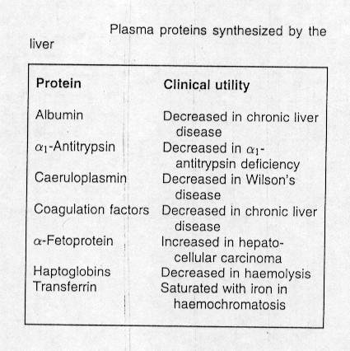
Proteins measured in the investigation of disease

Slide 22
Serum albumin
Synthesized by hepatocytes
Serum half life about 3 weeks
Decreased in chronic and severe liver disease
Other causes for hypoalbinemia:
  protein-losing enteropathy
  Urinary losses: nephrotic syndrome
  malnutrition

Slide 23
Plasma Proteins in Liver Disease
Serum globulins are often increased in cirrhosis
alpha1-Antitrypsin deficiency:
- neonatal jaundice and
- cirrhosis in children and young adults.

Slide 24
Plasma Proteins in Liver Disease
Alpha-fetoprotein:
- modest levels are found,
e.g; during acute viral hepatitis,
- very high values occur
in hepatocellular carcinoma.

Slide 25
Autoantibodies
Antimitochondrial Ab: in primary biliary cirrhosis
Antinuclear Ab and antismooth muscle Ab: in autoimmune hepatitis type 1
Anti LKM1 antibodies in type 2 AIH
Antibodies to soluble liver antigen in type 3 AIH

Slide 26
Serum ammonia
Released from proteins in the gut
Detoxified in the liver to urea
Increased serum level due to decreased detoxification by the liver and due to portal-systemic shunting
Elevation does not correlate with hepatic function or the presence or degree of hepatic encephalopathy.

Slide 27
Tumor markers
α fetoprotein: increased in hepatocellular carcinoma.
CA 19-9: increased in tumors of biliary tree

Slide 28
Blood sugar in liver diseases
Impaired Glucose tolerance test in liver cirrhosis
Hypoglycemia in fulminant hepatitis and terminal liver cirrhosis

Slide 29
Serum lipids in liver disease
Cholesterol level increased in liver diseases especially cholestatic diseases with decreased esterified fraction.
Abnormal lipoprotein X in biliary cirrhosis.
Triglyceride level increased due to decreased mobilization from liver cells

Slide 30
Liver function tests 2
Hepatitis antibodies: A, B, C….D, E
  EBV, Toxo, CMV, Leptospirosis
Ferritin and fasting transferrin saturation,
  Haemochromatosis genetics
Caeruloplasmin and copper (serum),
  24 hour urine for copper
Autoantibodies: ANA, ASMA, AMA, Coeliac
Immunoglobulins: IgG, IgA, IgM
Cholesterol, triglycerides, glucose, TFTs
a₁antitrypsin levels + phenotype
a-fetoprotein (cirrhotics only)

Slide 31
Chronic hepatitis B
50 - 90% neonates and children infected with hepatitis will develop chronic hepatitis B infection, but < 5% of adults.
Chronic hepatitis B carriers have ~ 25% risk of developing liver damage, cirrhosis, liver failure and liver cancer.
LFTs should be tested at least 6 monthly.
Screening for hepatitis B infection, using HBsAg, is recommended for all people not previously been immunised.

Slide 32
Screening for hepatitis B in people not previously immune
HBsAg
Negative
Positive
No evidence of Hepatitis B infection
If positive for > 6 months, consistent with chronic Hepatitis B infection

Slide 33
Investigation for Previous Infection or Immunisation with Hepatitis B – See footnote (a)
Anti-HBs
Negative
Positive
No evidence of previous infection or immunization
See footnote(b)
Compatible with previous infection or immunisation
A previous vaccination with documented immune response, the patient can then be presumed to be protected long term unless they are immunosuppressed. If in doubt revaccinate and recheck anti-HBs in 3 weeks.
A small number of patients may be positive for anti-HBc from a previous HBV infection in the absence of anti-HBs. If there is a strong suspicion of previous infection or high risk, then order an anti-HBc.

Slide 34
Chronic hepatitis C
- Most people will not be symptomatic during the acute infection but approximately 70% will remain infected.
- Chronic infections carry a substantial risk of liver damage, cirrhosis and liver cancer.
- Test blood for Anti HCV-Ab of all those at risk e.g:blood /components reciepients.

Slide 35
Investigation for Evidence of Chronic HCV Infection
Anti-HCV Ab
Negative
Positive
No evidence of chronic Hepatitis C infection
See footnote (a)
Indicates possible current, previous or chronic Hepatitis C infection
See footnote (b)
A negative test does not exclude infection within the previous eight weeks.
Positive anti-HCV is followed up by HCV RNA tests. Persistently normal LFTs and two negative HCV RNA tests 3 months apart indicate that active HCV is extremely unlikely.

Slide 36
LFTs Requests
Liver function testing is not indicated for asymptomatic people without risk factors

Slide 37
Asymptomatic people at risk of abnormal LFT’s
Diabetes or metabolic syndrome (increased risk of NAFLD)
Chronic hepatitis B
Chronic hepatitis C
Excessive alcohol intake

Slide 38
Risk of abnormal LFTs using drugs
Drugs for which LFT monitoring is recommended in primary care:
Valproic acid | Ketoconazole
Methrotrexate | Dantrolene
Amiodarone | Thiazolidinediones
Azathioprine | Synthetic retinoids
Anti-tuberculous drugs | Chemotherapy drugs

Slide 39
Monitoring of LFTs for statin use
Risk of liver damage from statin use has been overstated.
Liver failure occurs with statins is similar to liver failure rate in general population.
Irreversible liver damage resulting from statin therapy is exceedingly rare.
Routine monitoring is not necessary.
Statins should not be withheld in patients with baseline abnormal LFTs.

Slide 40
Laboratory Findings in Progression of Chronic Hepatitis to Cirrhosis
Laboratory parameter | Change | Late Finding
Platelet count | Decrease | Early
Prothrombin time | Increase | Early
AST/ALT ratio | >1 | Early – Mid
Albumin | Decrease | Early – Mid
Globulins | Increase | Early – Mid
AFP | Increase | Early – Mid
ALP | Increase | Mid
Cholesterol | Descrease | Late
BUN/Urea | Decrease | Late
Ammonia | Increase | late

Slide 41
Cirrhosis
MELD = 6.43 + 9.57 (Creatinine mg/dL max.
upto 4 + 3.78 (Bilirubin mg/dL) + 11.2 (INR)
Score > 15 , liver transplantation may be considered

