Slide 1
Biochemistry of
Pregnancy and Fetal Well being
Sameena Ghayur
Associate Professor
Shifa College of Medicine sameena.ghayur@yahoo.com

Slide 2
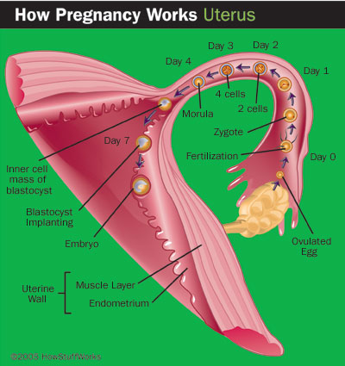
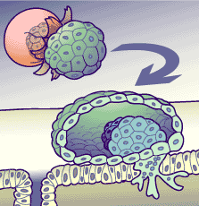
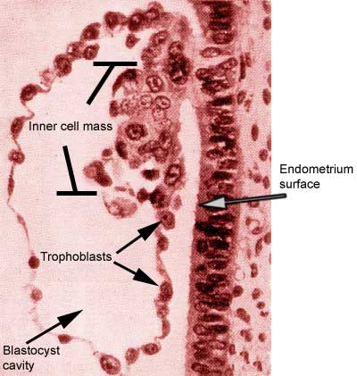
Placenta and the Fetal membranes
Maternal and fetal circulation separate
Nourishes the fetus
Eliminates fetal wastes
Produces hormones vital to pregnancy

Slide 3
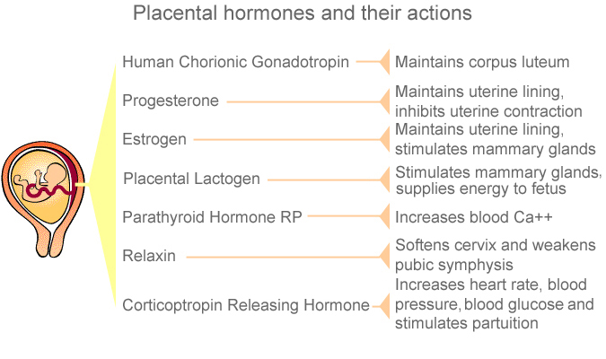
Placental Hormones
Actions

Slide 4
Placental Hormones
Human chorionic gonadotropin(HCG)
Fertilization of the ovum prevents the regression of the corpus luteum (50 d)
Enlarges, stimulated by the glycoprotein hormone, human chorionic gonadotropin (hCG), produced by the trophoblast (the developing placenta).
Detected in maternal blood 6-9 days after conception and may be detectable in the urine 1-2 days later.
The secretion of β-hCG begins to fall by 10-12 weeks, although it remains detectable in the urine throughout pregnancy.

Slide 5
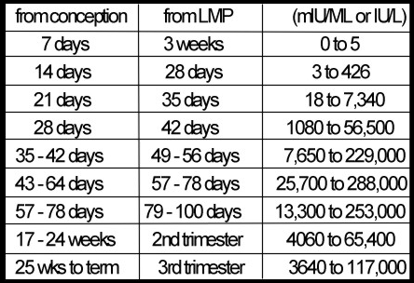
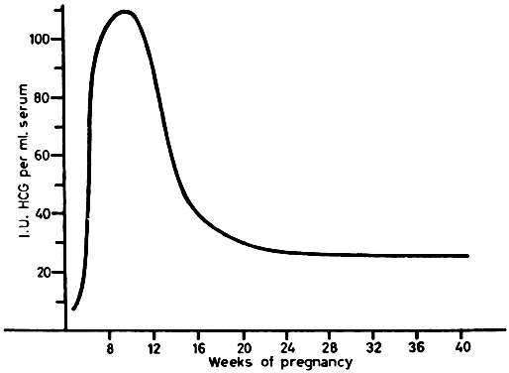
Placental Hormones
Human chorionic gonadotropin(HCG)

Slide 6
Steroidogenesis in pregnancy
Hyperestrogenic state - unique and obligatory relationship with fetal adrenal secretion of C-19 steroids
Syncitiotrophoblast – utilize LDL-cholesterol from maternal plasma for progesterone biosynthesis
Notes:
6

Slide 7
Steroidogenesis in pregnancy
Composed of 3 compartments
PLACENTAL
MATERNAL COMPONENT
FETAL
Complementary forms complete unit utilizes
Source of precursors, clearance of steroids
Notes:
7

Slide 8
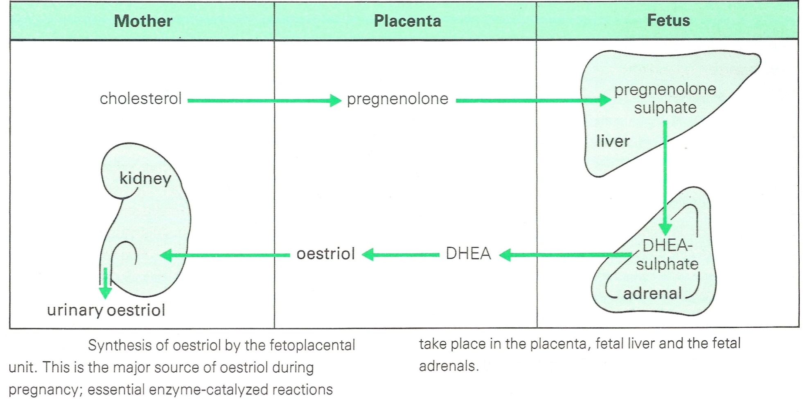
Placental Hormones
Placental steroids

Slide 9
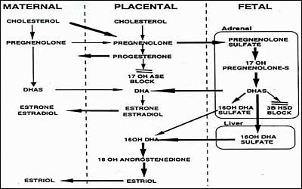
Placental steroids
15-20mg/d
50-150mg/d

Slide 10
Placental Hormones Human Human Placental lactogen
Help prepare breasts for lactation.
Stimulates breast growth and development and stimulates the secretion of colostrum.
Decrease the mother's use of glucose, so that it can be used by the fetus for growth and development
Promotes breakdown of maternal fats- ↑ maternal fatty acids in the plasma.
"saving" the glucose for the fetus.

Slide 11
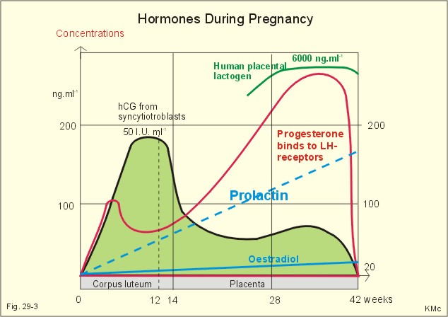
Placental Hormones

Slide 12
Placental Hormones
Parathyroid hormone (PTHrp)
↑40%, no change in plasma calcium
A new set point for secretion of PTH
No change in plasma free calcitonin
↑ Vitamin 1,25-(OH) ₂D₃ increasing calcium absorption

Slide 13
Placental Hormones
Relaxin
Expressed in: human corpus luteum, decidua, and placenta
Structurally similar to insulin and insulin-like growth factor
Relaxin along with rising progesterone levels acts on myometrial smooth muscle to promote uterine relaxation and the quiescence observed in early pregnancy
Relaxin and relaxin-like factors in the placenta and fetal membranes may play an autocrine–paracrine role in regulation of extracellular matrix degradation in the puerperium
Notes:
13

Slide 14
Placental Hormones
Inhibin
Produced by the testis, ovarian granulosa cells and the corpus luteum
Placenta produces inhibin alpha-, and beta A and beta B-subunits
Placental inhibin production together with large amounts of placental sex steroids → inhibit FSH secretion and preclude ovulation during pregnancy
Notes:
14

Slide 15
Placental Hormones
Endocrine changes
↑ Cortisol-CBG
↑ DHEAS
↑ SHBG
↑ Estogen-Prolactin
↓ FSH and LH
↑ T4-TBG

Slide 16
Chemical Changes in Pregnancy
↑ Plasma triglycerides and cholesterol (40%) phospholipids and free fatty acids
↑ the glomerular filtration rate, ↓plasma urea and creatinine.
Glycosuria may be from a temporary hormonal impairment of glucose tolerance or a lowered renal threshold,
Lactosuria is often present
↓ Plasma albumin and total protein
↑ concentration of Metals and hormones caused by binding to transport globulin synthesized in excess, (TBG, CBG and SHBG)
↑ Placental synthesis of a specific isoenzyme may double the total plasma alkaline phosphatase (ALP) activity.

Slide 17
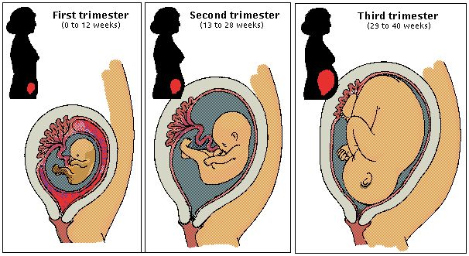
Testing throughout pregnancy

Slide 18
Antenatal Monitoring
Why?
What?
How?

Slide 19
Antenatal Monitoring
Why?
Two thirds of fetal deaths occur before the onset of labor.
Many antepartum deaths occur in women at risk for uteroplacental insufficiency.
Ideal test: allows intervention before fetal death or damage from asphyxia.
Preferable: treat disease process and allow fetus to go to term.

Slide 20
Antenatal Monitoring what?
Conditions placing the fetus at risk for UPI
  Preeclampsia, chronic hypertension
  Collagen vascular disease
  diabetes mellitus
  Renal disease
  Fetal or maternal anemia, blood group sensitization,
  Hyperthyroidism
  Thrombophilia
  Cyanotic heart disease
  Postdate pregnancy
  Fetal growth restriction

Slide 21
Antenatal Monitoring
How?
Methods for antepartum fetal assessment
  Fetal movement counting
  Assessment of uterine growth
  Antepartum fetal heart rate testing
  Biophysical profile
  Doppler velocimetry

Slide 22
Antenatal Monitoring
How?
Maternal and Fetal Health Assessment
(Bichemical tests)
Neural tube defects -16-18 weeks
Downs syndrome -16-18 weeks
Fetal lung maturity
Rh immunization
Gestational diabetes mellitus -24-28 weeks
HPL and Estriol- obsolete

Slide 23
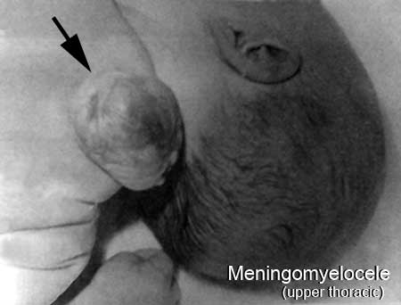
Maternal and Fetal Health Assessment Neural tube defects
Neural tube formation complete after 4 weeks after fertilization
Failure of neural tube fusion leads to permanent developmental defects of the brain or spinal cord/both
Anencephaly, meningomyelocele (spina bifida) and encephalocele
All- 95% are open ,no overlying skin and in direct communication with the amniotic fluid
Fetal serum proteins gain access
AFP (α fetoprotein) appears in large quantities in the maternal circulation

Slide 24

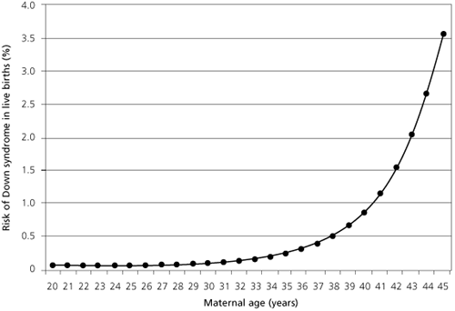
Downs syndrome
Risk Factors
Incidence (live births)
  21: 1/6-800
Spontaneous and induced losses
Maternal age
Multiple gestation
Previous aneuploidy (patient or family)
70% have no identifiable risk factors

Slide 25
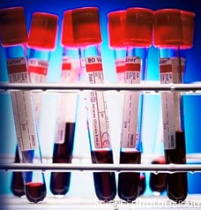
Maternal and Fetal Health Assessment
Downs syndrome
Triple test (Kettering test or the Bart's test )
Usually performed at 15 to 18 weeks of gestation.
  α fetoprotein
  Estriol,
  βHCG
  Second-trimester maternal serum levels of AFP and unconjugated estriol are about 25 percent lower than normal levels and maternal serum hCG is approximately two times higher than the normal hCG level.
  Guidelines published by the American College of Obstetricians and Gynecologists state that maternal serum screening may be offered “as an option for those women who do not accept the risk of amniocentesis or chorionic villus sampling or who wish to have this additional information prior to making a decision about having amniocentesis.”The triple test has a detection rate of between 67 per cent and 71 per cent.

Slide 26
Maternal and Fetal Health Assessment
Downs syndrome
Maternal Alpha fetoprotein
Recommended at 16 weeks of gestation
Expressed as MoM
Typical median is 35ng/ml (weight, race and for twins adjustment )
Maternal βHCG
20,000-40,000IU/l at 16 weeks (weight adjustment )
2.04 times higher

Slide 27
Maternal and Fetal Health Assessment
Downs syndrome
Quad test
Alpha-fetoprotein (α FP)
Free ß-human chorionic gonadotrophin (free ß-hCG)
Unconjugated oestriol (uE3 )
Inhibin-A
  Recommended for women who:
    Have family history of birth defects
    Are 35 yrs or older
    Used harmful medications or drugs during pregnancy
    Have diabetes and use insulin
    Had a viral infection during pregnancy
    Have been exposed to high levels of radiation

Slide 28
Maternal and Fetal Health Assessment
Downs syndrome
Pregnancy associated plasma protein A (PAPP-A)
Produced by both embryo and placenta
Zinc glycoprotein metalloproteinase and a member of the alpha-macroglobulin plasma protein family.
Protease for IGF binding protein
The gene for PAPPA is in chromosome band 9q33.1.
PAPPA has been used in prenatal genetic screening
Women with low blood levels of PAPPA at 8 to 14 weeks of gestation have an increased risk of trisomy 21, premature delivery, preeclampsia, and stillbirth.
BJOG 19vol100 issue 4 1993 pp 324-326
Ginecol Pol 2007 May;78(5):384-7

Slide 29

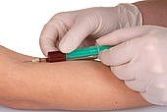
Third trimester
Glucose Screening: to test for gestational diabetes or glucose intolerance and assess the need for intervention (diet and meds)

Slide 30
Amniotic Fluid testing Amniocentesis
Amniotic fluid obtained by inserting a needle through the abdominal and uterine walls
Purpose
  Genetics - Abnormal AFP
  Fetal lung maturity
Risks
  Infection (Sterile tech req’d)
  Pregnancy loss
Tests
  Triple tests – AFP, hCG, and UE3 (unconjugated estriol/estrogen)
  L/S ratio- “Lecithin/Sphingomyelin” test for fetal lung maturation; 2:1
  Fetal maturity index
  Phosphatidylglycerol- another phospholipid surfactant
Notes:
30

Slide 31
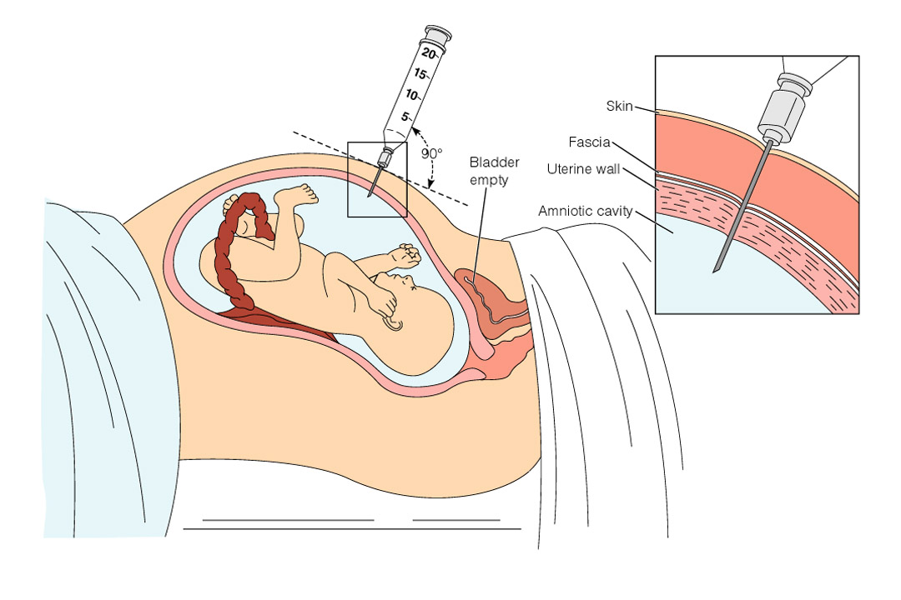
Amniocentesis
Figure 14–9 Amniocentesis. The woman is scanned by ultrasound to determine the placental site and to locate a pocket of amniotic fluid. Then the needle is inserted into the uterine cavity to withdraw amniotic fluid.
Notes:
31

Slide 32
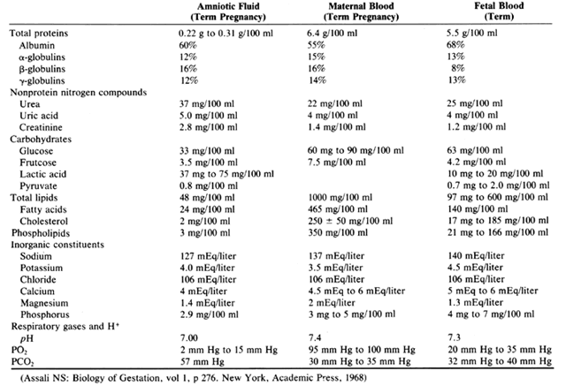
Amniotic fluid

Slide 33
Fetal lung maturity
Respiratory distress syndrome
Specialized alveolar cells –type II granulocytes synthesize pulmonary surfactant – storage granules -lamellar bodies
Surfactant – complex mixture of lipids and proteins with <3% CHO
Lipid – phospholipid and majority is lecithin
Sphingomyelin present in very small amounts -2%
Tests
  L/S ratio
  DSPC
  Phosphotidylglycerol
  Foam stability
  Flourescent polarization
  Lamellar body count

Slide 34
Fetal lung maturity
Lecithin Sphingomyelin ratio
Amniotic fluid sample collected via amniocentesis
Spun down in a centrifuge at 1000 rpm for 3 to 5 minutes.
Thin layer chromatography (TLC) performed on the supernatant, which separates out the components.
Lecithin and sphingomyelin are relatively easy to identify on TLC and the predictive value of the test is good
L/S ratio of less than 1.5 is associated with a high risk of infant respiratory distress syndrome

Slide 35
Fetal lung maturity
Foam Stability Index
When pulmonary surfactant is present in amniotic fluid in sufficient concentrations , the fluid is able to form a highly stable surface film that can support the structure of a foam
Method
Centrifuge , mix supernatant by inverting several times
Add 95% ethanol into tubes labelled 0.50, 0.48, 0.45, 0.44, add amniotic fluid to them , shake vigorously , allow to settle
A ring of bubbles at the air fluid meniscus in the is a positive test
Highest concentration of ethanol at which aopositive readind g is obtained – foam stability index

Slide 36
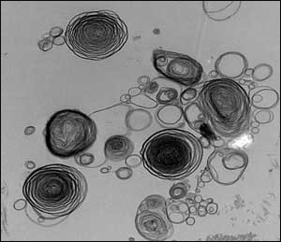
Fetal lung maturity
Lamellar body count
. Am J Obstet Gynecol. 2002 Oct;187(4):908-12.

Slide 37
Amniotic fluid Bilirubin
Amount of bilirubin is a marker of RBC hemolysis in the fetal circulation
Most common –Rh Incompatibility
Feto maternal hemorrhage, repeat exposure causes an augmented response
Liley – degree of hemolysis is assessed by measuring the absorbance of bilirubin pigment in amniotic fluid
Classification into 3 zones based on gestational age
∆ A ₄₅₀
Serial amniotic fluid estimations starting at 22 weeks

Slide 38
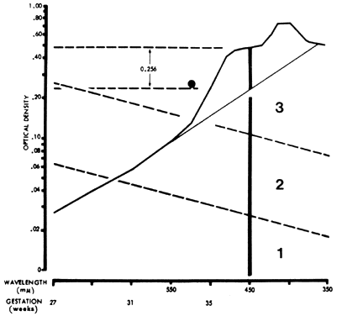
Amniotic fluid Bilirubin
Absorption spectrophotometry
Max absorption at 450nm
Semilog scale , the degree which the curve deviates from a straight line at 450 nm is linearly proportional to the conc of of bilirubin in the amniotic fluid
Clinical Chemistry June 2003 vol. 49 no. 6 986-987

Slide 39
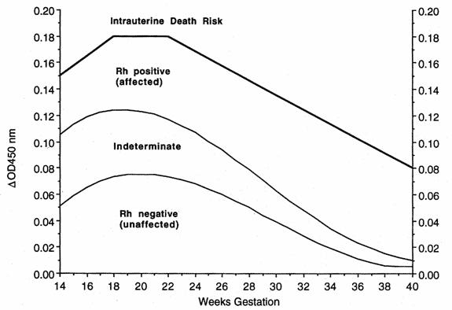
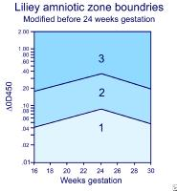
Amniotic fluid spectrophotometric reading. Liley method ΔOD 450 (0.256 in this example) falls into zone 3, indicating impending fetal death. A second pigment peak at 405 nm denotes the presence of heme pigment, further evidence of very severe erythroblastosis.(Bowman JM, Pollock JM: Amniotic fluid spectrophotometry and early delivery in the management of erythroblastosis fetalis. Pediatrics 35:815, 1965)
Liley method ΔOD 450

Slide 40
Other Fetal Diagnostic Tests
Chorionic Villus Sampling – performed at 10 – 12 weeks, off the placenta
Percutaneous Umbilical Blood Sampling-
Computed Tomography- obtain maternal pelvic and fetal diameters
Magnetic Resonance Imaging- confirm anamolies, placental assessment for location and size
Fetal Echocardiography- identify cardiac anomalies- during 2nd and 3rd trimester
Notes:
40

Slide 41
References
Sher G, Statland BE, Freer DE, Kraybill EN Obstet Gynecol. 1978 Dec;52(6):673-7. Assessing fetal lung maturation by the foam stability index test.
B J Trudinger, Y B Gordon, I G Grudzinskas, M G R Hull, P I Lewis, Marie E Lozana Arrans. Fetal breathing movements and other tests of fetal wellbeing: a comparative evaluation. British Medical Journal, 1979, 2, 577-579
Pertl B, Pieber D, Lercher-Hartlieb A, Orescovic I, Haeusler M, Winter R, Kroisel P, Adinolfi M. Rapid prenatal diagnosis of aneuploidy by quantitative fluorescent PCR on fetal samples from mothers at high risk for chromosome disorders Mol Hum Reprod. 1999 Dec;5(12):1176-9.
Gordon C. S. Smith, Emily J. Stenhouse, Jennifer A. Crossley, David A. Aitken, Alan D. Cameron and J. Michael Connor. Early Pregnancy Levels of Pregnancy-Associated Plasma Protein A and the Risk of Intrauterine Growth Restriction, Premature Birth, Preeclampsia, and Stillbirth. The Journal of Clinical Endocrinology & Metabolism.2002 vol 87, no 4, 1762-67

Slide 42


