Slide 2

4th Biennial Course - PSCP
ROLE OF CHEMICAL PATHOLOGYIN PATIENT CARE
MAJ GEN FAROOQ AHMAD KHAN, HI(M)
MBBS (Pb), MCPS (Pak), Dip Endocrinol (Lond),
FCPS (Pak), FRCP (Ireland), FRCPath(UK),PhD(Lond)
Comdt & Advisor in Pathology
Armed Forces Institute of Pathology, Rawalpindi

Slide 3
What is Chemical Pathology?
Service Discipline
  diagnosis / screening
  monitoring / therapeutic control.
  provides advice
    individual cases
    clinical care protocols
Major Clinical Science
  research into the biochemical basis of disease.
  clinical trials
  science of diagnosis
Bridges preclinical and clinical subjects

Slide 4
Chemical Pathology
Conventional
  LFTs, RFTs, Enzymology etc.
Endocrinology
  Adult, paediatric
Metabolic medicine
  Inherited, Acquired
Molecular biology
  Conventional, Genomic medicine, Proteomics
TDM & Toxicology
  TDM, Clinical toxicology, forensic toxicology
Specialised miscellaneous
  ICU specific, tumor markers, special proteins,

Slide 5
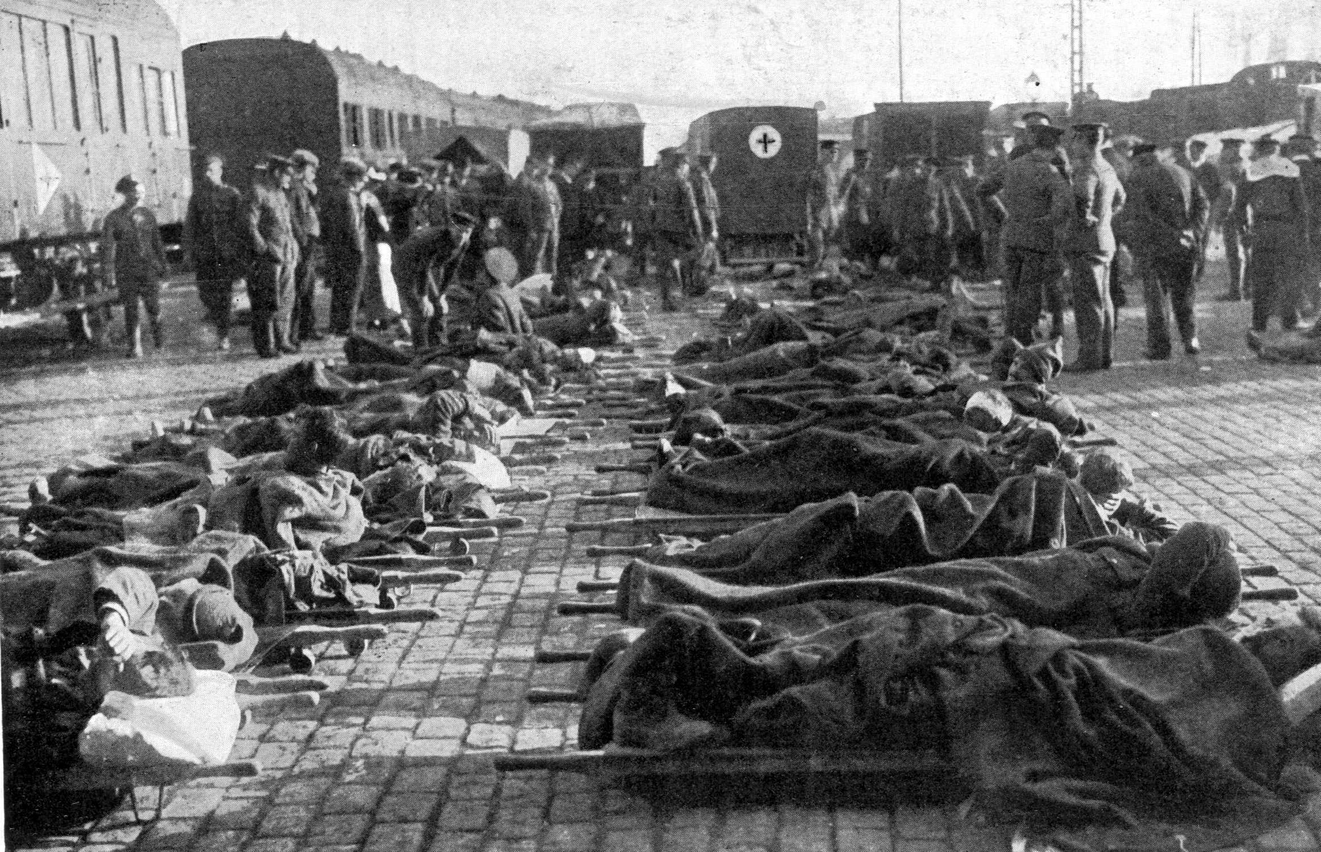

Slide 6
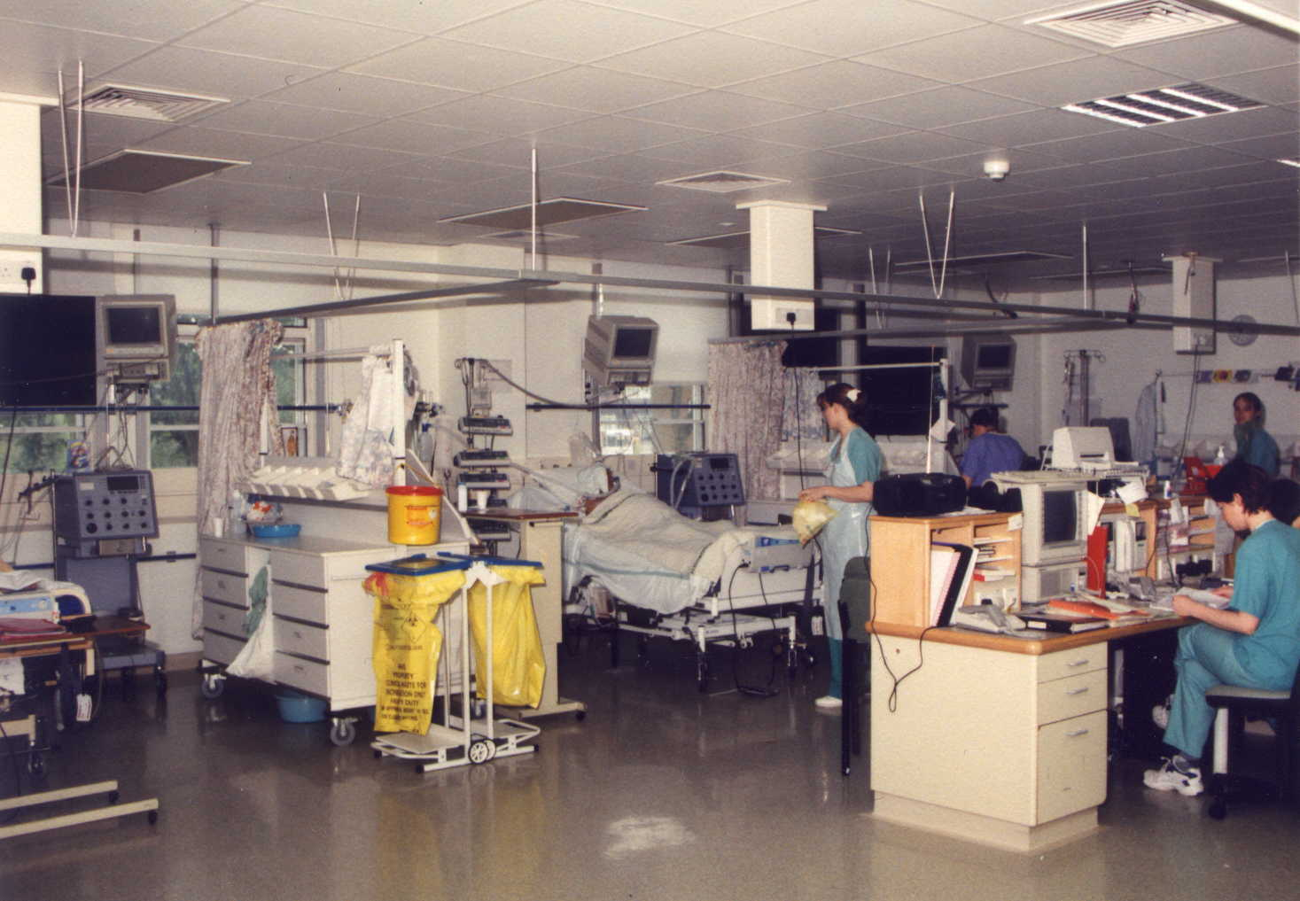

Slide 7
Early detection of organ dysfunction
Cardiovascular
Kidneys
Lungs
Others

Slide 8
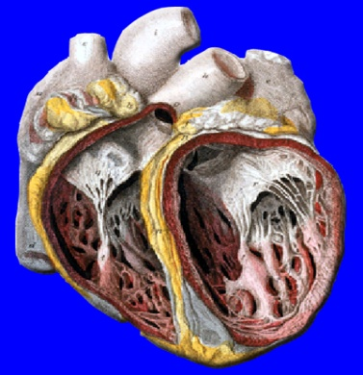
Cardiovascular/ Heart Disease Markers
Coronary Artery Disease (CAD)
Plaque Rupture Angina
Unstable Angina
Infarction
Heart Failure
Homocysteine
High Sensitive CRP
CRP
Troponin
Troponin
CK-MB
Myoglobin
Troponin
BNP
Heart disease evolves over the years and different markers are
needed to assist in identifying risk or aid in diagnosis of the disease.

Slide 9
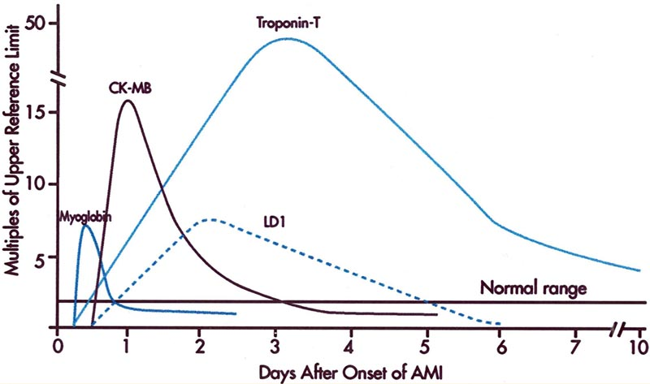
Biochemical markers in AMI

Slide 10
Early diagnosis of MI by hs cTnT, MPO& PAPP-A
AUC (95 CI)
hs cTnT 0.952 (.909-.978)
MPO 0.886 (.830-.929)
PAPP-A 0.797 (.730-.854)
Khan DA et al. /Korea J Lab Med. 2011; 31: 172-178

Slide 11
Beyond Cholesterol: Predicting Cardiovascular Risk In the 21st Century
Cardiovascular Risk
Lipids
HTN
Diabetes
Behavioral
Hemostatic
Thrombotic
Inflammatory
Genetic
Notes:
Slide 2. Beyond cholesterol: predicting cardiovascular risk in the 21st century
As we understand more about the biology of atherothrombosis, we need to move beyond standard cholesterol screening if we are to appreciate the promise of preventive early intervention therapies. While hyperlipidemia, hypertension, and diabetes, as well as the behavioral risk factors of smoking and diet, remain major critical modifiable risk factors for vascular disease, we have learned over the years that many hemostatic and thrombotic markers such as lipoprotein(a), D-dimer, and homocysteine, inflammatory markers such as C-reactive protein (CRP), fibrinogen, and interleukin-6, and genetic markers are all part of the evolving understanding of cardiovascular risk.
Keywords: markers, risk factors
Slide type: figure (chart)

Slide 12
A Complex Metabolic Disorder
Impaired
insulin
secretion
Insulin
resistance
Macrovascular
complications
Hypertension
“Insulin
Resistance
Syndrome”
Microvascular
complications
Central
obesity
Dyslipidaemia

Slide 13
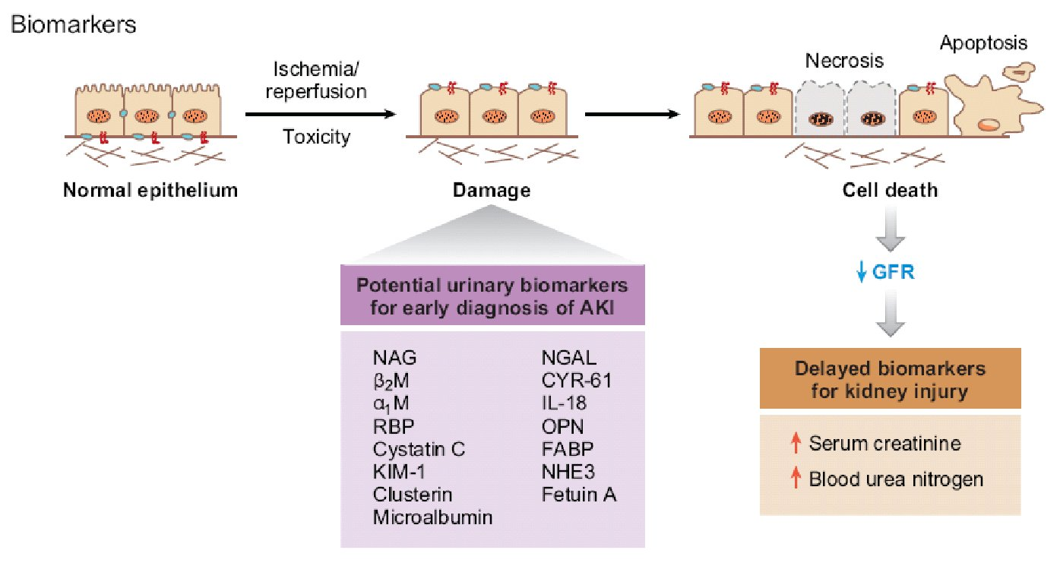
Acute kidney injury biomarkers

Slide 14
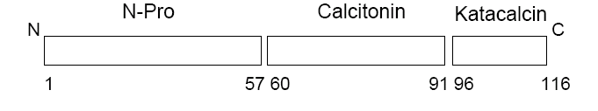
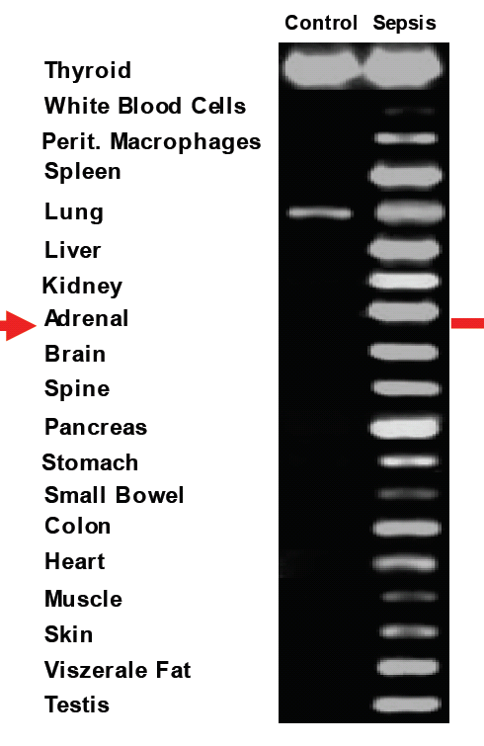
PCT response to a severe bacterial infection
Bacterial
Infection
PCT
Müller B, et al. J Clin Endocrinol Metab 2001
Notes:
14
14
Procalcitonin (PCT) has been described as to be a highly specific marker for the diagnosis of clinically relevant bacterial infections and sepsis. PCT could support early diagnosis and clinical decision making which could direct an effective therapy at the right time and save unnecessary spending for critically ill patients.

Slide 15
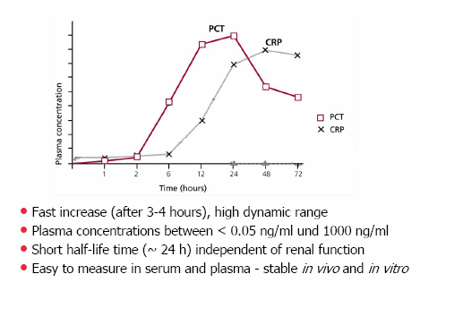
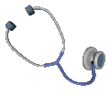
PCT AS EARLY MARKER
Pattern of release of PCT & CRP
Fast increase after bacterial invasion
Khan DA et al./ J Clin Lab Anal. 2010; 24: 1-5.

Slide 16
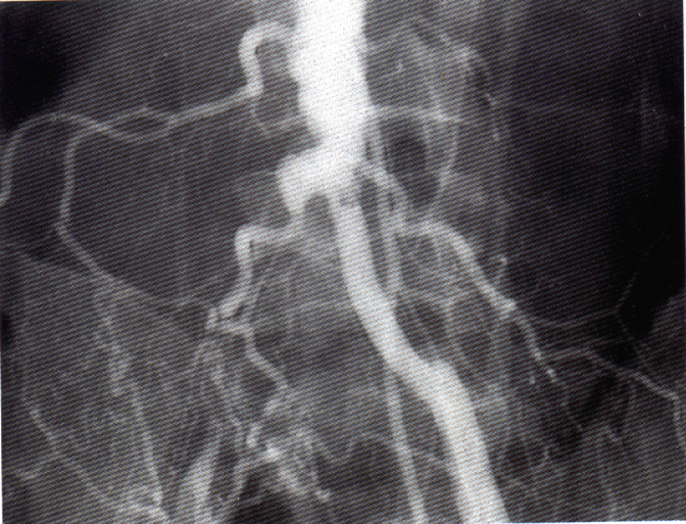
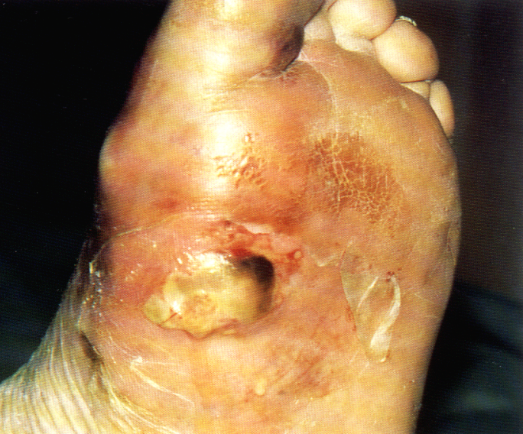
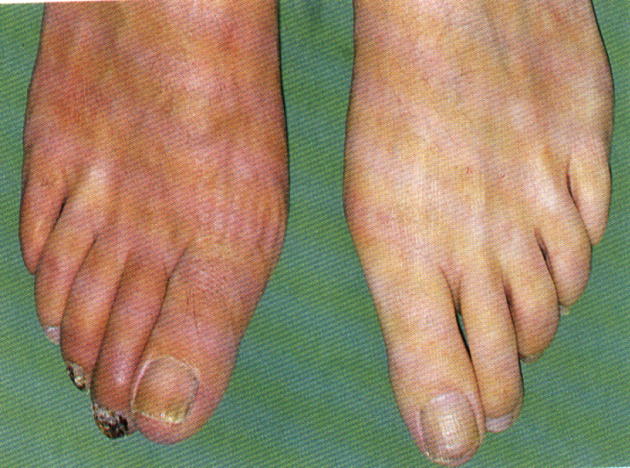
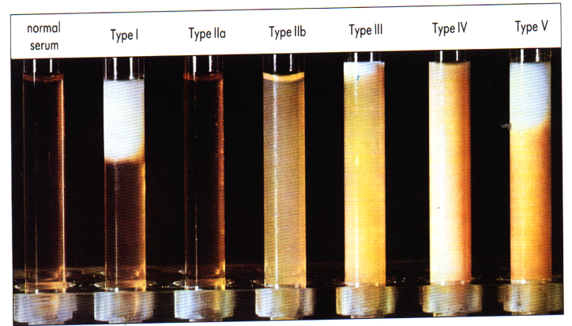
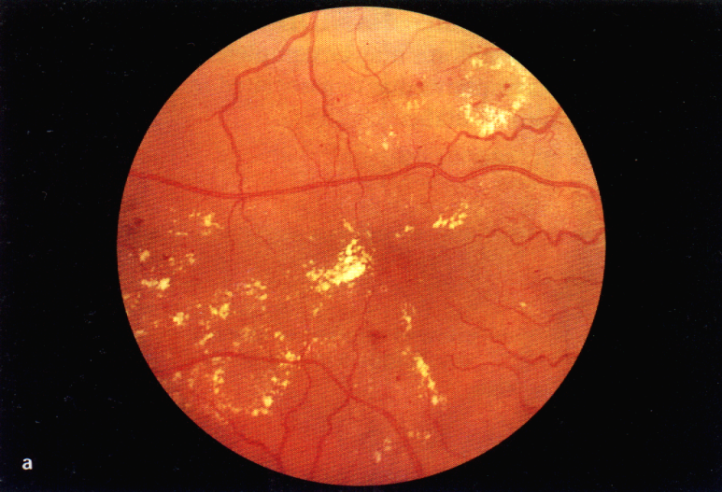
Why Diabetes?
serious
  common
Huge public health problem
  costly
Controllable

Slide 17


Healthcare Today and Tomorrow
Shifting the Paradigm
From Reactive Treatment to Proactive Wellness
Healthcare today
Healthcare today
Future of healthcare
Predisposition
Screening
Targeted
Therapy
Prevention
Lifestyle
Nutrition
Medication
Disease
Diagnosis
Disease
Diagnosis
Therapy
Therapy
Therapy
Monitoring
Therapy
Monitoring

Slide 18
Laboratory Automation

Slide 19
Automated Core Laboratory
New Generation of
Laboratory Automation

Slide 20
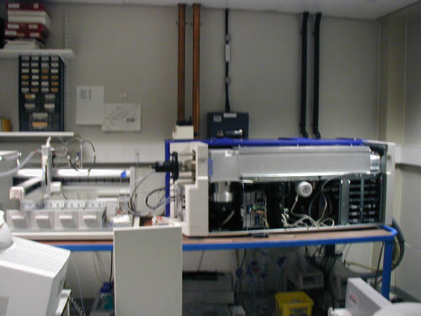
Tandem Mass Spectrometry

Slide 21
Merging of Clinical Chemistry and Molecular Techniques in Diagnostic Laboratory
Does it matter whether you are testing for
  Protein
  Peptide
  Amino Acid
  RNA/DNA
Automated techniques widely available
Clinical Chemistry journals carry significant articles on molecular techniques
In future, little discrimination between chemical and molecular techniques in the lab

Slide 22
Genomics
What is Genomics?
  An operational definition:
    • The application of high throughput automated technologies to molecular biology.
  A philosophical definition:
    • A wholistic or systems approach to the study of information flow within a cell.

Slide 23
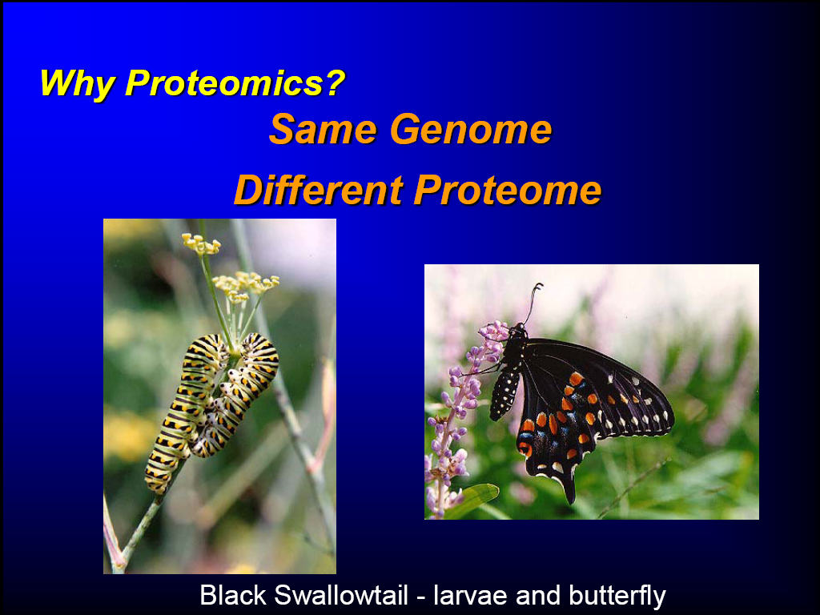

Slide 24
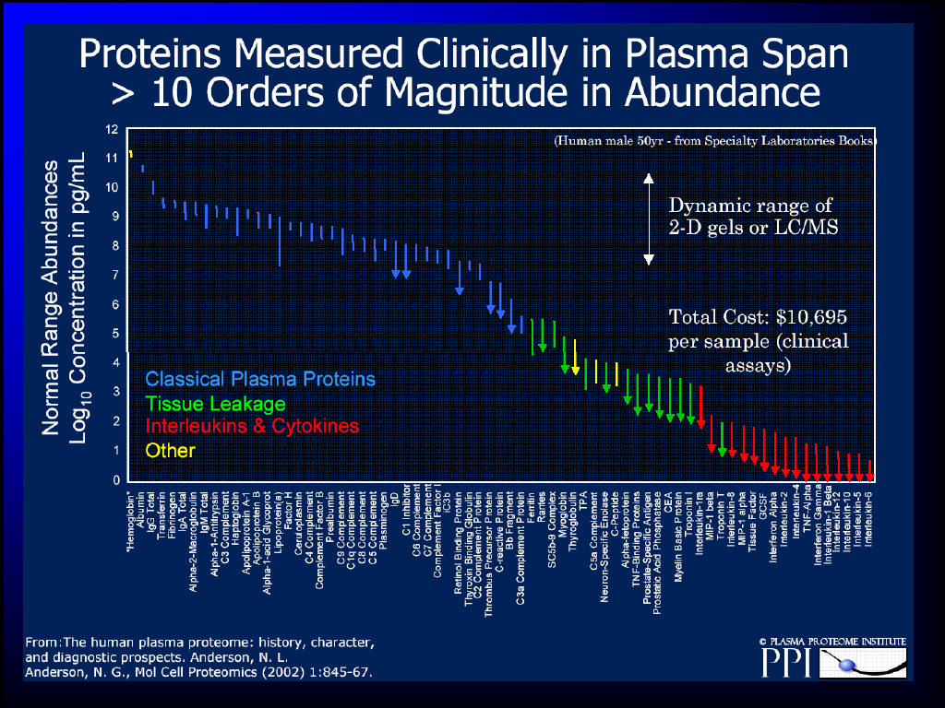

Slide 25
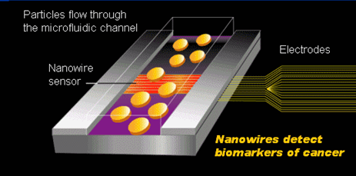
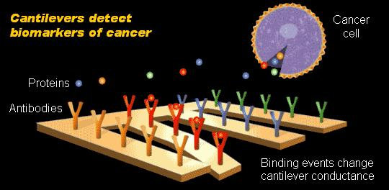
Nanotechnology in Health Care
Nanotechnology offers tools and techniques for more effective detection, diagnosis and treatment of diseases
Detection and Diagnosis
Lab on chips help detection and diagnosis of diseases more efficiently
Nanowire and cantilever lab on chips help in early detection of cancer biomarkers
The microfluidic channel with nanowire sensor can detect the presence of altered genes associated with cancer – J. Heath, Cali. Insti. of Technology
The nanoscale cantilever detects the presence and concentration of various molecular expressions of a cancer cell – A. Majumdar, Univ. of Cal. at Berkeley

Slide 26
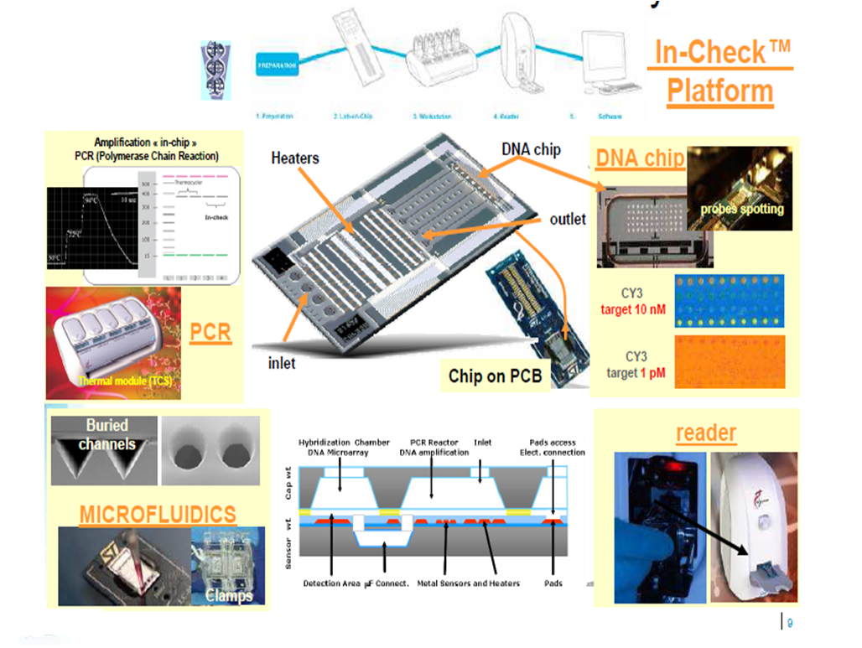
Point Of Care based on DNA analysis

Slide 27
Nanoelectrodes for sensors
Nanoscale electrodes create a dramatic improvement in signal detection over traditional electrodes
Traditional Macro- or
Micro- Electrode
Nanoelectrode
Array
Electrode
Insulator
• CNT tips are at the scale close to molecules
• Dramatically reduced background noise
Nano-
Electrode
• Scale difference between macro-/micro- electrodes and molecules is tremendous
• Background noise on electrode surface is therefore significant
• Significant amount of target molecules required
• Multiple electrodes results in magnified signal and desired redundance for statistical reliability.
• Can be combined with other electrocatalytic mechanism for magnified signals.

Slide 28
Pakistan Society of Chemical Pathologists (PSCP)

Slide 29
Brief History
Jan 2004 – March 2010

Slide 30
patron in chief
Lt Gen (Rtd) Syed Azhar Ahmed, HI (M)
PATRON
Maj Gen farooq Ahmad Khan, HI (M)

Slide 31
Objectives
To promote the discipline of chemical pathology
To hold meetings, symposia, seminars, lectures and clinical workshops and conferences.
To promote and develop rules and procedures for quality assurance and accreditation of laboratories.
To motivate and encourage chemical pathologists for multicenter research activities.

Slide 32
TOTAL NO. OF MEMBERS 107
FULL MEMBERS 93
ASSOCIATE MEMBERS 14

Slide 33
PSCP courses/ conferences
Events | Venue | Date
1st Biennial Conference | KEMU Lahore | 24th -26th Feb 2005
1st Biennial Course | AFIP Rawalpindi | 18th -20th Aug 2006
2nd Biennial Conference | AKU Karachi | 9th – 10th March 2007
2nd Biennial Course | AFIP Rawalpindi | 1st – 3rd Feb 2008
3rd Biennial Conference | QMC Bahawalpur | 6th – 8th March 2009
3rd Biennial Course | AFIP Rawalpindi | 2nd – 3rd April 2010
4th Biennial Conference | AIMC Lahore | March 2011

Slide 34
PSCP workshops
Events | Venue | Date
Workshop on Quality Assurance | CH & ICH Lahore | 22nd March 2003
External Quality Control | KEMU Lahore | 2006
Workshop on Lab Management | Shalamar Hospital Lahore | 6th May 2006
Workshop on Diabetes Mellitus | Children Hospital Lahore | 27th November 2006
Workshop on Lab Reengineering & Process improvement | AKU Karachi | 9th March 2007
External Quality Control | KMC Peshawar | 30th Nov 2007
Workshop on Lab Accreditation | NIH Islamabad | 2008
Awareness workshop on Lab Accreditation | Ziauddin University Karachi | 2008
Workshop on Diabetes Mellitus | QMC Bahawalpur | March 2009

Slide 35
International affiliation with
APFCB & IFCC

Slide 36
4th Biennial Course Programme

Slide 37
1st Day – 16th March 2012
Time (hrs) | SESSION - 1
0830-0925 | Course Registration
0925-0930 | Guests to be seated
0930 | Arrival of Chief Guest
0930-0935 | Tilawat
0935-0950 | Welcome address/ course introduction by Comdt AFIP
0950-1000 | Address by Chief Guest
1030-1100 | Tea Break

Slide 38
1st Day – 16th March 2012
Time | Topics |  | Speakers
SESSION - 2
1030-1130 | Diabetes: An update | Maj Gen Farooq Ahmad Khan, HI(M)
1130-1230 | Thyroid diseases | Dr Shahzad Ahmad
1230-1250 | Osteoporoses | Dr Javaid Mehmood Malik
1250-1310 | Vitamin D deficiency: Insight from local experience | Dr Ayesha Habib
1300-1400 | Juma Prayers & Lunch

Slide 39
1st Day – 16th March 2012
Time | Topics |  | Speakers
SESSION – 3
1420-144 | Improving efficiency in clinical lab | Dr Farooq Ghani
1440-1500 | The impact of stat laboratory services on the management of patients | Dr Shireen Mansoor
1500-1520 | Role of autoantibodies in clinical practice | Brig Tahir Aziz Ahmed
1520-1540 | Insulin resistance in liver diseases | Lt Col Shakil Mirza
1540-1600 | Tumour markers | Dr Sami Saeed
1600-1620 | Thyroid cancer management | Dr Shahzad Ahmad
1620-1640 | Biochemistry of pregnancy and fetal function | Lt Col (R) Samina Ghayyur

Slide 40
2nd Day – 17th March 2012
Time | Topics |  | Speakers
SESSION – 1
0900-0920 | Metabolomics: Current analytical platforms and methodologies | Col Tariq Bin Sharif
0920-0940 | Selection of a clinical chemistry instrument | Brig (R) Abdus Sattar
0940-1000 | Clinical applications of LC/MS/MS in the patient care | Brig Dilshad Ahmed Khan
1000-1020 | Point of care testing: Role in patient care | Dr Imran Siddiqui
1020-1040 | Effect of laboratory errors on patient care | Dr Asim Mumtaz
1040-1110 | Tea

Slide 41
2nd Day – 17th March 2012
Time | Topics |  | Speakers
SESSION – 2
1110-1130 | Role of vitamins in coronary heart disease | Dr Asma Shoukat
1130-1150 | Dynamic function tests in adrenal disorders | Brig Rizwan Hashim
1150-1210 | Cystatin C as a marker of renal function | Dr Adnan M Zubairi
1210-1230 | Biochemical investigations of chronic liver disease | Col Asif Nawaz
1230-1250 | Novel cardiac biomarkers | Col Syed Raza Jaffar
1250-1310 | Respiratory acidosis | Lt Col (R) Anjum Iqbal
1310-1330 | Lab information system | Dr Haroon Khan
1330-1350 | Applications of molecular diagnostics in clinical chemistry | Lt Col Zujaja Hina Haroon
1350-1400 | Closing ceremony
1430-1800 | Workshop “Good professional practices in chemical pathology”

